Slide 1
Space Park Leicester
William Wells
Head of Reserach & Enterprise Partnerships, University of Leicester
Category A – Direct Commercialisation of Exploration Outcomes
Workshop on “Commercialisation and Utilisation of Space Exploration Technologies”
Turin, 15-16 March 2018

Slide 2
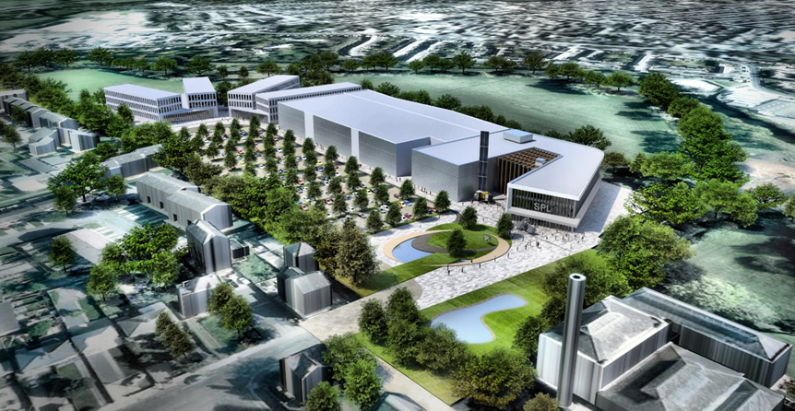
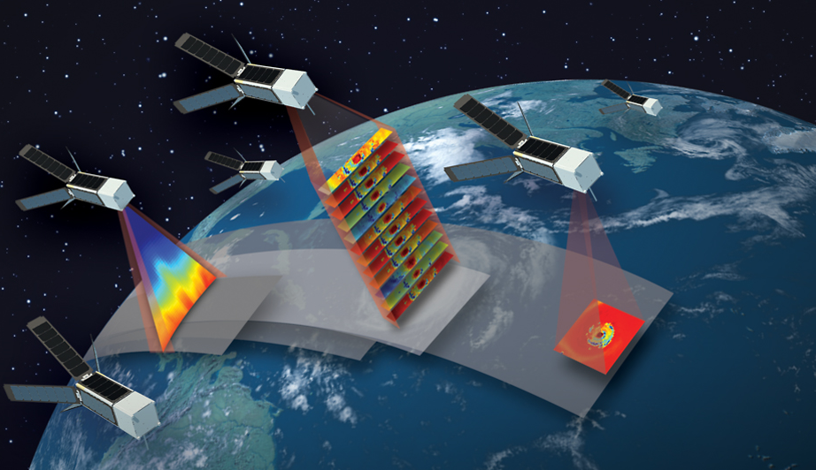
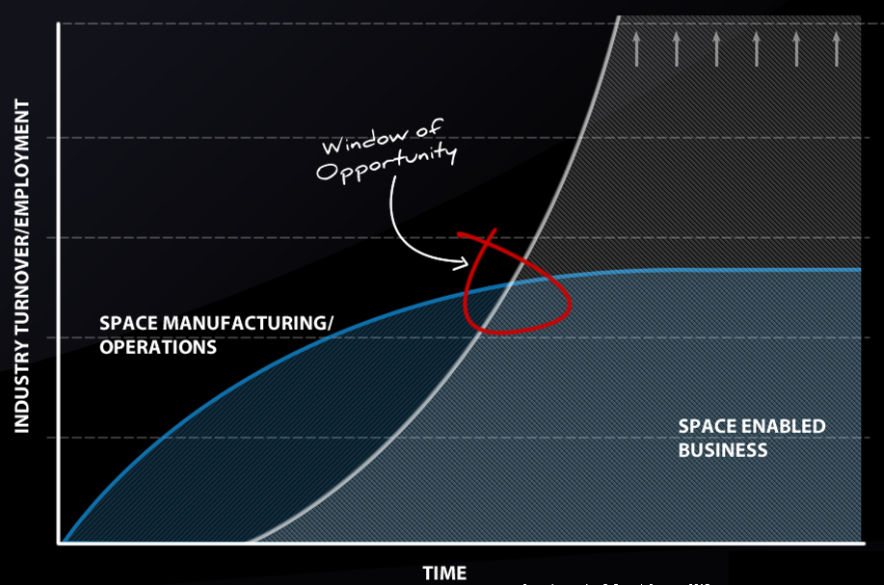
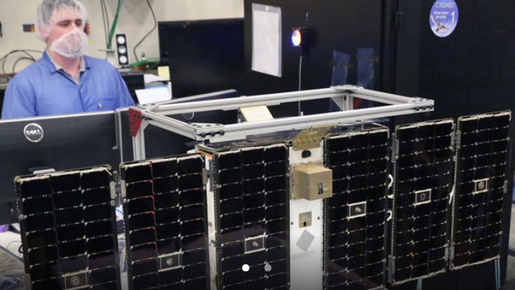
UK Government target 10% of the global space market -£400 billion by 2030 and the creation of 100,000 new jobs nationally.
Space Innovation & Growth Strategy 2015
The Case for Space 2015
Notes:
National priority to seek economic growth from the space sector. Stated in Space Innovation & growth strategy.
It also wants to see this growth in the regions –outside of the south-east (note Brexit)
Timing is right.
Expectation that much of that growth will come from space enabled economy –new applications products and services emerging from the use of data.
As a partner in the national innovation system University of Leicester has worked with partners (City, Region, UKSA, Govt) to meet this challenge.
Space Park Leicester – A physical environment -4000m2 Science & Innovation hub to open in Spring 2020.
A community of researchers, businesses and students collaborating on space data opportunity. Home to existing businesses and new. National Centre Earth Observation.
Plans to develop facilities for advanced manufacturing to deliver on New Space – constellations of satellites.

Slide 3
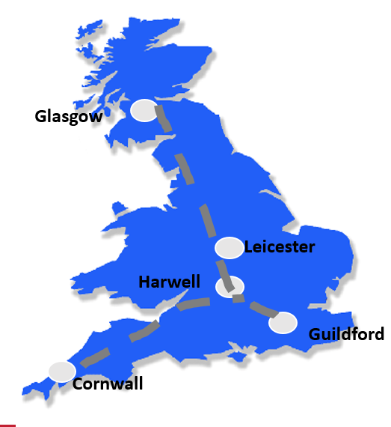
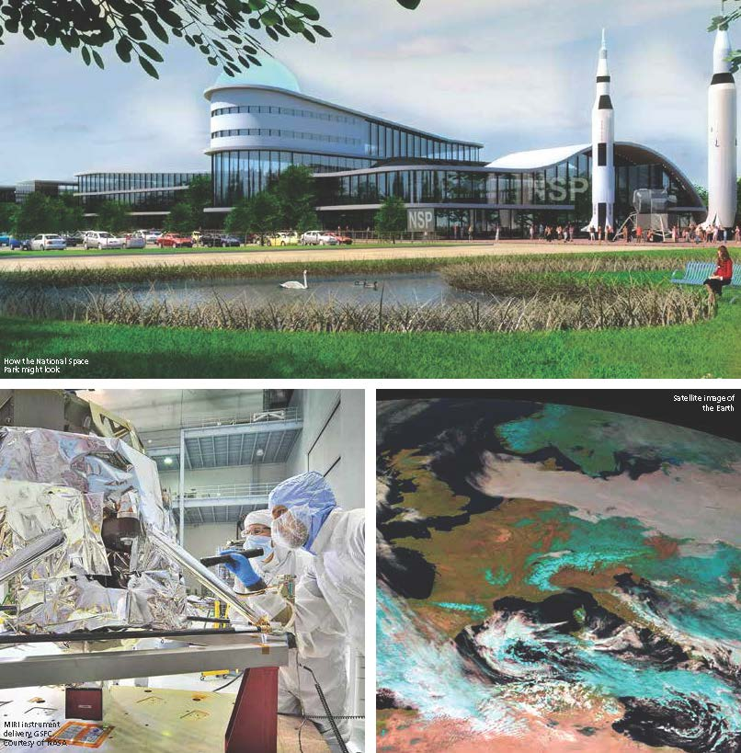
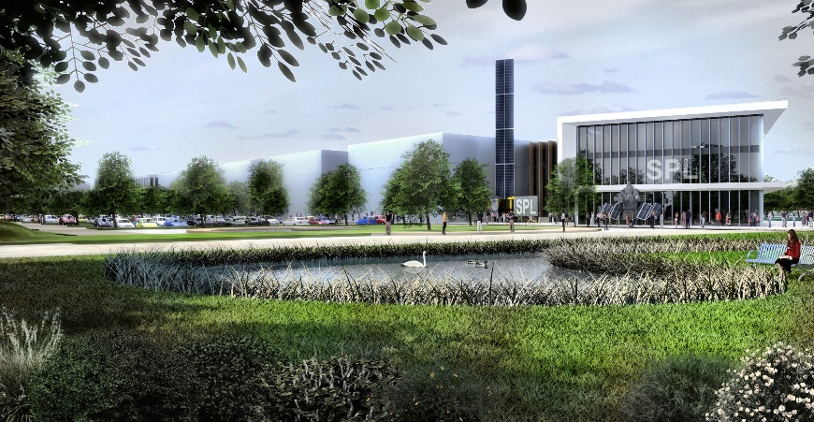
Research
Skills
Innovation
Public Engagement
Workshop on “Commercialisation and Utilisation of Space Exploration Technologies”
Turin, 15-16 March 2018
Notes:
Realising growth in the sector will emerge from a number of Key Features:
Research Base
Bringing the market together to develop new commercial services
Educated talent to code, design software & engineer
And bringing young people and the public in.
Global leadership in Space & Earth Observation Science
Home of National Centre for Earth Observation
Innovation programme leaderClutch of Space & Space Enabled businesses, spin outs
MSC in Space Engineering, GIS Leader, National Space Aacdemy (school age)
The home of The National Space Centre

Slide 4
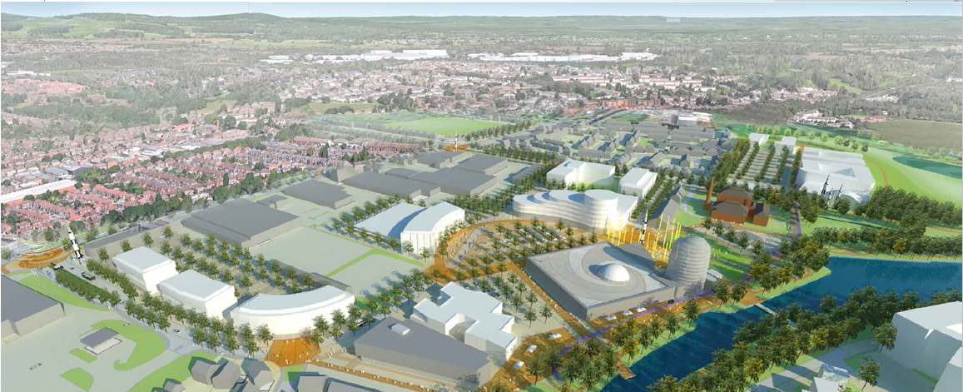
Commercial Space
Low Cost Access to Space
Space Innovation Centre
Space Park Science & Innovation
Hub
Commercial Space
National Space Centre
Dock
2017
2018
2019
2020
2021
Site Infrastructure
Core Science & Innovation Hub
Space Innovation Centre
Centre of Low Cost Access to space
Data Accelerator/Refinery
Further Business
Space
GVA - £850 million additional by year 5
Jobs – 2700 FTE supported by year 5
Wider Impacts - Inward investment; workforce upskilling; wider positive effects through clustering, including skills and knowledge transfer and productivity gains.
2700

