Slide 1
TOUCH VIRTUAL REALITY
The VR/AR interaction solution for Business

Slide 2
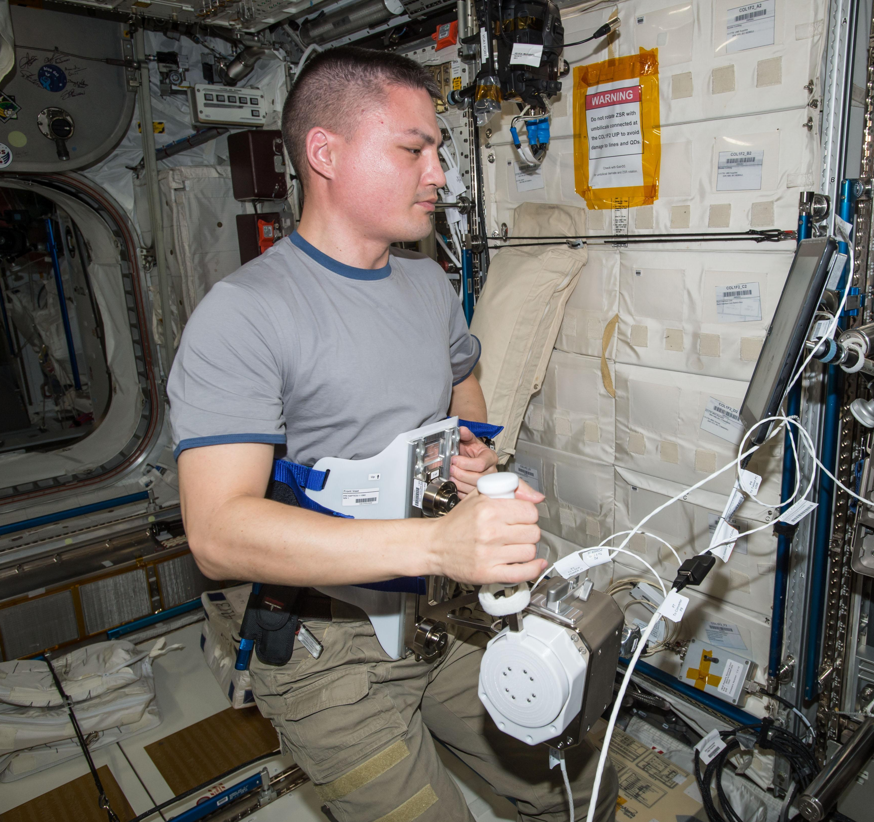
HAPTICS IN SPACE
ESA-Haptics-1 on ISS
Thomas Sednaoui, PhD
Co-Founder of Go Touch VR in the Engineering Team of Haptics-1

Slide 3
OPPORTUNITY
DIGITALIZE “HANDS-ON” TRAINING
VR and AR reduces training time and risks, and increase repeatability
52%
46%
42%
Showcasing
Current interaction solutions limit
the use of VR/AR for “hands-on” training.
Sales-mkt-com
Engineering
Training
VR/AR in Enterprises
Go Touch VR technology and platform enables Virtual “hands-on” training in a scalable manner

Slide 4
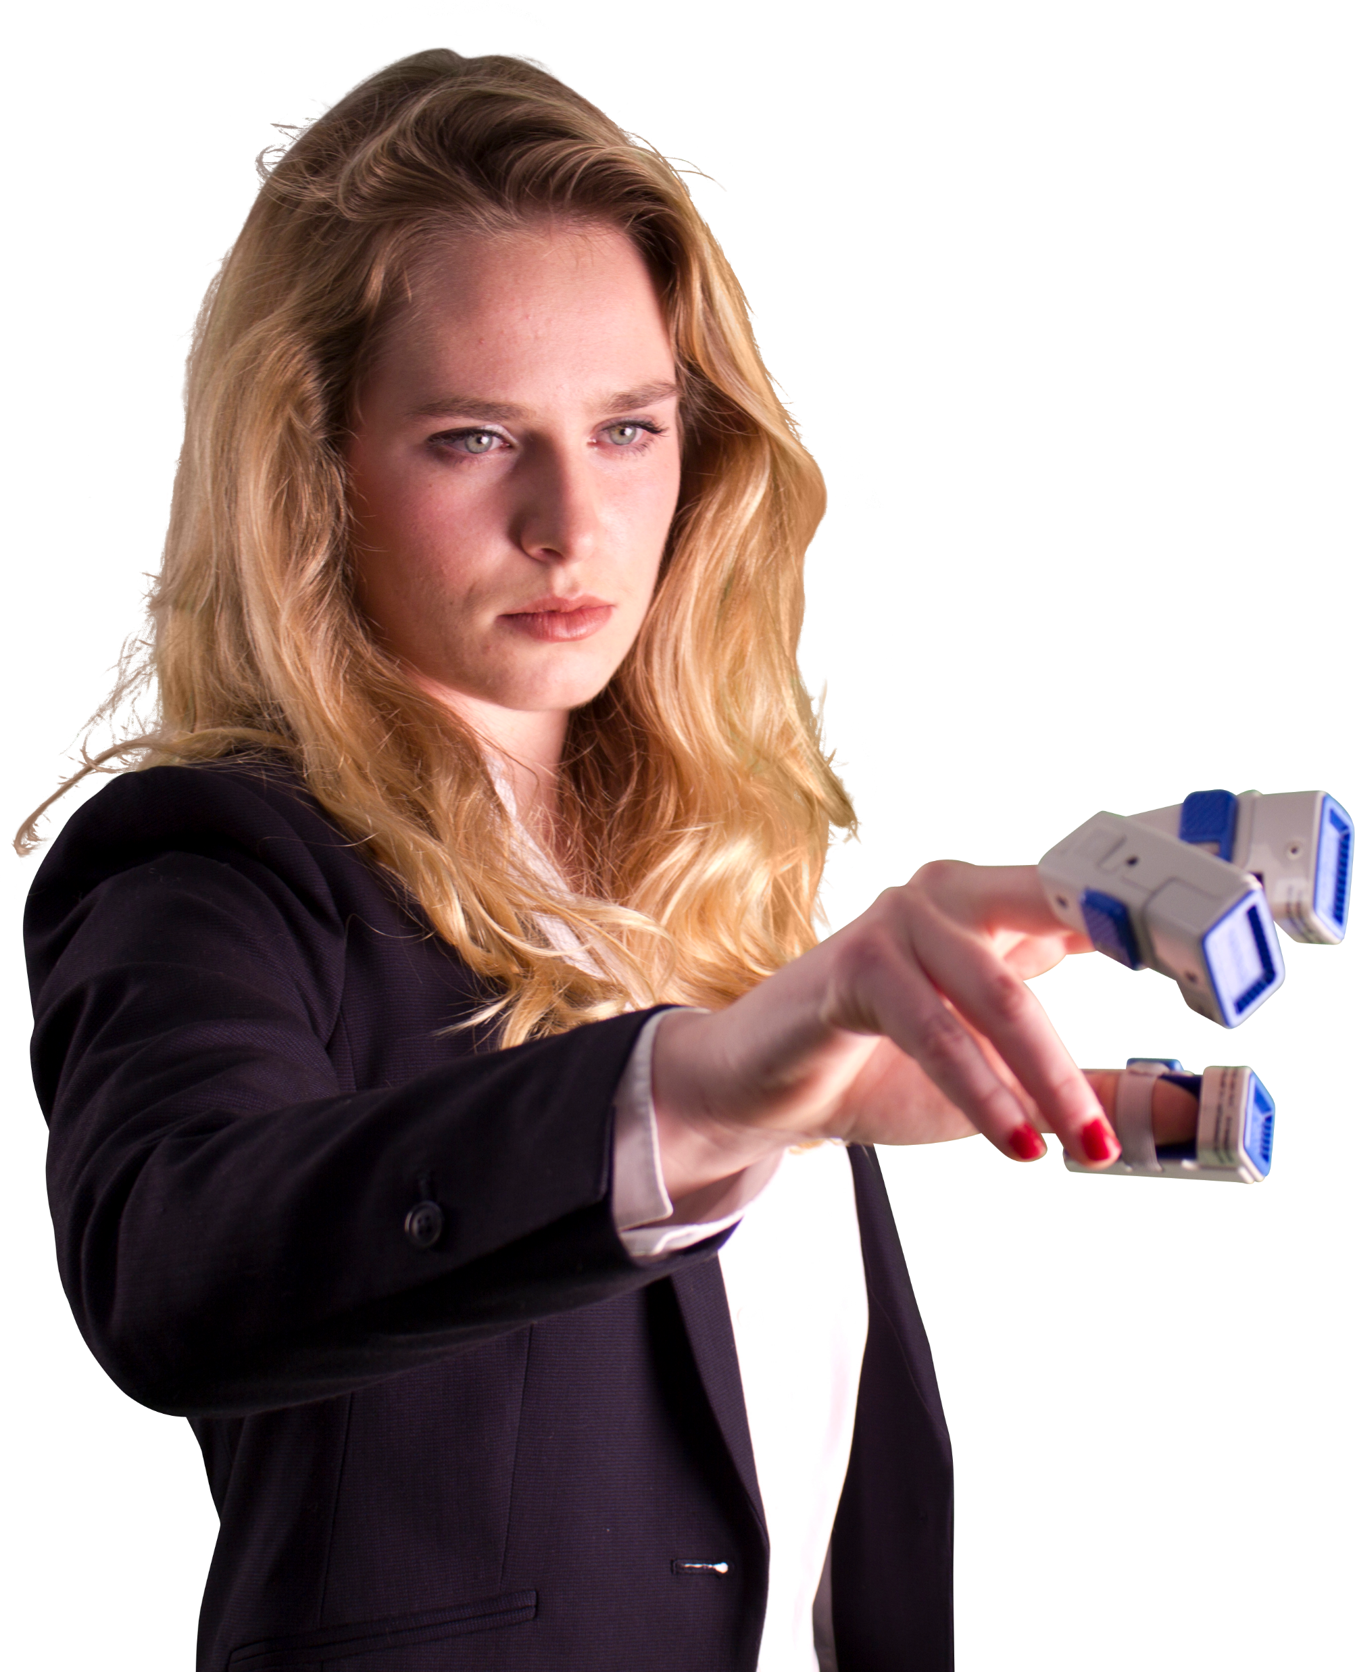
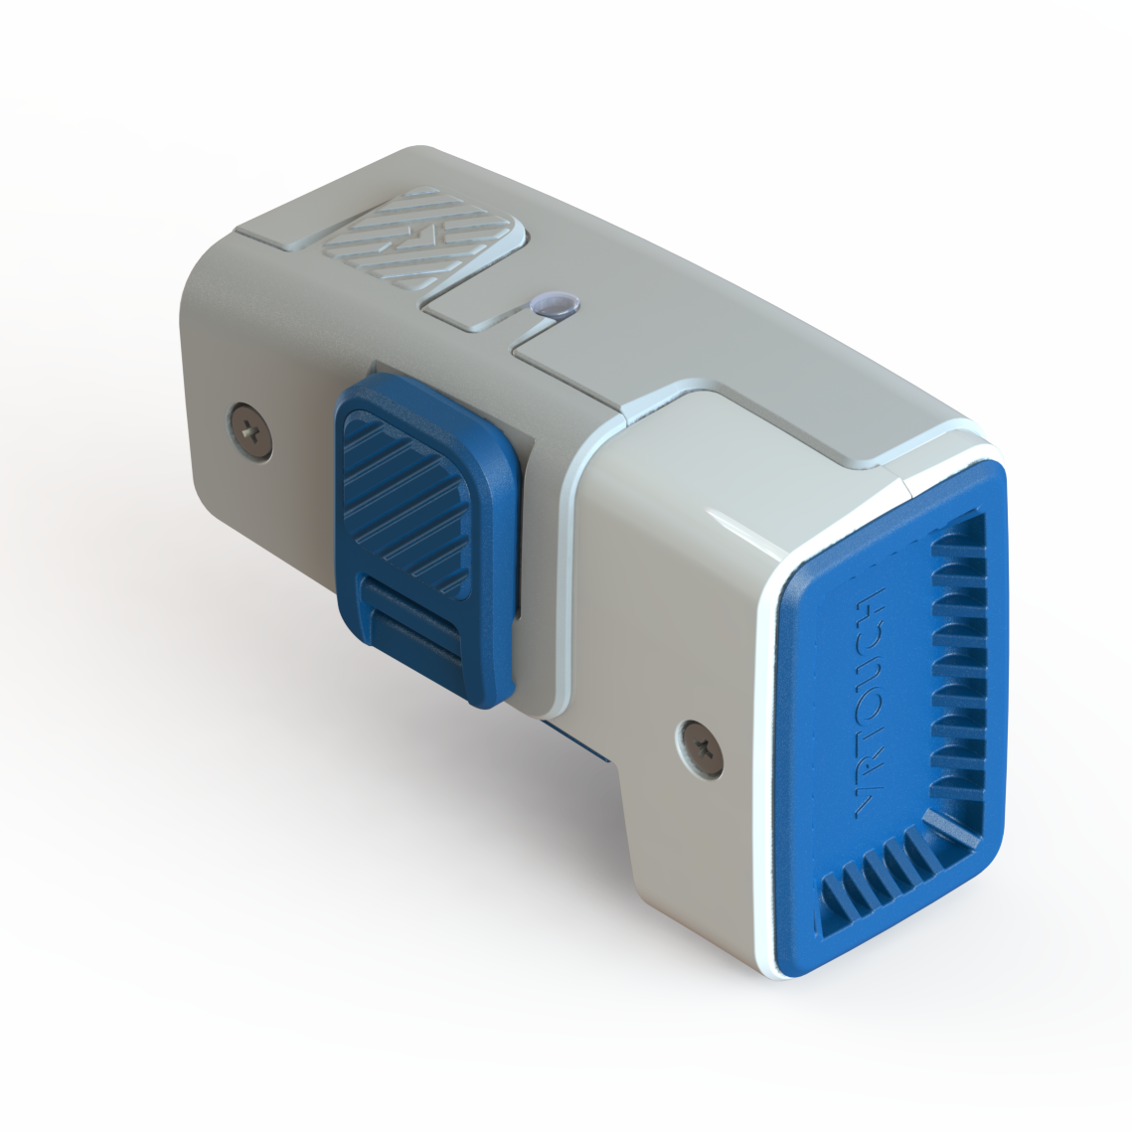
VALUE PROPOSITION
An innovative and scalable platform to touch VR
SECTORS
ADVANTAGES
a simple and effective system
to interact and manipulate
Virtual Reality objects
Large players and organizations and players active in digitalization of professional training
Hygienic
Scalable and Robust
Tracking Agnostic

Slide 5
GO TO MARKET
NAMED ACCOUNTS
PARTNERS
HAPTICS LEADERSHIP
Direct sales
partners recruitment
1
2
Academic program
3
Platform License

Slide 6
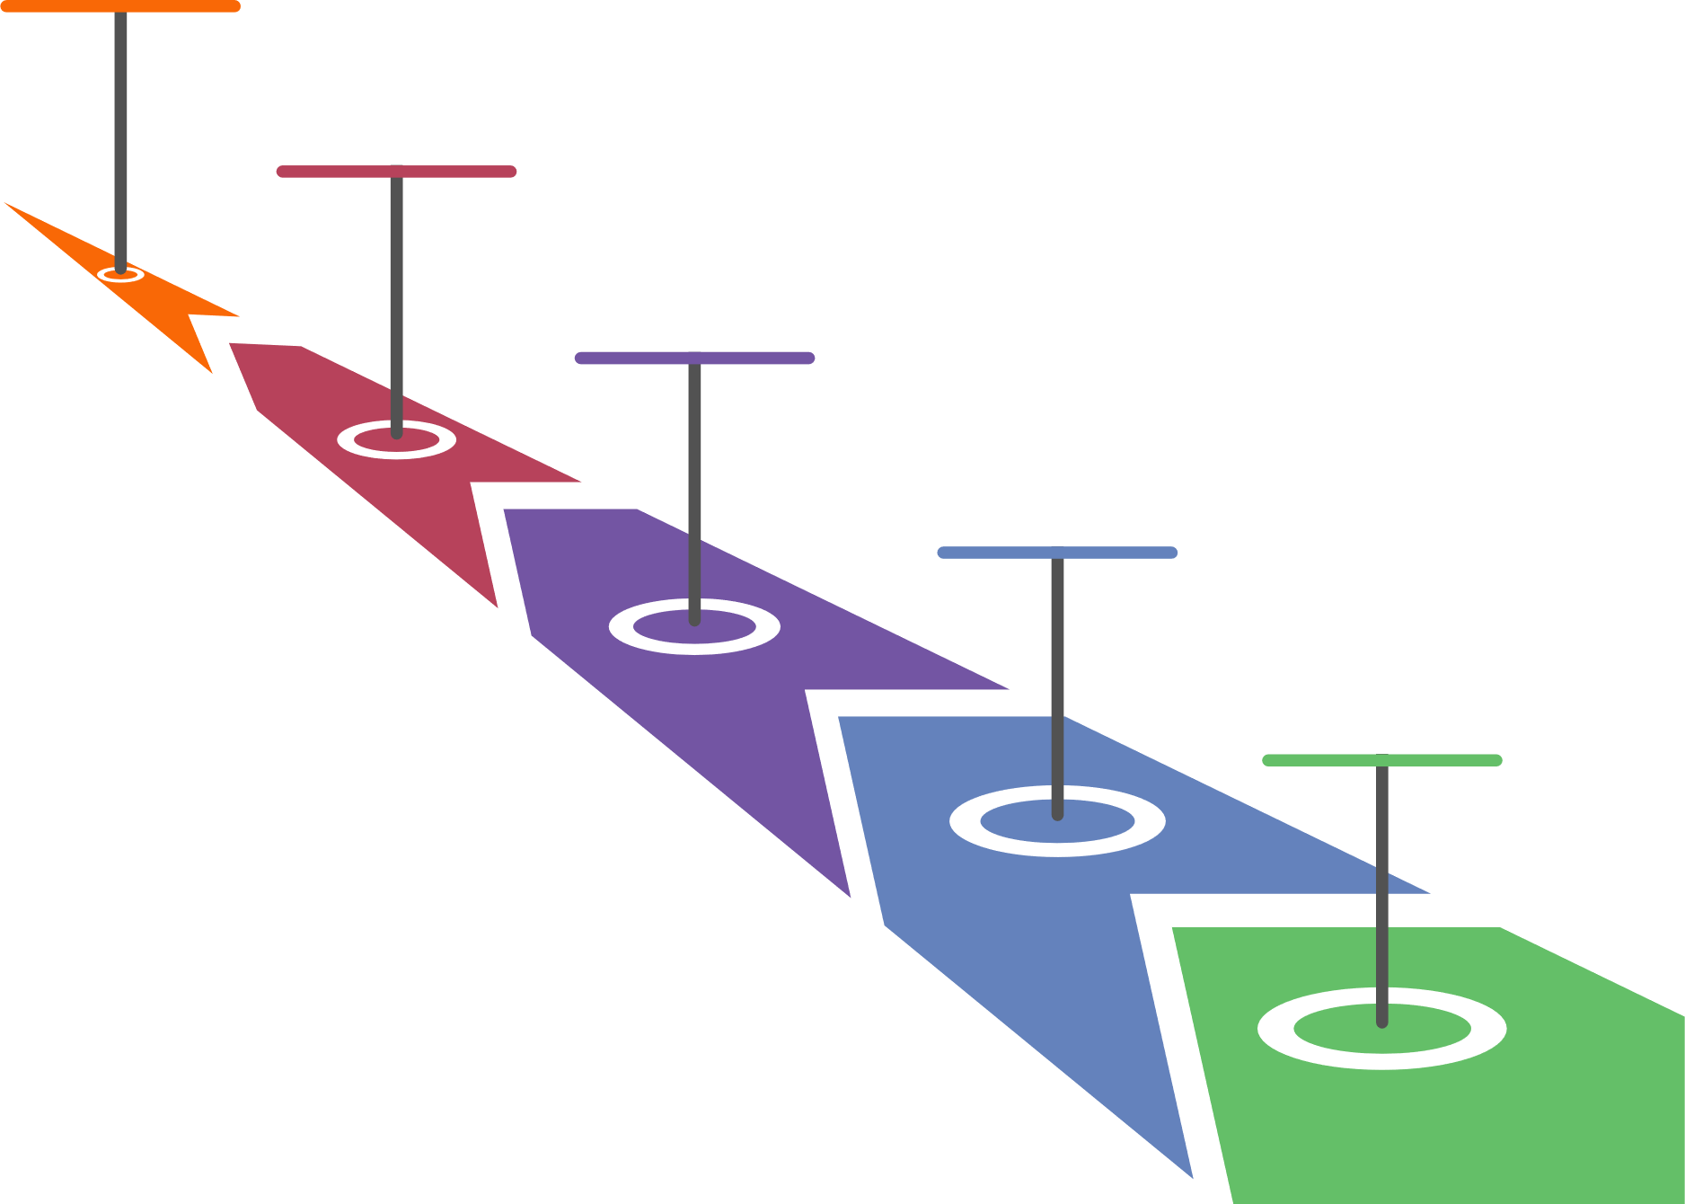
CURRENT STATUS
ALLIANCES
01/2018
Presentation VRtouch DK at CES2018
11/2017
CUSTOMERS
Ship the fist units to customers
09/2017
Raise 1 M$ in VCs, BA, Gov. Loan and Projects
01/2017
Wireless prototype presented at CES 2017
03/2016
PROSPECTS
First wired prototypes integrated with VR
Notes:
Strongly advancing in Professional training technology
BMW, Other industrial partners
Healthcare through partners and research institution

