Slide 1
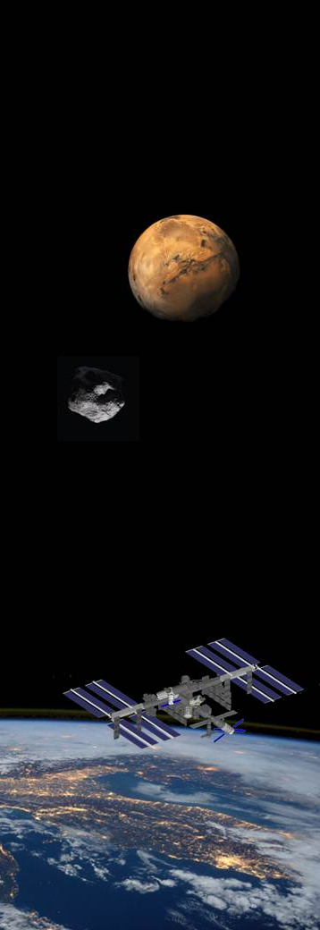



ICE CUBES – INTERNATIONAL COMMERCIAL EXPERIMENT SERVICE
Making access for space experiments fast, simple and affordable for research, technology and education
Hilde Stenuit
ICE Cubes, Space Applications Services
www.icecubesservice.com
ICECubes@spaceapplications.com
Category A – Direct Commercialisation of Exploration Outcomes
Workshop on “Commercialisation and Utilisation of Space Exploration Technologies”
Turin, 15-16 March 2018

Slide 2
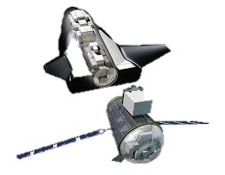
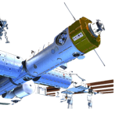
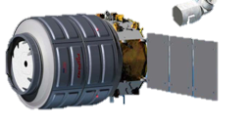

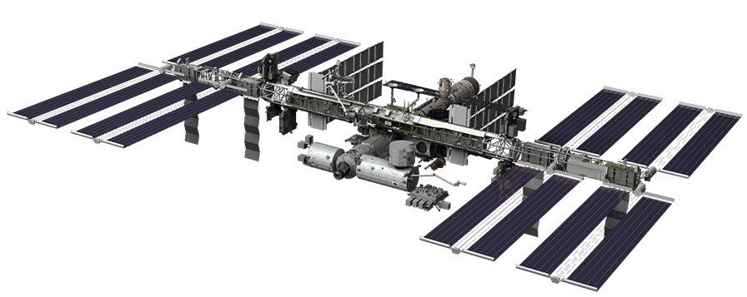







Category A – Direct Commercialisation of Exploration Outcomes
Fast pls
Affordable pls
Simple pls
IOD/IOV Techn
Industrial R&D companies
Microgravity industrial manufacturing
Emerging nations capacity building
Scientists
STEM education
Workshop on “Commercialisation and Utilisation of Space Exploration Technologies”
Turin, 15-16 March 2018

Slide 3
Category A – Direct Commercialisation of Exploration Outcomes
BACK-UP
Workshop on “Commercialisation and Utilisation of Space Exploration Technologies”
Turin, 15-16 March 2018

Slide 4
Category A – Direct Commercialisation of Exploration Outcomes
Challenge: access to space for any organization for research, technology or educational objectives.
ICE Cubes service provides FAST, SIMPLE and AFFORDABLE access for experiments to the ISS.
Assets / added-value features:
FAST = ~12months from agreement to launch.
SIMPLE = Simplified access to LEO with streamlined engineering processes reducing the complexity and time needed to prepare for and launch a payload with standardized interfaces.
AFFORDABLE = from 50K€ reference price for 1kg experiment.
Technical capabilities of launch / return and on-orbit resources (e.g. data downlink / power / conditioned stowage).
It ensures committed & recurring launches, as important asset for the potential commercial users of the LEO market.
Users directly interact with their experiments from their premises via Internet.
Workshop on “Commercialisation and Utilisation of Space Exploration Technologies”
Turin, 15-16 March 2018

Slide 5

Category A – Direct Commercialisation of Exploration Outcomes
The ICE Cubes service is suitable to provide access to space for a wide range of users / customers:
Developers of technologies (companies) for In-Orbit Demonstration / Validation (IOD / IOV)
Fundamental and applied science community from universities and research centres (academia)
Growing commercial industrial R&D (companies) for e.g. pharmaceutical, biotechnology & food, cosmetics, soft matter & coatings …
A growing microgravity industrial manufacturing and processing sector
Emerging space-faring nations capacity building
Educational (STEM), academic and private individuals
Hence the customers combine both public and private sector. The target is a gradual transition to more industrial R&D utilization in LEO.
Workshop on “Commercialisation and Utilisation of Space Exploration Technologies”
Turin, 15-16 March 2018

Slide 6
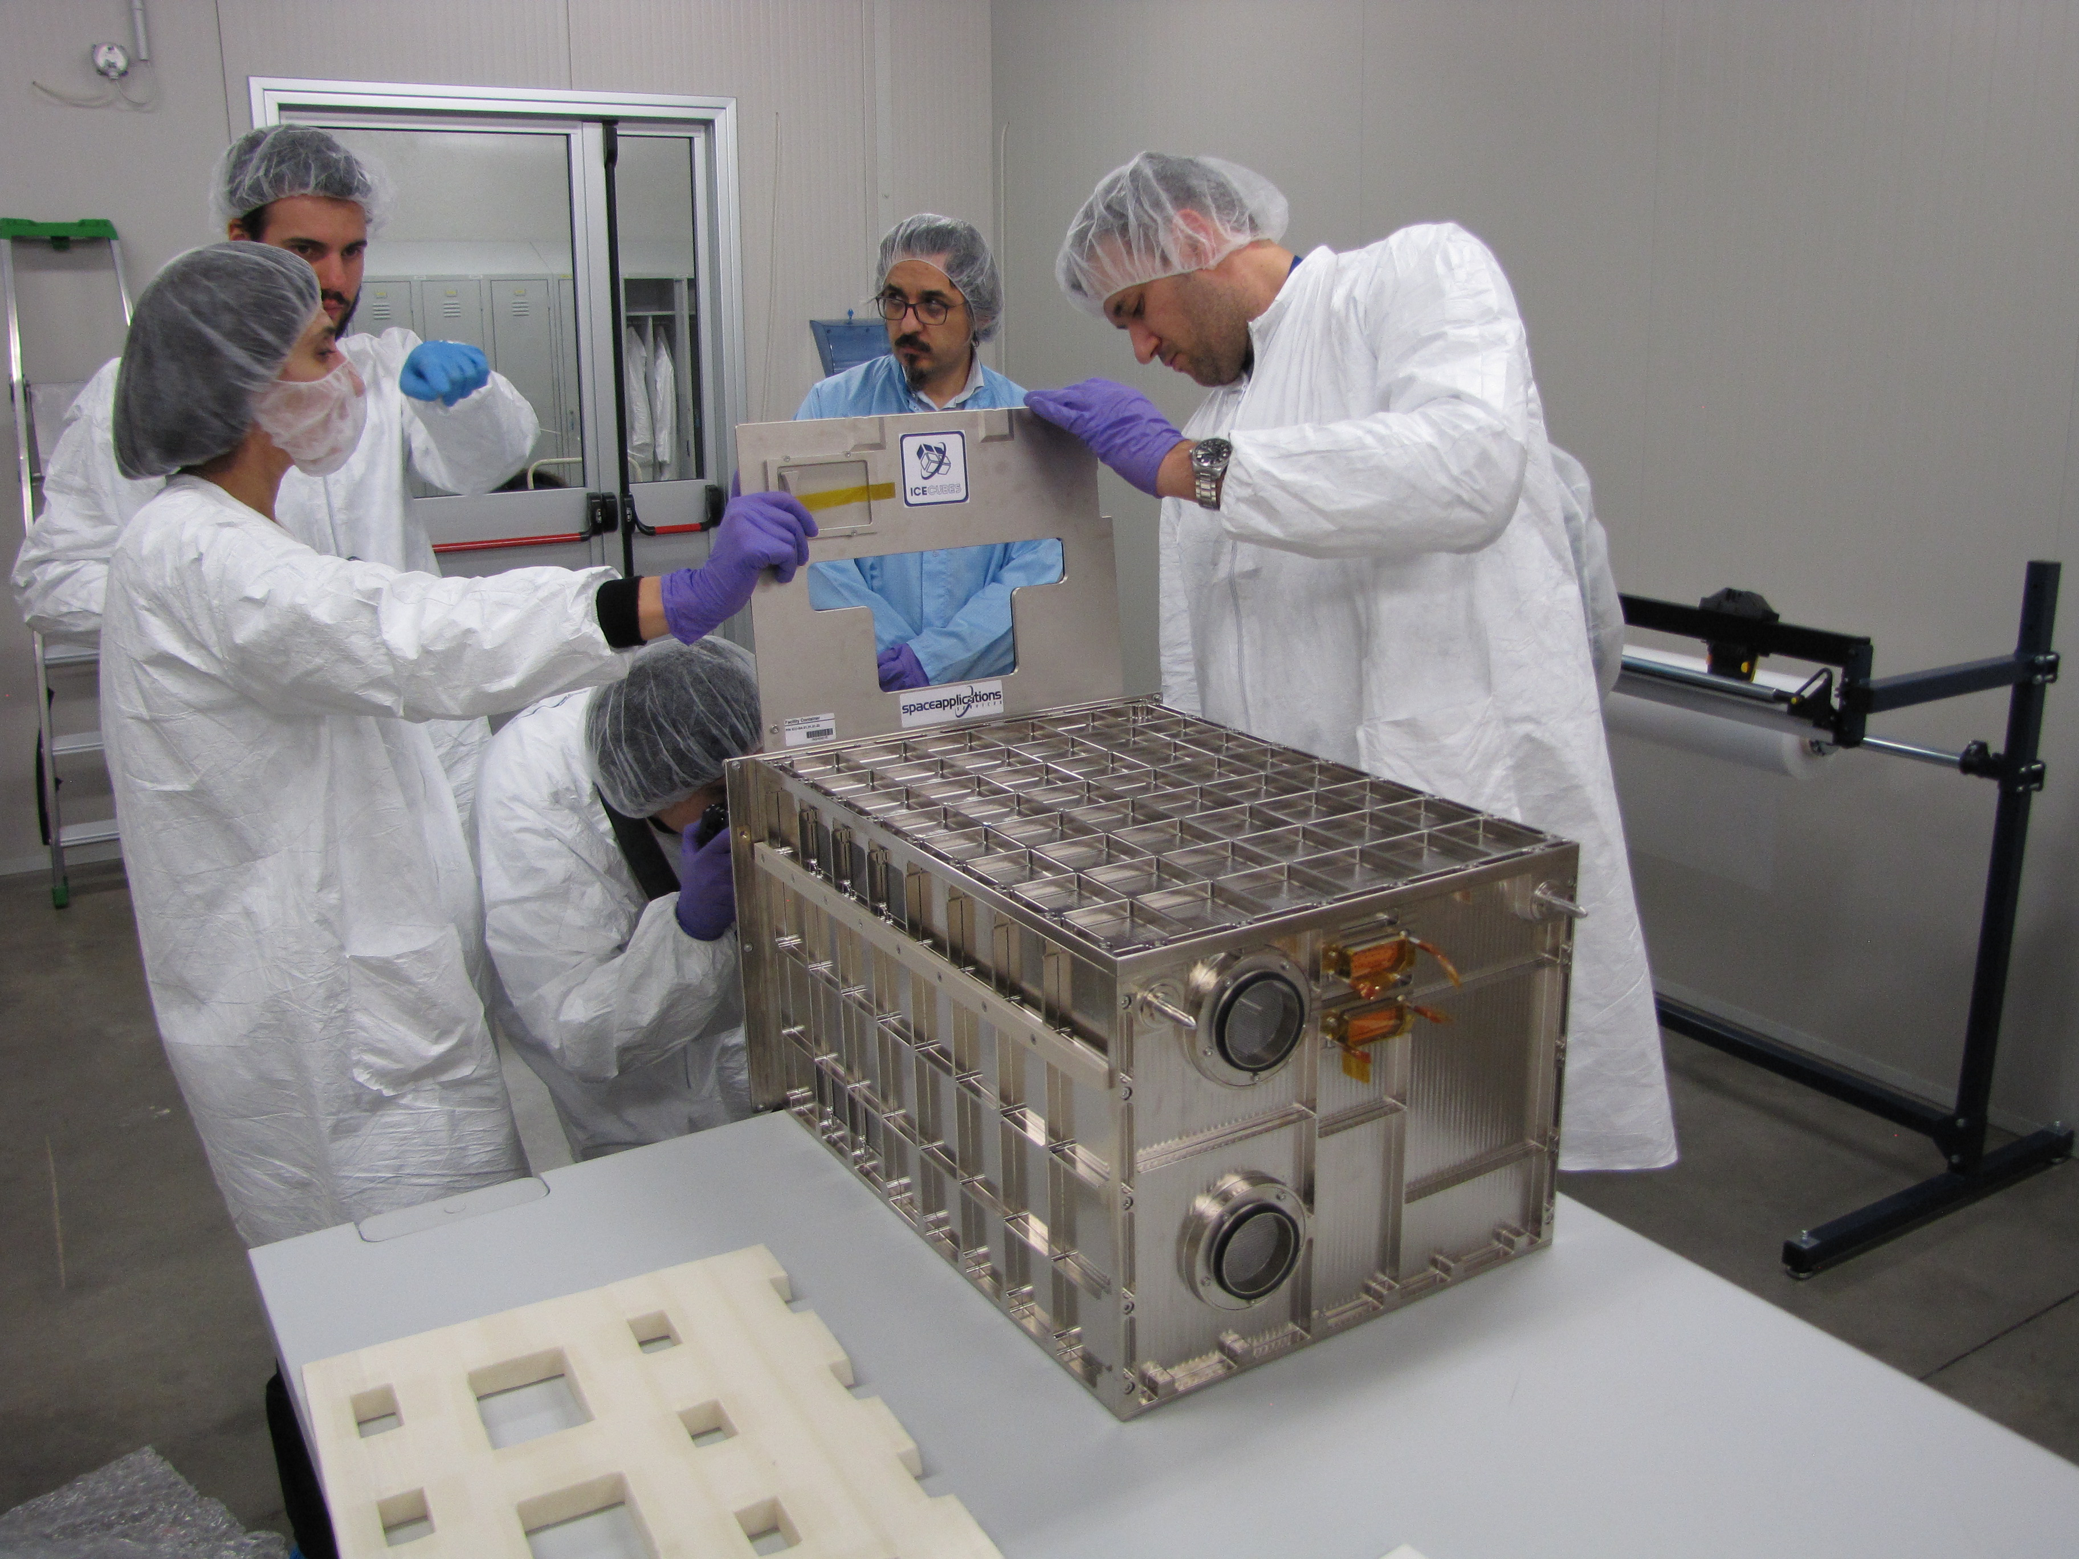
Category A – Direct Commercialisation of Exploration Outcomes
ICE Cubes facility development has been completed: first facility will be launched to ISS in May 2018.
The end-to-end ICE Cubes commercial service is set up including the ground infrastructure for the management of the facility and the cubes
  www.icecubesservice.com
For targeted R&D areas, the ICE Cubes service through partnerships will establish state-of-the-art diagnostic facilities.
Will evolve to provide access for research on free-flying platforms, on commercial space stations and for cis-lunar & moon accommodation.
Through market survey, specific sectors and related R&D have been identified as worth targeting, to take advantage of the space environment and to generate socio-economic benefits: e.g. pharmaceutical / biotech / agriculture / food / cosmetics…
Workshop on “Commercialisation and Utilisation of Space Exploration Technologies”
Turin, 15-16 March 2018

