Slide 1
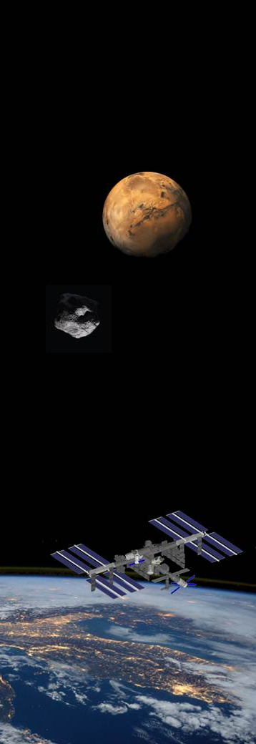



The challenge of setting up an Italian Spaceport and a suborbital spaceflight initiative for space tourism and microgravity experimentation
Francesco, Santoro
Advanced Projects & Studies Suborbital Spaceport Project Manager, ALTEC S.p.A.
Category A – Direct Commercialisation of Exploration Outcomes
Workshop on “Commercialisation and Utilisation of Space Exploration Technologies”
Turin, 15-16 March 2018

Slide 2
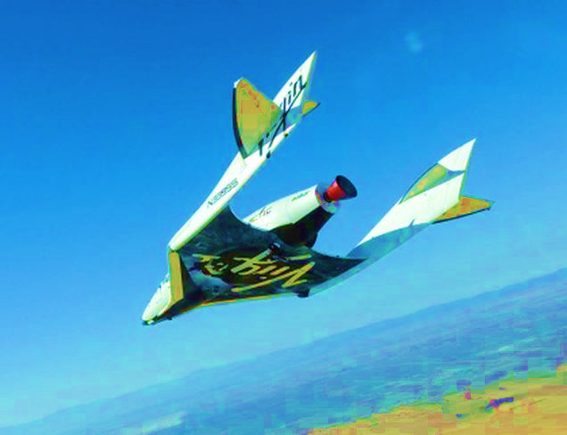
Category A – Direct Commercialisation of Exploration Outcomes
Challenge: Enable Italy as a Gateway to Space by setting up suborbital spaceflight capabilities in the Country based on a spaceport in the Italian territory
Enable Suborbital Flights Capability in Italy
Italian Spaceport
Technology
Suborbital Spaceflight System
Customer Base:
Individuals
Enterprises
Development Status:
Technical
Regulatory
Business
MARKET OPPORTUNITIES
SPACE TOURISM
SCIENCE,
TECHNOLOGY
TRAINING
100 Km altitude suborbital
4 to 6 minutes of microg.
Workshop on “Commercialisation and Utilisation of Space Exploration Technologies”
Turin, 15-16 March 2018

Slide 3
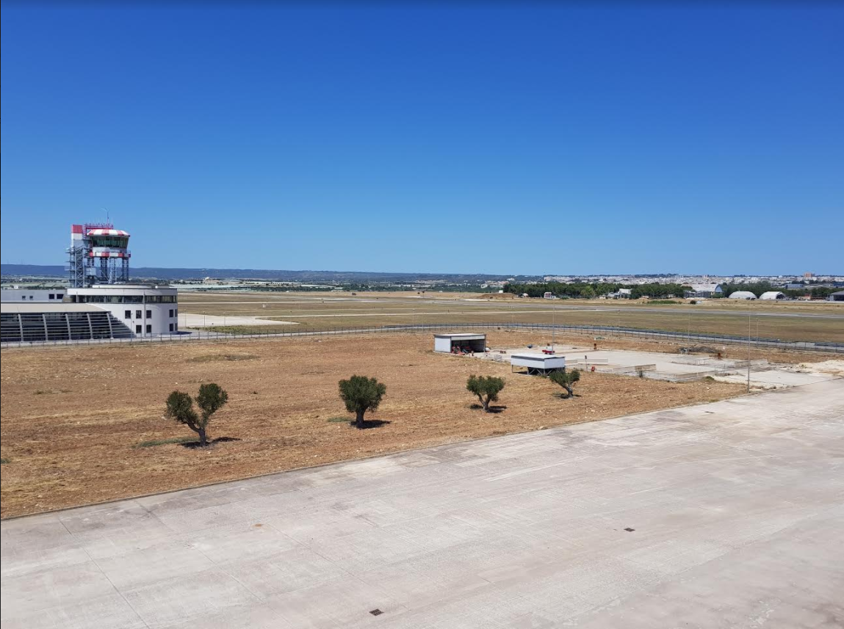
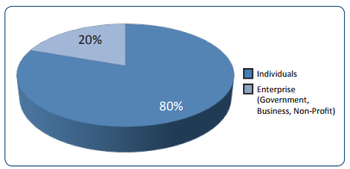
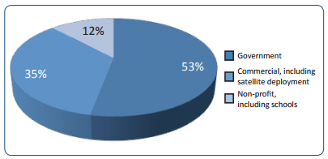
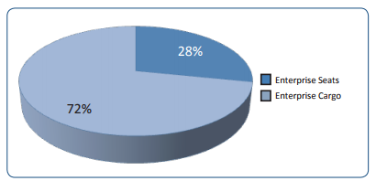
Category A – Direct Commercialisation of Exploration Outcomes
Targeted Customer base
Individuals:
High Net Worth Individuals
Capability and viability influenced by individual decision makers
Quick purchasing decisions
Enterprises:
Government Agencies
Commercial Entities
Schools, Universities
Source: Tauri Group,
Suborbital Reusable Vehicles:
A 10-Year Forecast of Market Demand
Workshop on “Commercialisation and Utilisation of Space Exploration Technologies”
Turin, 15-16 March 2018

Slide 4
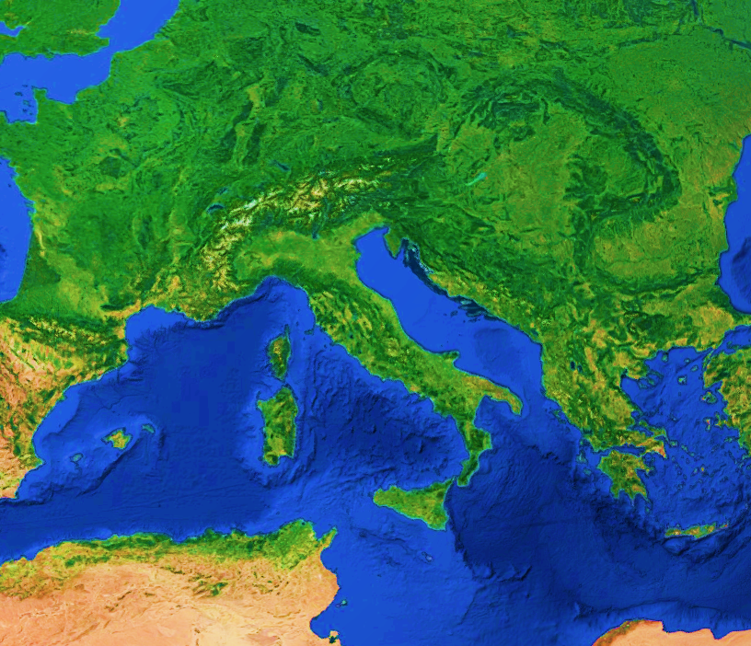
Fast access to Space
Air launched Reusable Spaceplane
Spaceport from existing site
Category A – Direct Commercialisation of Exploration Outcomes
SPACE EXPLORATION TECHNOLOGIES AND INNOVATIVE DIMENSION
Commercial Human spaceflight
Microgravity science and tech.
Astronaut/Pilots Training
MARKET OPPORTUNITIES AND SPACE EXPLORATION ADVANCES
ADDED VALUE FOR REGION DEVELOPMENT AND BENEFITS FOR CITIZENS
Catalyst to Space Industry
Employment
Education and Resrarch
Growing Space User Community
Workshop on “Commercialisation and Utilisation of Space Exploration Technologies”
Turin, 15-16 March 2018

Slide 5
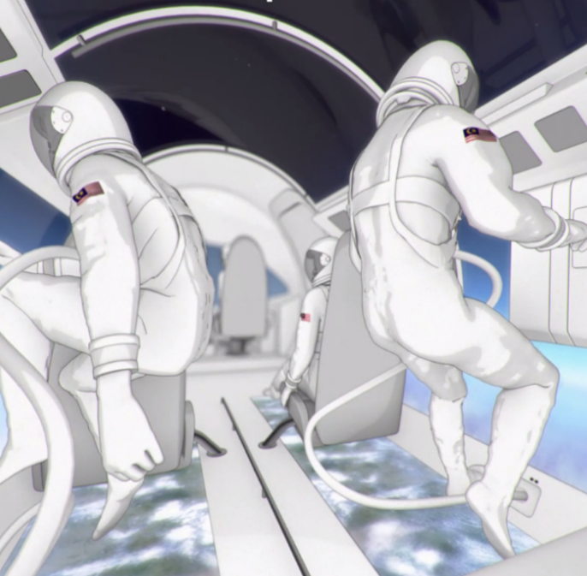
Category A – Direct Commercialisation of Exploration Outcomes
DEVELOPMENT STATUS AND AND NECESSARY ENHANCEMENTS
TECHNICAL
Spaceflight System
testing
BUSINESS
Market Potential and Business Approach
Spaceport Technical Evaluation
Governance and funding model
REGULATORY
Commercial
Agreements
ENAC, FAA, ASI on Commercial Spaceflight
Activities
2018
Investors
Working Group on Regulatory
(led by ENAC)
Licensing
Workshop on “Commercialisation and Utilisation of Space Exploration Technologies”
Turin, 15-16 March 2018

