Slide 1
Panel: Commercial Paradigm in Space Exploration
Yossi YAMIN
CEO
SPACEPHARMA
Workshop on “Commercialization and Utilization of Space Exploration Technologies”
Turin, 15-16 March 2018

Slide 2
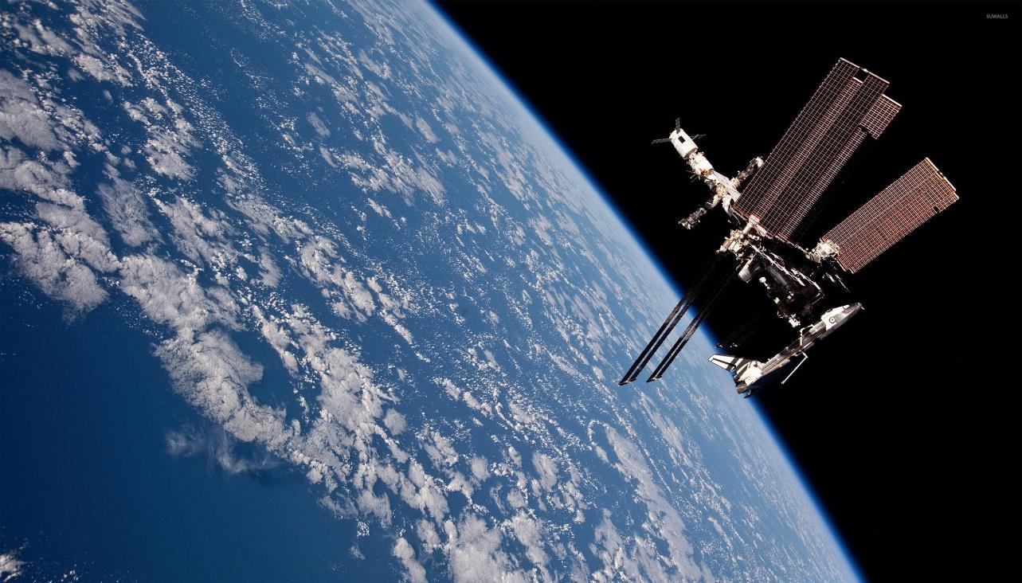
Target markets: pharmaceutical, cosmetics, biotechnologies
In short term manufacturing of new drugs is the most active form of private enterprise interests with room for business
Market becomes mature with stakes of billions of dollars
Role of space agencies in developing the market is mainly through cheap access to space
Workshop on “Commercialization and Utilization of Space Exploration Technologies”
Turin, 15-16 March 2018

Slide 3
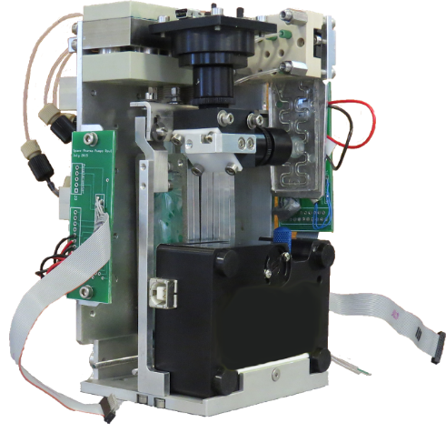
Main risk is currently not so much the lack of financing but is more the slow market growth due to:
Lack of awareness of relevant customers
Conservativeness of pharmaceutical industry
Access to space which is still rare and expensive
SpacePharma strikes deals and establish partnership with infrastructure and launch providers
Very efficient and high performance laboratory insures to secure short-term financial returns
Workshop on “Commercialization and Utilization of Space Exploration Technologies”
Turin, 15-16 March 2018

