Slide 1
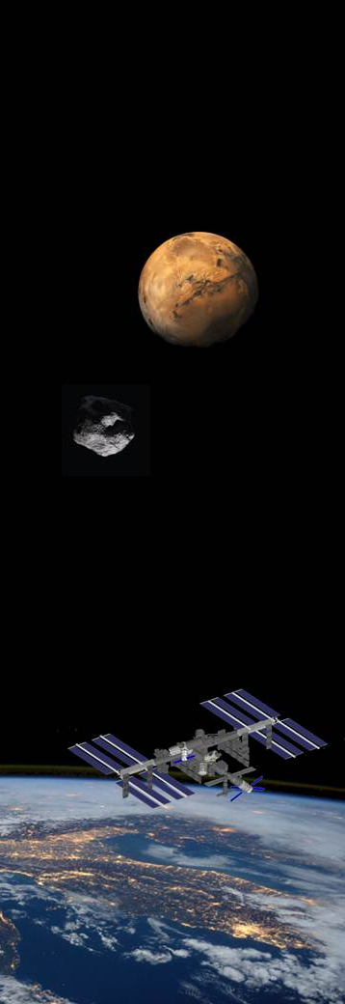






ORBITECTURE: Study of a Multifunctional SpaceHub
G. Russo^{1,2}, M. Pica Ciamarra^{1,3}, V. Torre¹, G. De Martino^{1,3}
¹ Center for Near Space, Italy
² Trans-Tech srl, Naples, Italy
³ Pica Ciamarra Associate International, Naples, Italy
Category A – Direct Commercialisation of Exploration Outcomes
Workshop on “Commercialisation and Utilisation of Space Exploration Technologies”
Turin, 15-16 March 2018

Slide 2
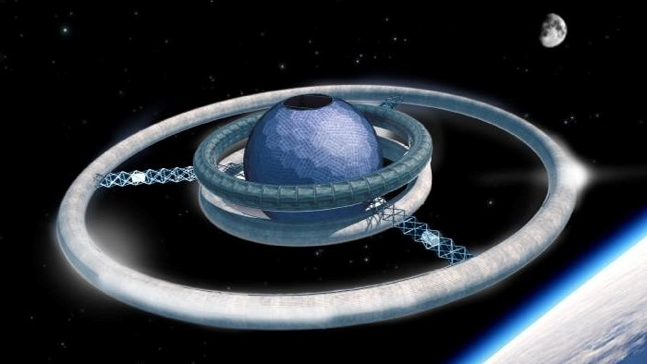
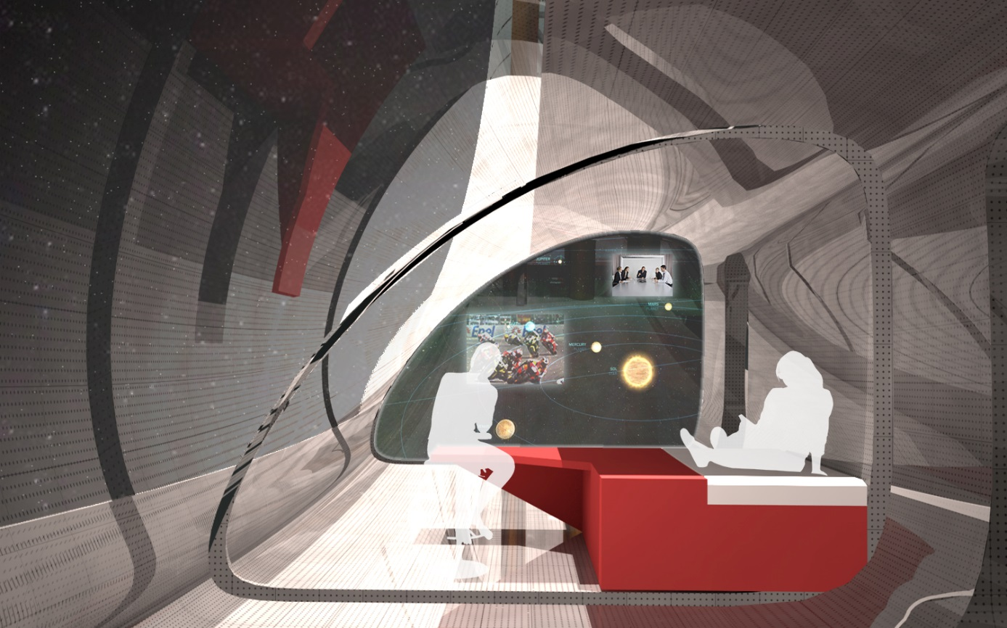
Category A – Direct Commercialisation of Exploration Outcomes
OrbiTecture (Orbital Architecture) is a neologism CNS coined to emphasize the importance of a multi-disciplinary and synergistic approach in space infrastructures conception of the medium-term future
The main design target are:
minimum weight per capita
maximum space per capita
integration of different activities inconceivable within the ISS present spaces, designed not for ordinary people
Workshop on “Commercialisation and Utilisation of Space Exploration Technologies”
Turin, 15-16 March 2018

Slide 3

Category A – Direct Commercialisation of Exploration Outcomes
Reference CNS scenario:
  Target period 2050-2070
  Cis-lunar City population 1000
  Number of districts 10-12
  Number of trips/year 100000
Workshop on “Commercialisation and Utilisation of Space Exploration Technologies”
Turin, 15-16 March 2018

Slide 4

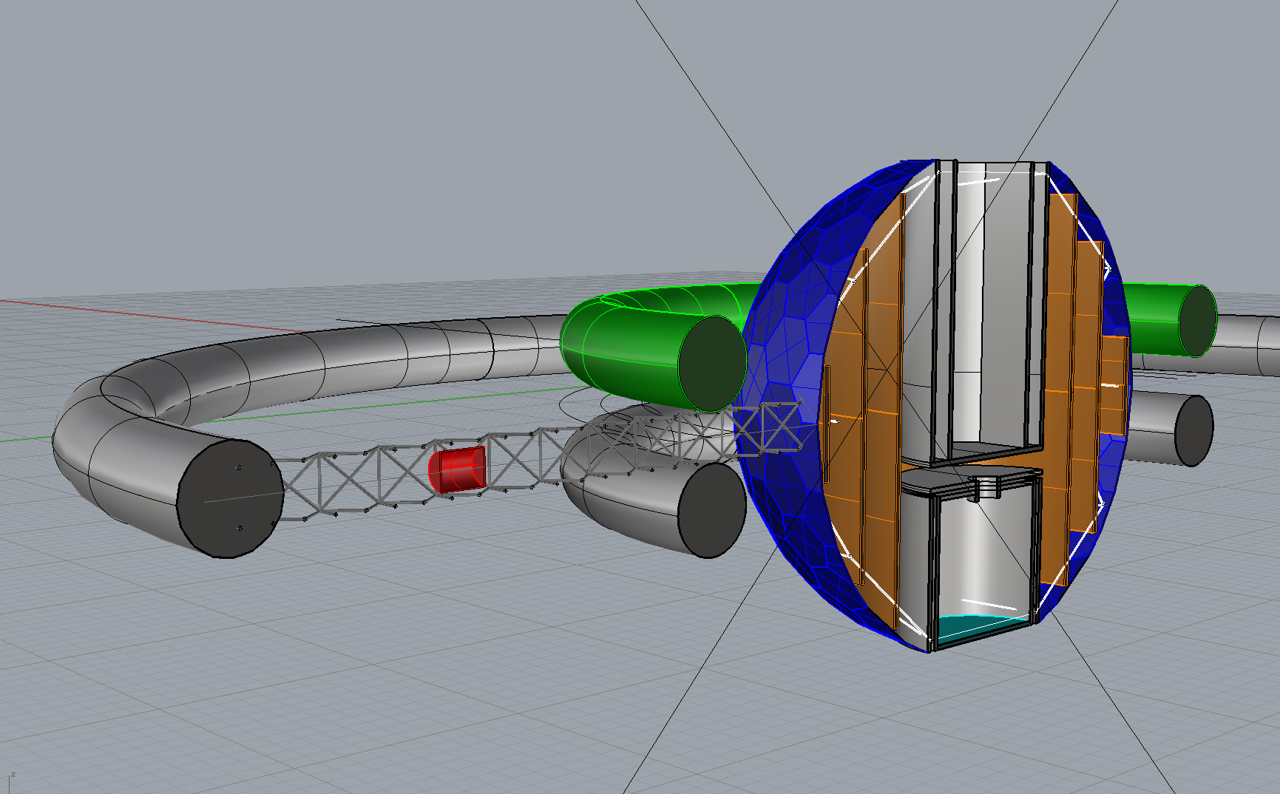
Residual gravity labs
"Martian" lab
"Lunar" lab
Microgravity laboratory

Slide 5
Single accomodation
Permanent workers
Transparent Cover
Double accomodation
Space tourists
3D printed structure

Slide 6
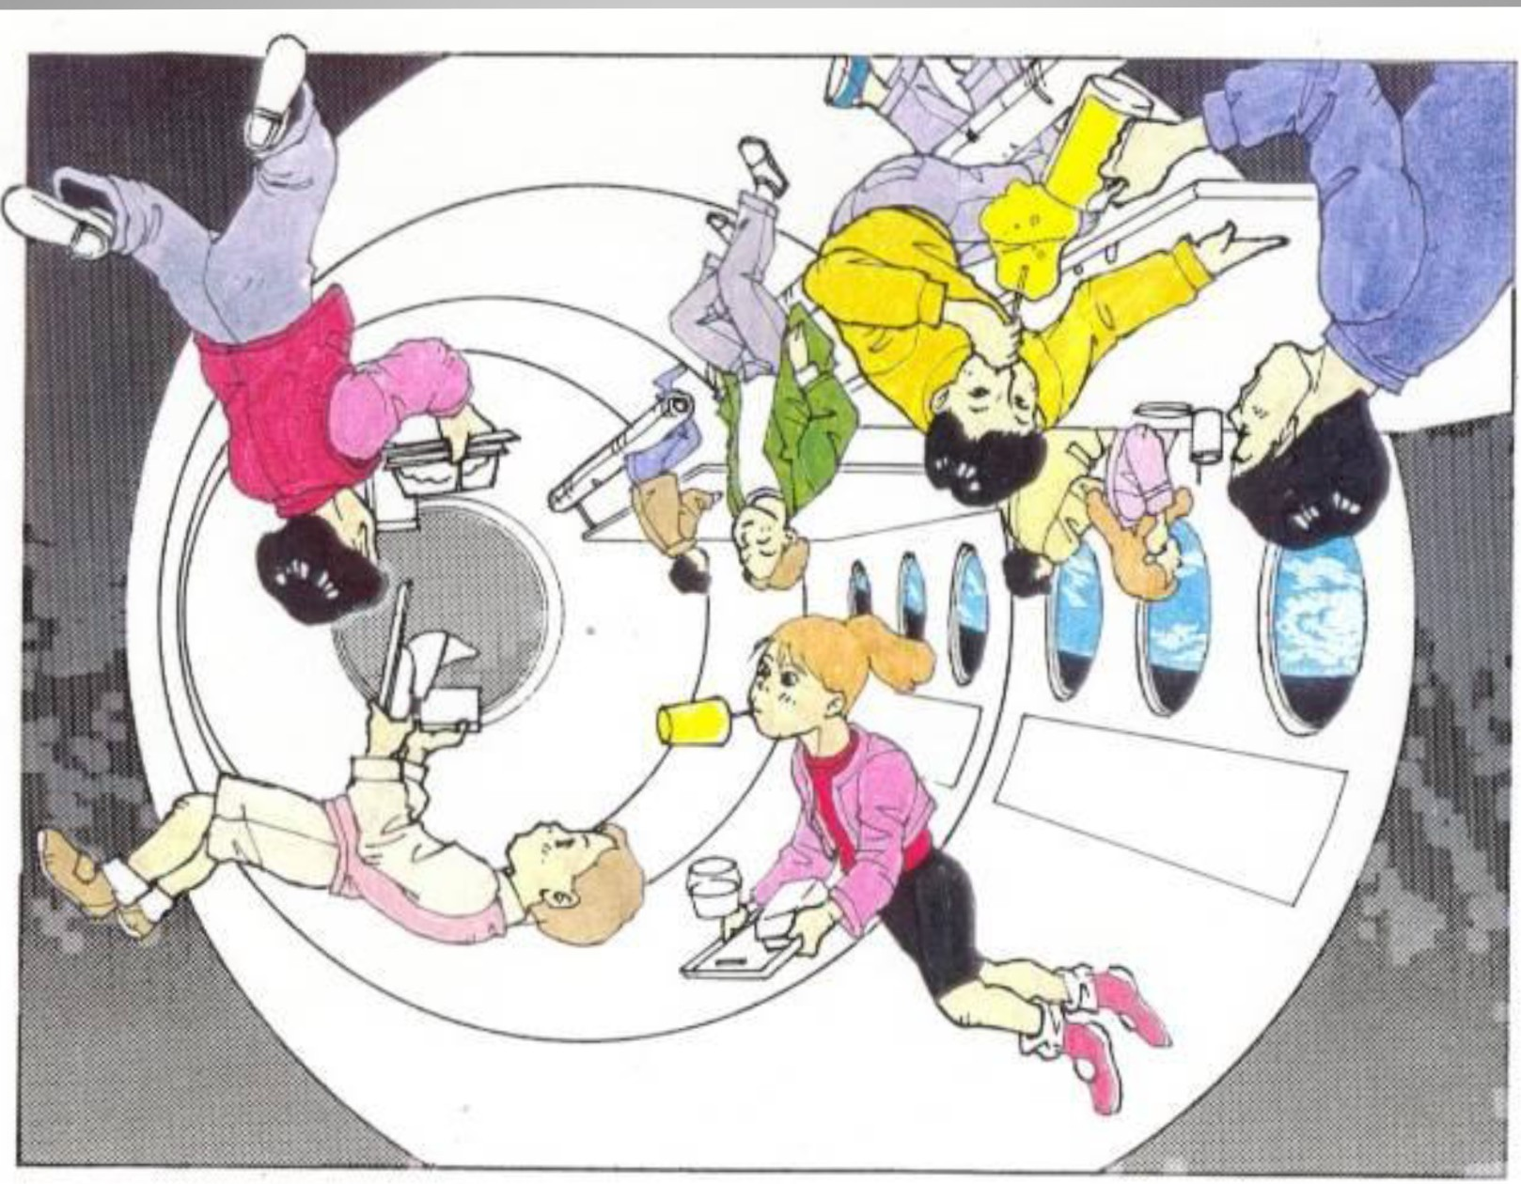
Double accomodation
Space tourists
Condensation areas
Single accomodation
Permanent workers

Slide 7
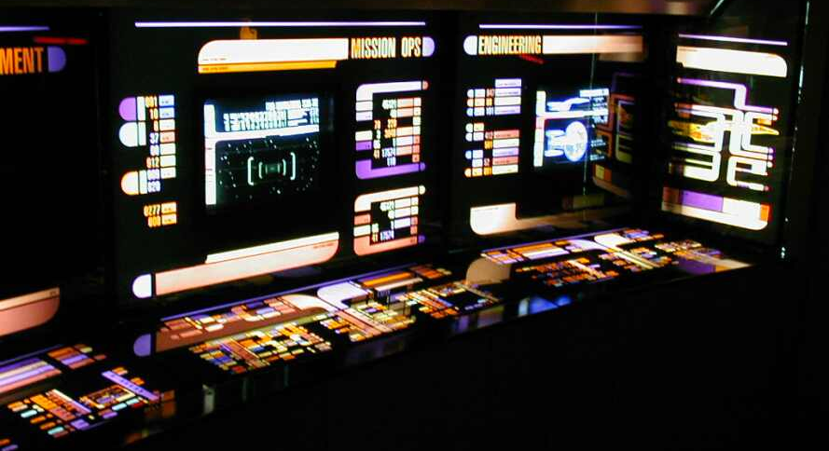
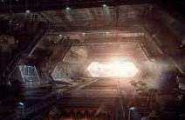
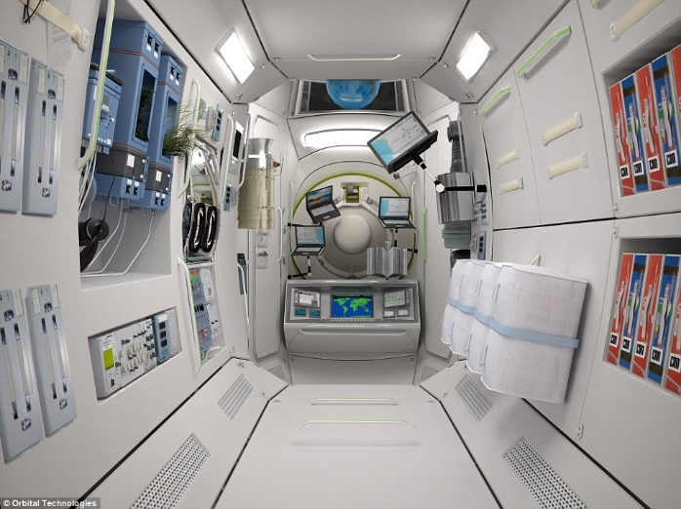
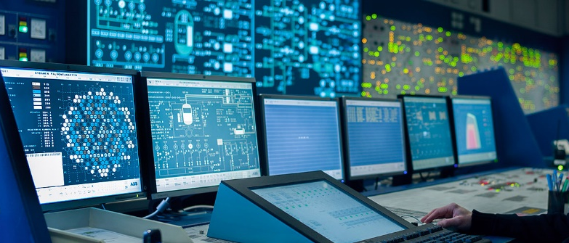
Command Room
Hangar
Medical Room and First Aid
Hangar control room

Slide 8
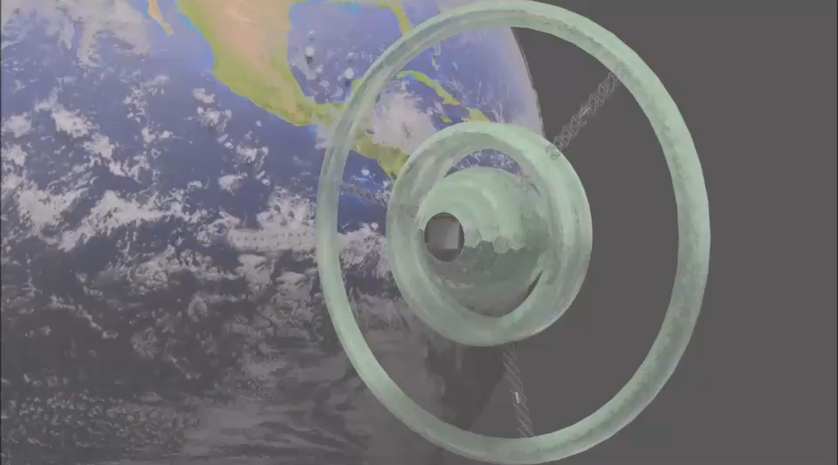
Category A – Direct Commercialisation of Exploration Outcomes
A cis-lunar multi-function infrastructure continously crowded by some 100 persons attending the following functions:
Space interchange pier
Maintenance and integration hangar
Scientific laboratory
Lodging (resort, hotel, …)
Workshop on “Commercialisation and Utilisation of Space Exploration Technologies”
Turin, 15-16 March 2018

Slide 9
Category A – Direct Commercialisation of Exploration Outcomes
THANK YOU
Workshop on “Commercialisation and Utilisation of Space Exploration Technologies”
Turin, 15-16 March 2018

