Slide 1
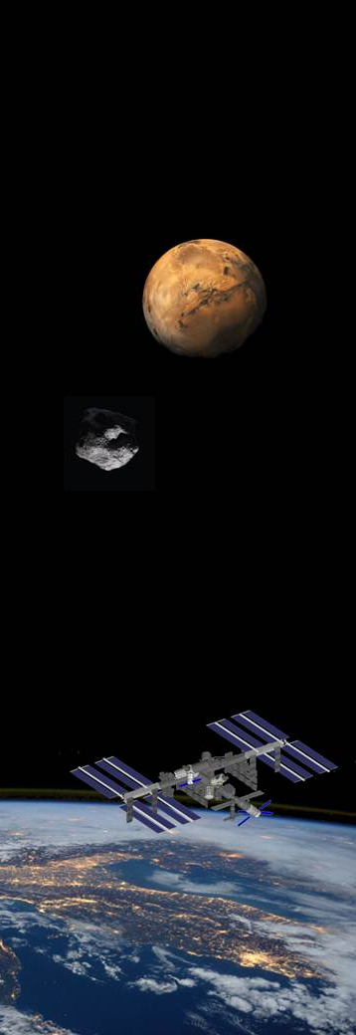


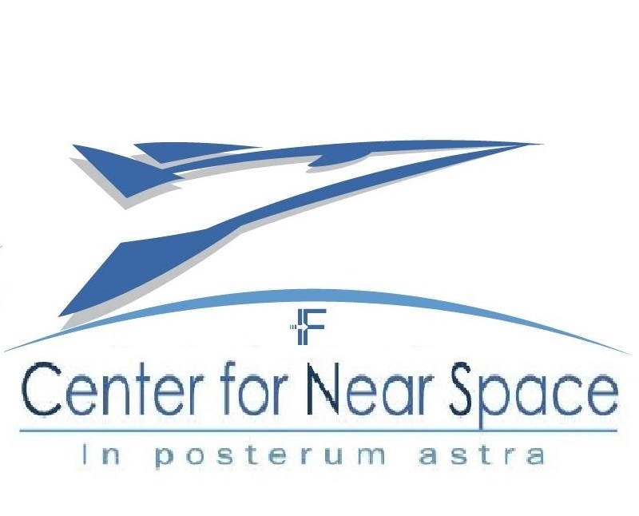



HYPLANE: The Future of Sub-orbital Space Access is Today
G. Russo^{1,3}, R. Savino^{2,3}, D. Pisanti³, M. Saviano³, F. Perrelli³
¹ Trans-Tech srl, Italy
² Dip. Ingegneria Industriale, Univ. Federico II, Naples, Italy
³ Center for Near Space, Naples, Italy
Category A – Direct Commercialisation of Exploration Outcomes
Workshop on “Commercialisation and Utilisation of Space Exploration Technologies”
Turin, 15-16 March 2018

Slide 2


Category A – Direct Commercialisation of Exploration Outcomes
Suborbital flight above the Karman line (Microgravity Exp., Space Tourism, Training)
Urgent Travel market segment
6-seats, Mach 4.5 spaceplane
HTHL from 80% of available airports (L<1000 m)
Integrates state-of-art aeronautic and space technologies:
combined cycles prop.
hot structures
thermal control
Advanced GNC
Workshop on “Commercialisation and Utilisation of Space Exploration Technologies”
Turin, 15-16 March 2018

Slide 3
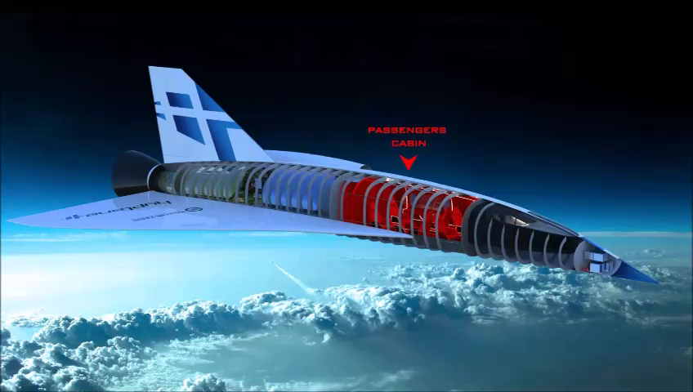
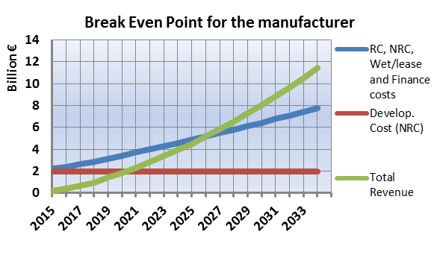
Category A – Direct Commercialisation of Exploration Outcomes
2 B€ development investment
10 B€ total life cycle cost
13.7 B€ total life cycle revenue
3.7 B€ Total life cycle First Operating Margin
(EBITDA)
50 k€ Ticket price for suborbital flight
11 years
Workshop on “Commercialisation and Utilisation of Space Exploration Technologies”
Turin, 15-16 March 2018

Slide 4
Category A – Direct Commercialisation of Exploration Outcomes
THANK YOU
Workshop on “Commercialisation and Utilisation of Space Exploration Technologies”
Turin, 15-16 March 2018

