Slide 1
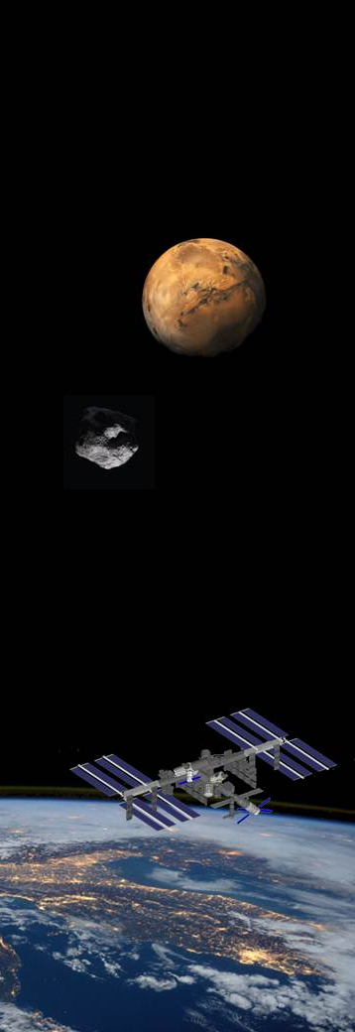



Innovative anti-bacteria fabric for astronaut clothes
Liliana Ravagnolo
Advanced Projects and Studies Project Manager
ISS Commercialization
Category A – Direct Commercialisation of Exploration Outcomes
Workshop on “Commercialisation and Utilisation of Space Exploration Technologies”
Turin, 15-16 March 2018

Slide 2
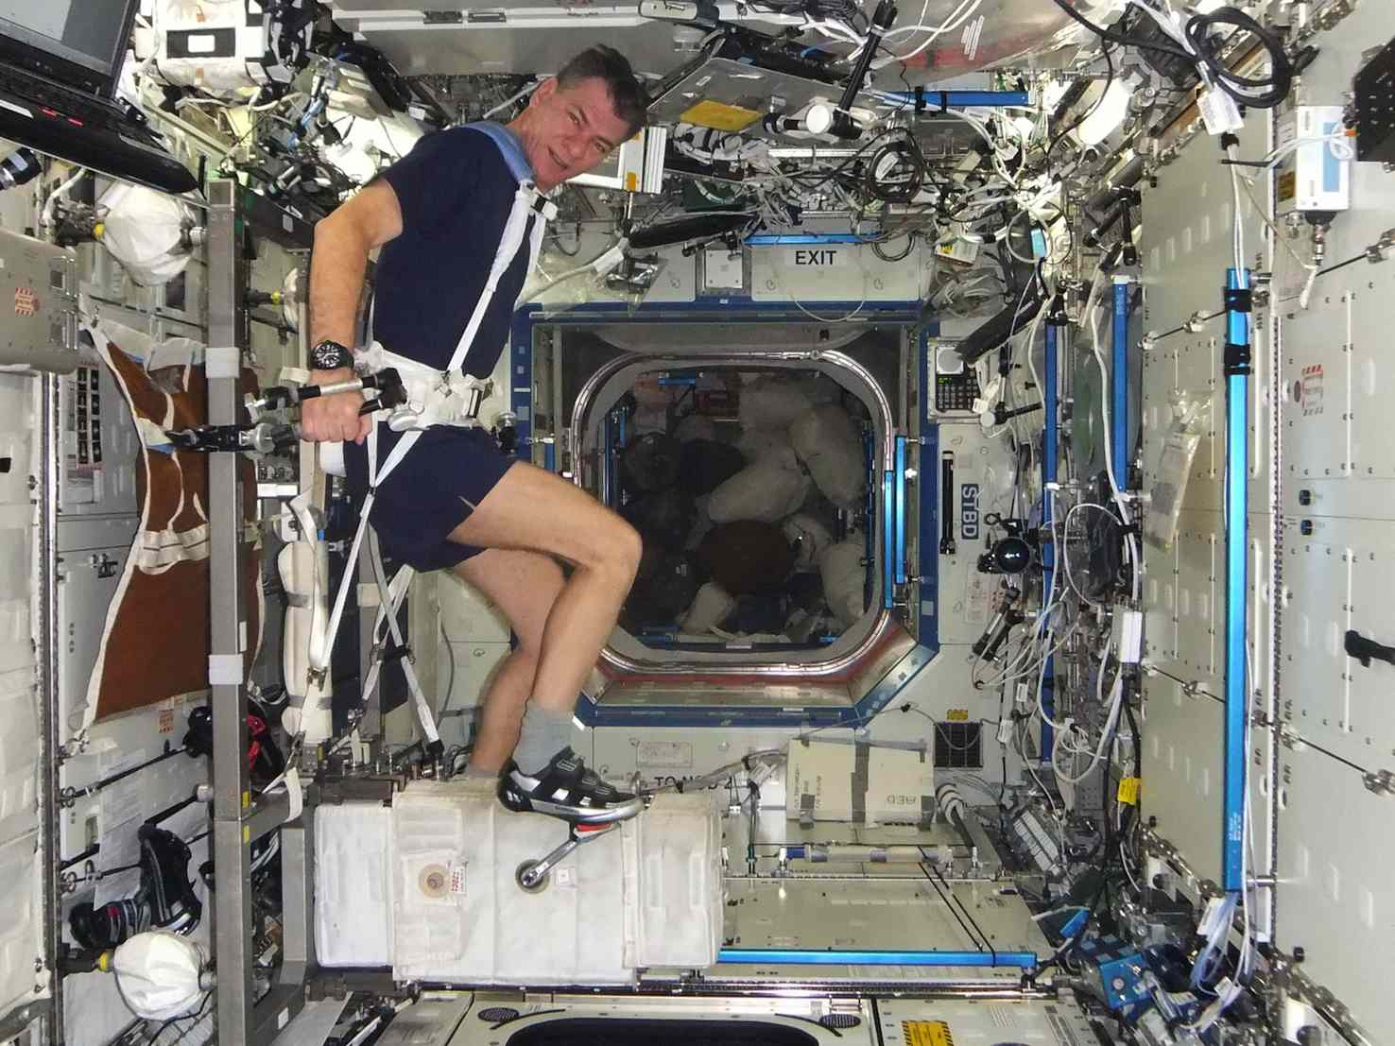
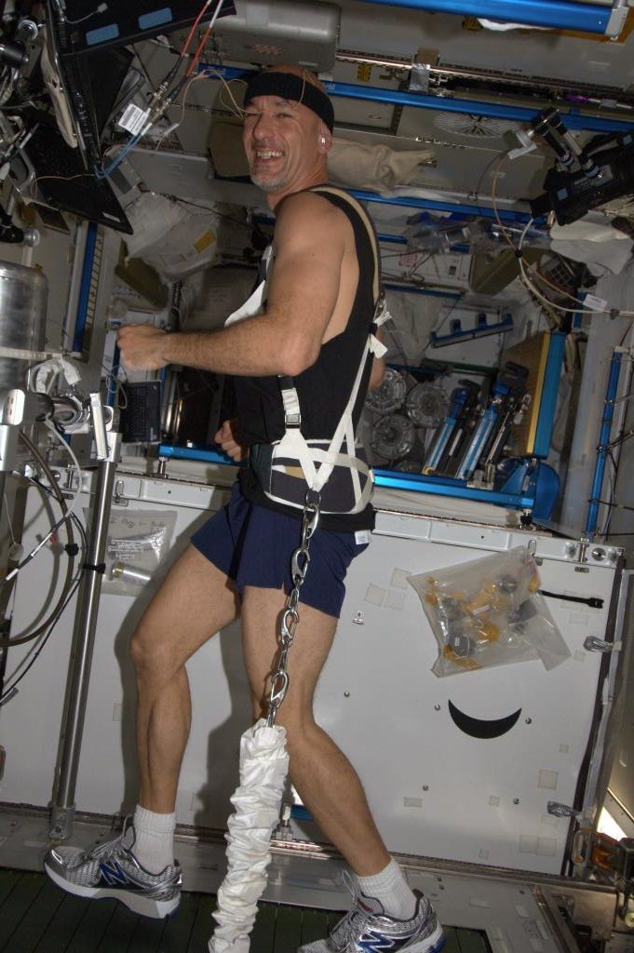
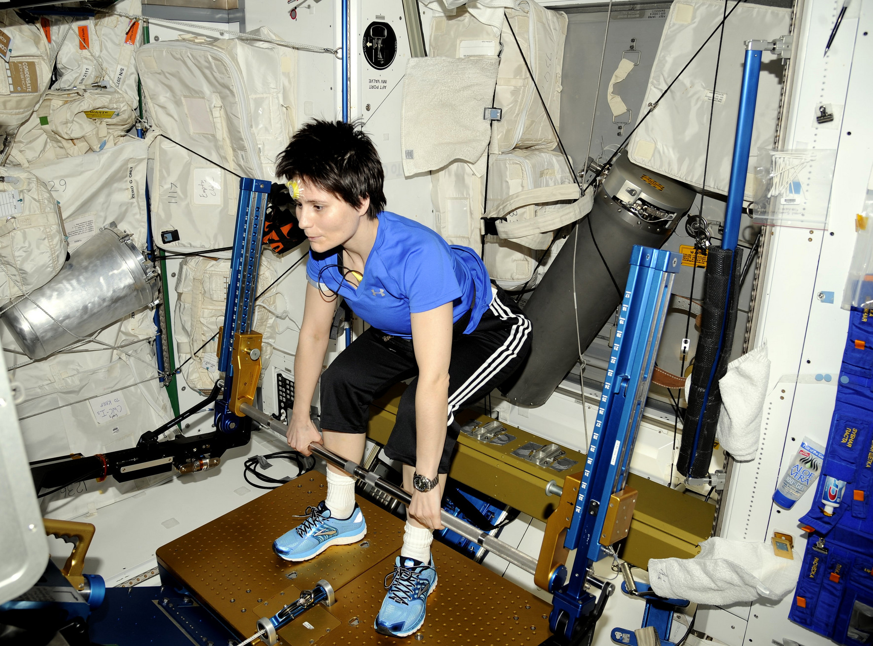
Category A – Direct Commercialisation of Exploration Outcomes
Astronauts on board for long duration mission perform 2 hrs. fitness activity per day.
Every 15 days they receive:
5 pants
5 socks
2 t-shirt
2 shorts
Workshop on “Commercialisation and Utilisation of Space Exploration Technologies”
Turin, 15-16 March 2018

Slide 3
Category A – Direct Commercialisation of Exploration Outcomes
Current process
New solution for Exploration - Benefits
Develop new technological clothes for Exploration
Less cargo up mass and down mass (reduce costs)
Reduce storage problem on board
Improve astronaut wellness on board
Follow on for terrestrial usage (athletes, extreme sports, etc..)
Launched on board via cargo (Expensive Upmass)
Used on board for several days (sweting, dirty, smell)
Stored on board with trash increasing IMS problems
Destroyed with cargo burn
Workshop on “Commercialisation and Utilisation of Space Exploration Technologies”
Turin, 15-16 March 2018

Slide 4
Category A – Direct Commercialisation of Exploration Outcomes
On orbit testing of new fibers:
Siver Fibers
Anti-bacteria properties
Carbon Fibers
UV resistant
Scratch resistant
Wool
Thermoregulator
Breathable
Fire retardant
Anti-bacteria properties
Nanocapsules
Release medicaments or body care substances in a controlled manner
Workshop on “Commercialisation and Utilisation of Space Exploration Technologies”
Turin, 15-16 March 2018

