Slide 1
USAGE OF SPACE DETECTORS FOR INDUSTRY 4.0 REAL TIME NON DISTRUCTIVE TESTING
Pietro Pozzi, CTO Xnext
ppozzi@x-next.com
www.x-next.com
Category B – Indirect Exploitation of Exploration results in other sectors
Workshop on “Commercialisation and Utilisation of Space Exploration Technologies”
Turin, 15-16 March 2018

Slide 2
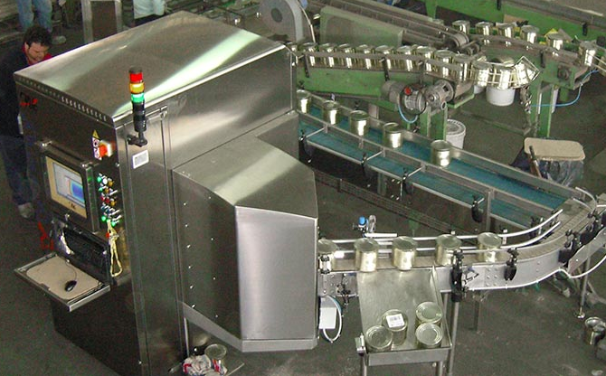
Category B – Indirect Exploitation of Exploration results in other sectors
Proprietary Hardware, software and identification algorithms
IoT Interfaces & Analytics for Line automation
Workshop on “Commercialisation and Utilisation of Space Exploration Technologies”
Turin, 15-16 March 2018

