Slide 1
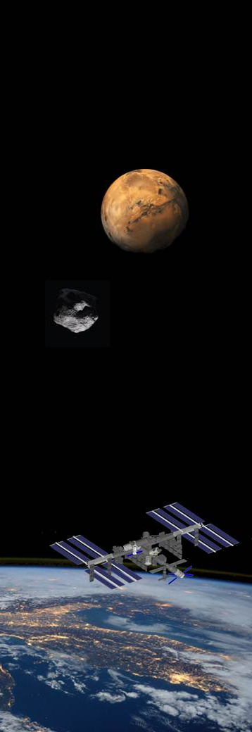
Panel: Commercial Paradigm in Space Exploration
Hilde Stenuit
ICE Cubes, Space Applications Services
Workshop on “Commercialization and Utilization of Space Exploration Technologies”
Turin, 15-16 March 2018

Slide 2

LEO Value chain clusters
Fundamental science
Applied research
Market product / end user
Products development
Science established grounds
R&D market
Microgravity as scientific tool, as manufacturing resource, as business research advantage
Facilities / capabilities
Enabling technologies
Workshop on “Commercialization and Utilization of Space Exploration Technologies”
Turin, 15-16 March 2018

Slide 3
LEO Value chain clusters
Example 1: Biosciences & pharma
Fundamental science
Applied research
Market product / end user
Products development
Science established grounds
R&D market
Microgravity as scientific tool, as manufacturing resource, as business research advantage
Microgravity scientists: cell & micro- biologists
Drugs R&D, 3D bioprinting applic, manufacturing nutraceuticals, vitamins
Sensors, analysis tech, on-chip processing,…
Bioreactors, microscope, …
Enabling technologies
Facilities / capabilities
Workshop on “Commercialization and Utilization of Space Exploration Technologies”
Turin, 15-16 March 2018

Slide 4
LEO Value chain clusters
Example 2: Colloids & soft matter
Fundamental science
Applied research
Market product / end user
Products development
Science established grounds
R&D market
Microgravity as scientific tool, as manufacturing resource, as business research advantage
Physical scientists: colloids / soft matter
Food formulations, cosmetics, …
Sensors, analysis tech, on-chip processing,…
Fluids vessels, optics, …
Enabling technologies
Facilities / capabilities
Workshop on “Commercialization and Utilization of Space Exploration Technologies”
Turin, 15-16 March 2018

Slide 5
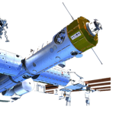
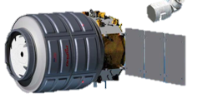
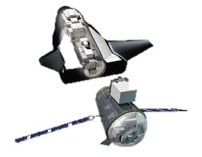

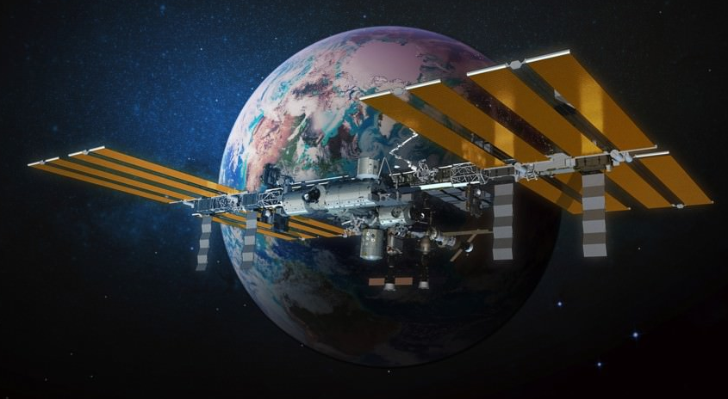
Space assets value chain clusters
Microgravity value chain clusters
Workshop on “Commercialization and Utilization of Space Exploration Technologies”
Turin, 15-16 March 2018

