Slide 1
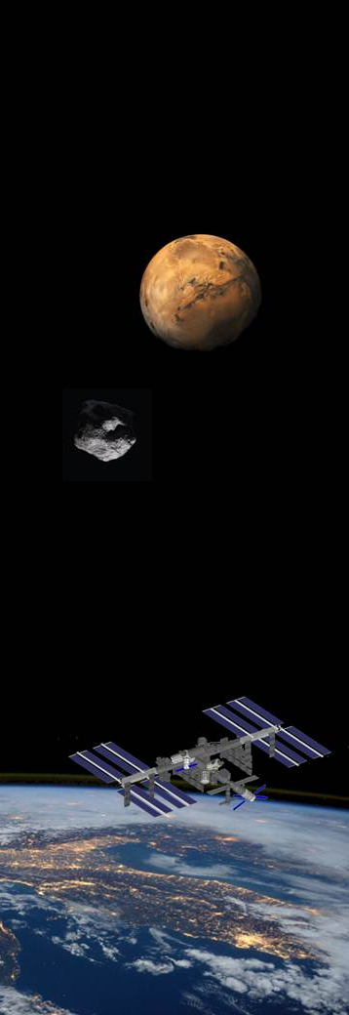



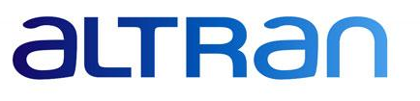



Portable on Orbit Printer 3D:
1st European additive manufacturing machine on International Space Station
G. Musso (Thales Alenia Space)
M. Guerricchio, L. Enrietti (ALTRAN)
E. Ambrosio, M. Lorusso (IIT)
G. Mascetti, G. Valentini (ASI)
Category A – Direct Commercialisation of Exploration Outcomes
Workshop on “Commercialisation and Utilisation of Space Exploration Technologies”
Turin, 15-16 March 2018

Slide 2
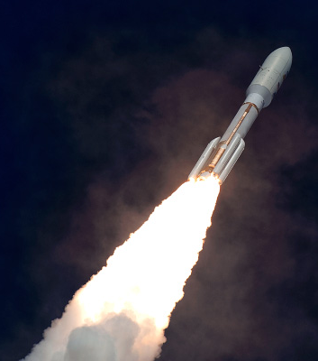
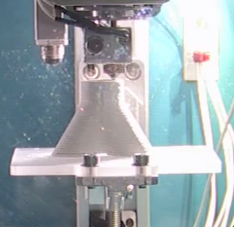
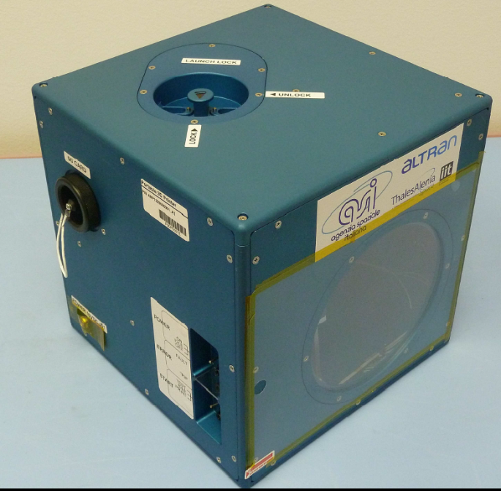
Category A – Direct Commercialisation of Exploration Outcomes
In orbit manufacturing and assembly
Space exploration plans requires autonomy from Earth, which in-orbit manufacturing can bring.
In-orbit assembly and manufacturing overcomes limitations on the size, volume and design of payloads manufactured on ground, …
generating attractive business cases
Additive Manufacturing in Space allows:
Reduction of launch costs
Revision of mission logistics
On demand production of spare parts on orbit / planet, design on ground & produce in space (digital technique).
Workshop on “Commercialisation and Utilisation of Space Exploration Technologies”
Turin, 15-16 March 2018

Slide 3
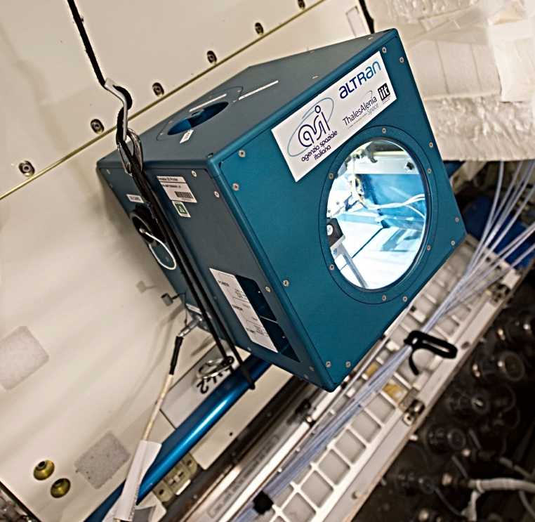
Category A – Direct Commercialisation of Exploration Outcomes
Portable on Orbit Printer 3D on ISS
Portable On Board Printer 3D funded and managed by
  as technology demonstration
Printer launch (Dec 2015) & return (May 2016) allocations and crewtime for onboard operations are part of the ASI resources of ISS utilization
Actors of this activity are
Based on Fused Deposition Modelling (FDM) technique (wire feed)
Build material: PLA (Polylactic Acid)
Power requirement: 30-70W, 16VDC
Standard power supply from onboard laptop
Standard power supply from rack UOP/SUP via Emerald Brick adapter
Workshop on “Commercialisation and Utilisation of Space Exploration Technologies”
Turin, 15-16 March 2018

Slide 4
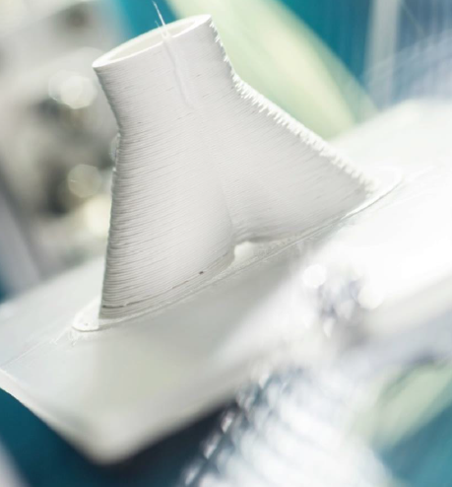
Category A – Direct Commercialisation of Exploration Outcomes
  1st European Additive Manufacturing machine in space
  The Portable On Board 3D Printer is a payload aimed to assess the capability of on-orbit additive manufacturing process in creating solid objects in microgravity and making a validation step for the introduction of the AM technology on board the ISS.
Additive Manufacturing…
Reduces Waste Production
Saves on Energy Costs
High flexibility & autonomy: enables complex design and changes implement; no need for tooling.
cost of entry is becoming more affordable
training programs are becoming readily available at all levels
Easier strength-to-mass ratio optimization
Workshop on “Commercialisation and Utilisation of Space Exploration Technologies”
Turin, 15-16 March 2018

Slide 5
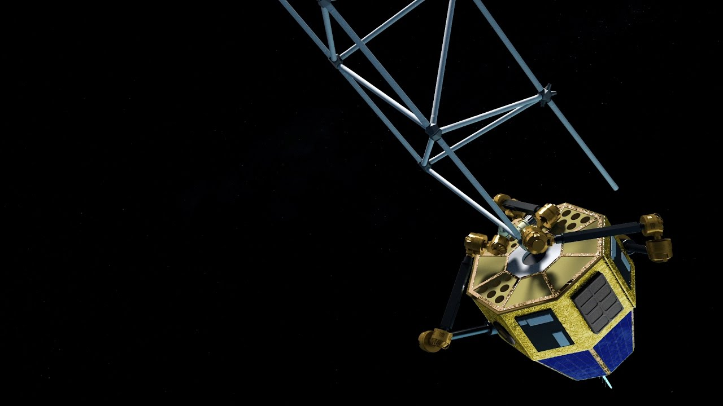



Thank
you
for
your
attention.

