Slide 1
High Power Electric Propulsion for Space Exploration
Tommaso Misuri
Head of Propulsion Division, SITAEL
Workshop on “Commercialisation and Utilisation of Space Exploration Technologies”
Turin, 15-16 March 2018

Slide 2
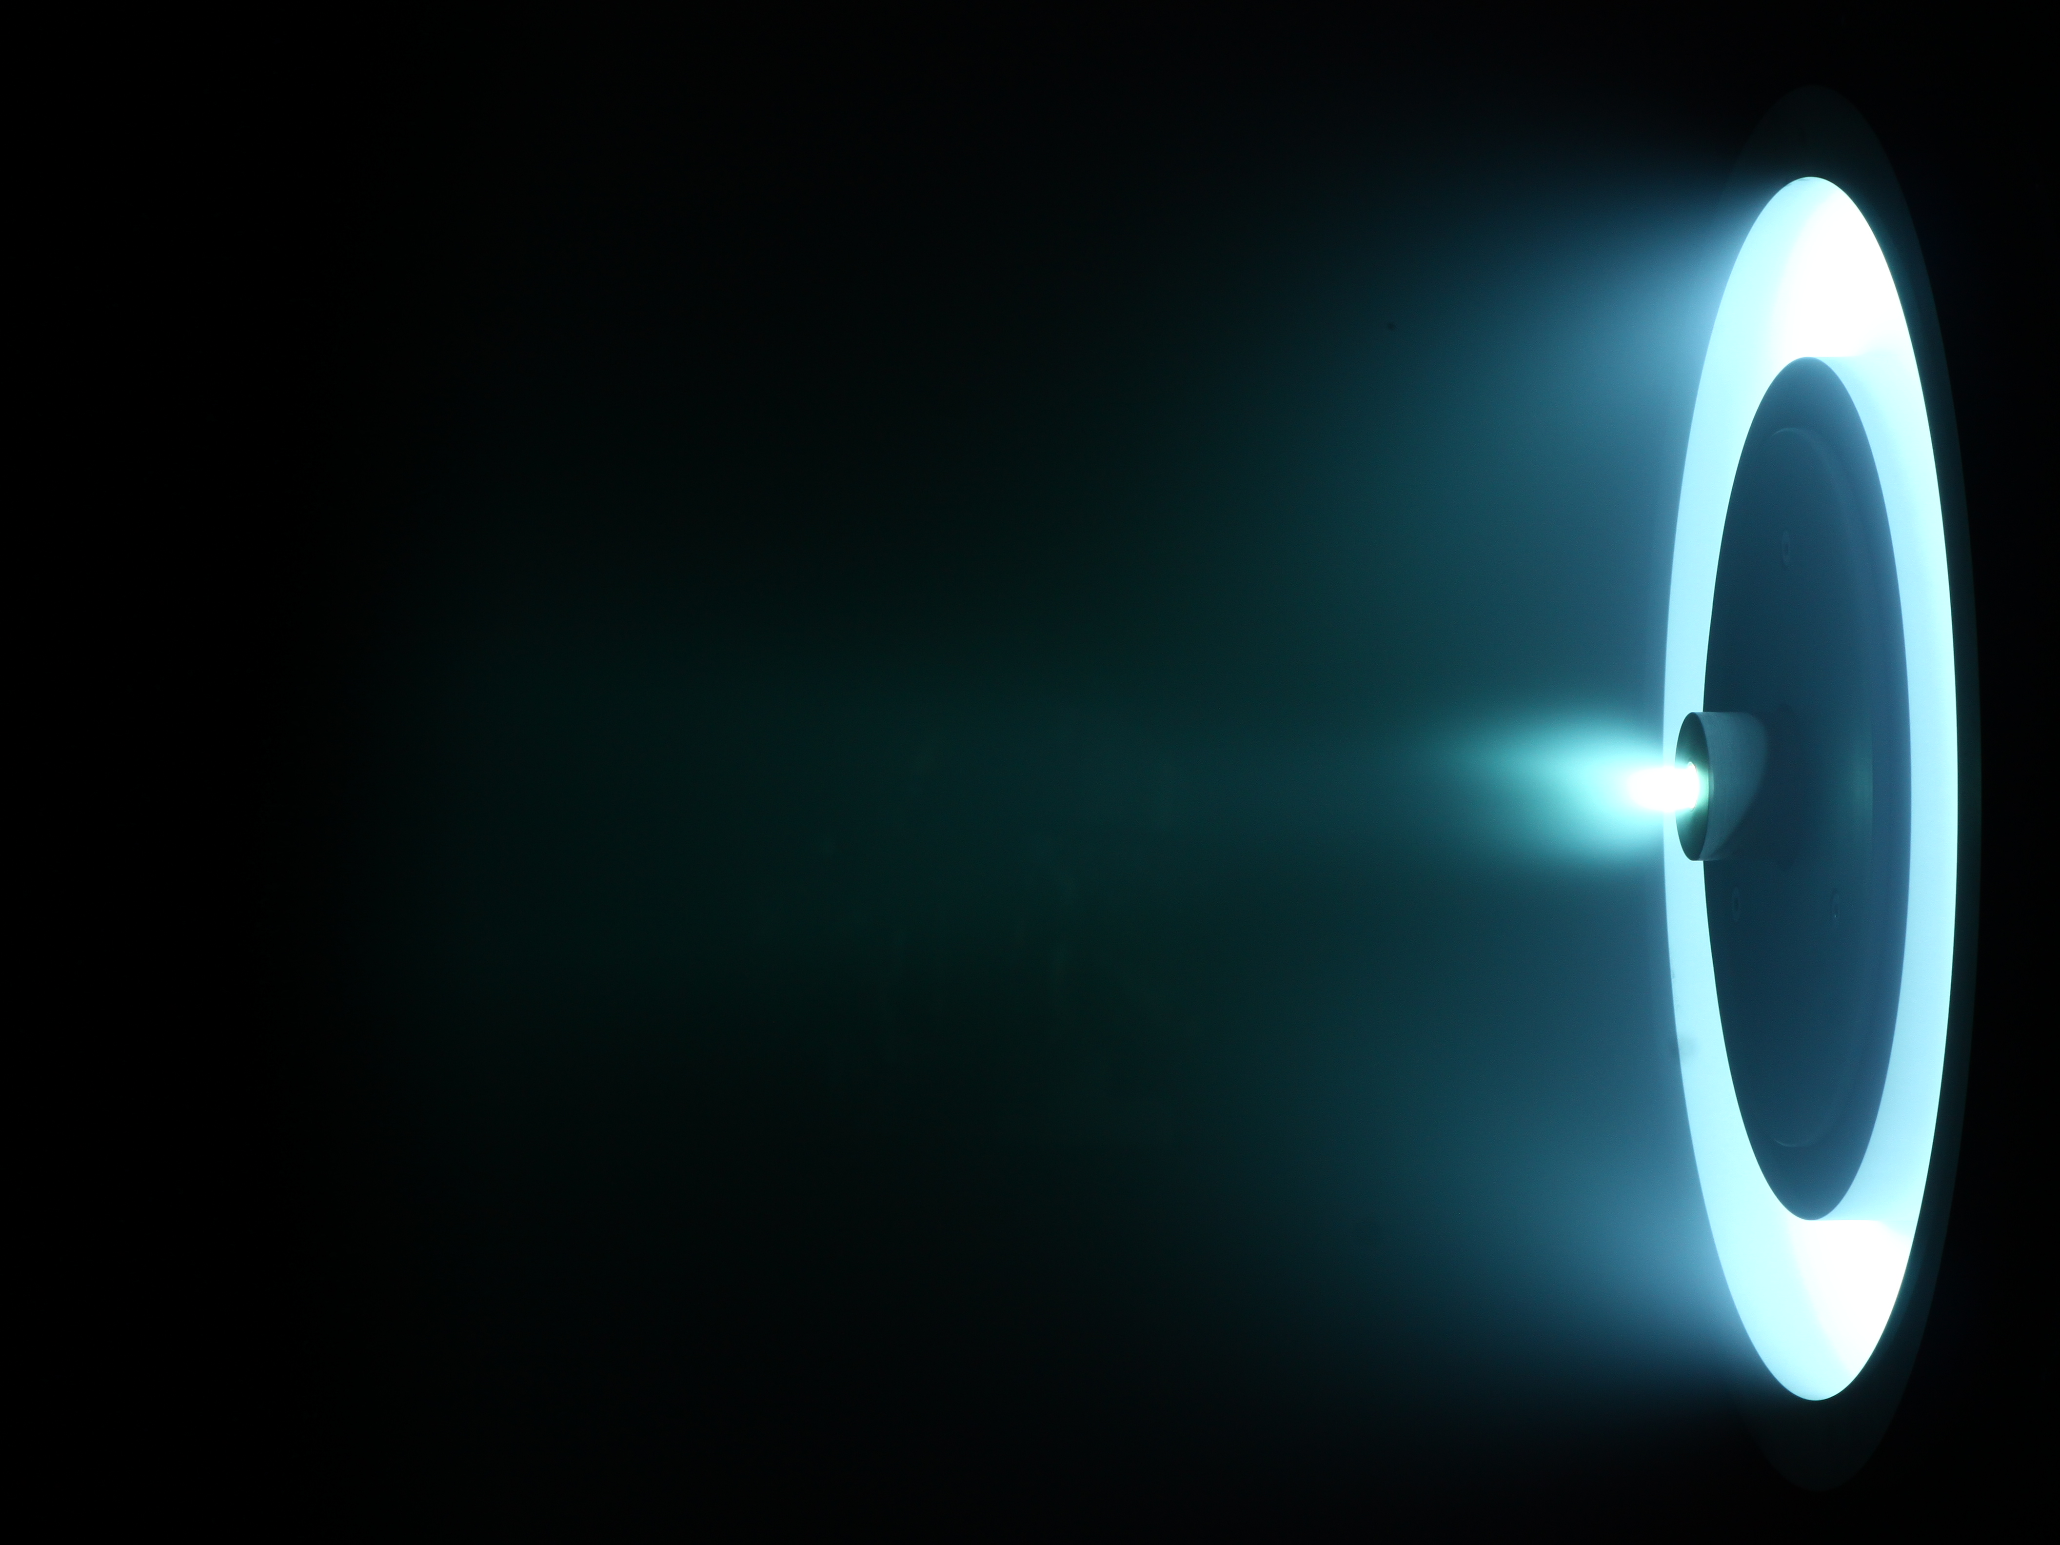
Electric Thrusters work by ionizing and accelerating a propellant by means of electromagnetic forces. The energy imparted to the propellant is not obtained through a combustion process and a much higher
exhaust velocity (specific impulse) can be attained.
Electric Thrusters work by ionizing and accelerating a propellant by means of electromagnetic forces. The energy imparted to the propellant is not obtained through a combustion process and a much higher
exhaust velocity (specific impulse) can be attained.
Electric Propulsion, WHY ?
Potential Benefits:
Electric Propulsion is an enabling technology for space exploration and exploitation (NEO missions, Cislunar SS, ISRU, Moon Base, etc…)
Destination: NEO
Starting from: LEO
Mission ΔV (one way): 7.5 km/s
S/C initial mass: 10 t
Propellant mass:
- Chemical Propulsion (Isp 300) → 9.2 t
- Electric Propulsion (Isp 3000) → 2.2 t
→ + 7 tons of payload
Main Challenges:
Power Generation
Thruster Clustering
Propellant Choice
Development Status and Way Forward:
SITAEL is now in the process of extensively testing a 20kW Hall Effect thruster using Xe and Kr as propellant.
Future developments:
Raise the power bar
Study alternative propellants for In-situ refuelling
Workshop on “Commercialisation and Utilisation of Space Exploration Technologies”
Turin, 15-16 March 2018

