Slide 1
Space Rider
MASSOBRIO, Federico
Advance Exploration Programs, Thales Alenia Space in Italy
Category A – Direct Commercialisation of Exploration Outcomes
Workshop on “Commercialisation and Utilisation of Space Exploration Technologies”
Turin, 15-16 March 2018

Slide 2
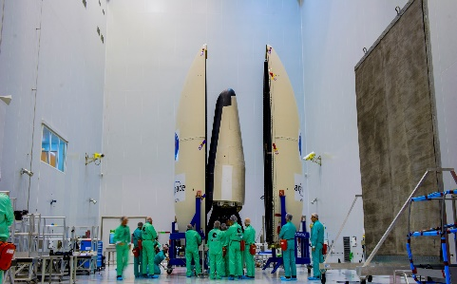
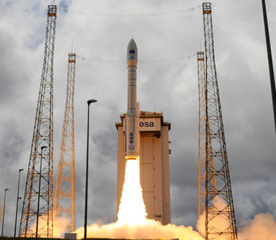
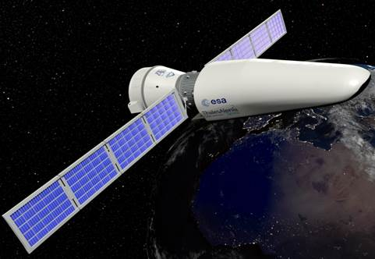
Category A – Direct Commercialisation of Exploration Outcomes
Define and develop an affordable reusable European space transportation system able to perform in-orbit operations, experimentation and demonstration of technologies for application missions, de-orbit, return from orbit and precision land on ground for re-flights, addressing progressive technological challenges with limited risks and minimal financial efforts for Europe.
Provide Europe with an autonomous system to be launched with VEGA-C that can guarantee not only routinely access to space but also return from space, allowing the implementation of several application scenarios.
Maximize competitiveness through the use of the cheapest European launcher solution and system reusability with limited refurbishment costs.
Capitalize to a maximum extent European investment in VEGA and IXV projects, exploiting technological commonalities and lesson learned.
Workshop on “Commercialisation and Utilisation of Space Exploration Technologies”
Turin, 15-16 March 2018

Slide 3
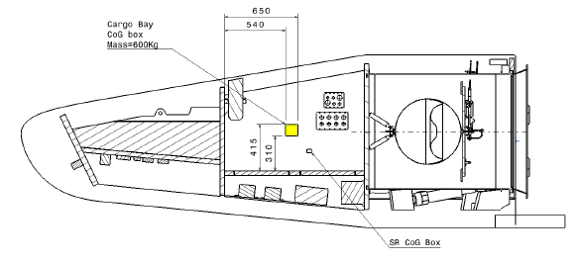
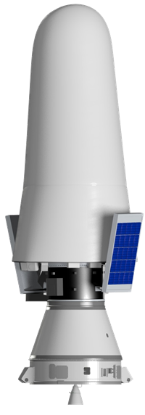
Category A – Direct Commercialisation of Exploration Outcomes
Space Rider Requirements
Payload Classes | Microgravity, IOD, Surveillance and Satellites inspection
Mass (kg) | >45 Up to 600 kg (target 800 kg)
Volume (dm3) | Up to 1.2 m³
Power (W) | Up to 450 W (TBC)
Voltage (V) | 72V and 28V
Other Avionics i/f | PPS, MILBUS 1553, RS 422 UART, Ethernet, HPC Signals, I/O signal, …
Data Rate | At least 1 Mbps (up to 4 Mbps, TBC)
Real Time video Link | Yes (limited to max downlink data rate)
Visibility | Yes (constrained by vehicle trajectory and available ground stations)
Environment | Cargo Bay controlled between: -30 : +30 °C (TBC) with stability of TBD °C Unpressurized environment
Mechanical | Mechanical latches to secure P/L Accelerations: 10E-6 g in orbit, 3 g (TBC) for re-entry
Pointing (deg) | 0,05 deg (TBC)
Field Of View (deg) | 0 - 180 deg
Operational needs | Early retrieval of payloads, exploitable soon after ground landing.
P/L needs
(environment, interfaces, mass, volume, operations, etc.)
Workshop on “Commercialisation and Utilisation of Space Exploration Technologies”
Turin, 15-16 March 2018

Slide 4
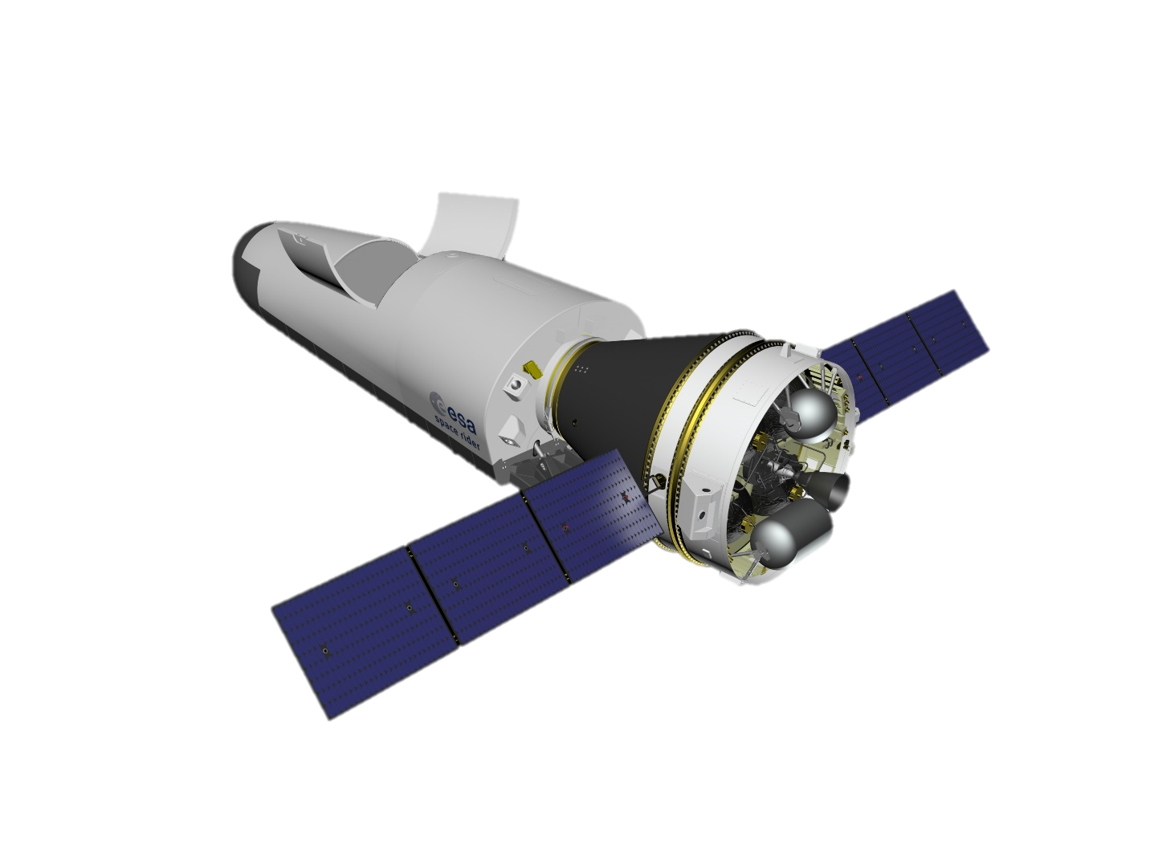
Category A – Direct Commercialisation of Exploration Outcomes
Reusable European space transportation system from launch to landing & safe recovery
Safety to be mastered during all mission phases incl. probabilistic risk assessment
Mission and system design driven by end user’s needs and payload applications
Optimal microgravity environment in free flyer scenario
Low Deceleration profile during Re-Entry and landing for experiments survivability
Early retrieval of payloads, exploitable soon after ground landing (landing site potentially equipped with laboratory)
Flexibility of the platform in terms of payload capability and mission scenarios.
Workshop on “Commercialisation and Utilisation of Space Exploration Technologies”
Turin, 15-16 March 2018

