Slide 1
Flexible Interconnect Technology « F.I.T. » Robin Lemsom Sales Manager Thales NL GCC-PCB

Slide 2
Category B – Indirect Exploitation of Exploration results in other sectors
Save weight and area space with thin Flexible Printed Circuits.
Advantages:
Potential of 60% - 70% of space and weight saving.
Lower assembly time & costs
Eliminate wiring errors
Ease of production repeatability
Easier design change
Improve heat dissipitation
Allows for unique designs
Huge effect on end product!
Rollable solar panels
Close following structure contour.
Proud team next to a 10 meter long flex PCB for antenna.

Slide 3
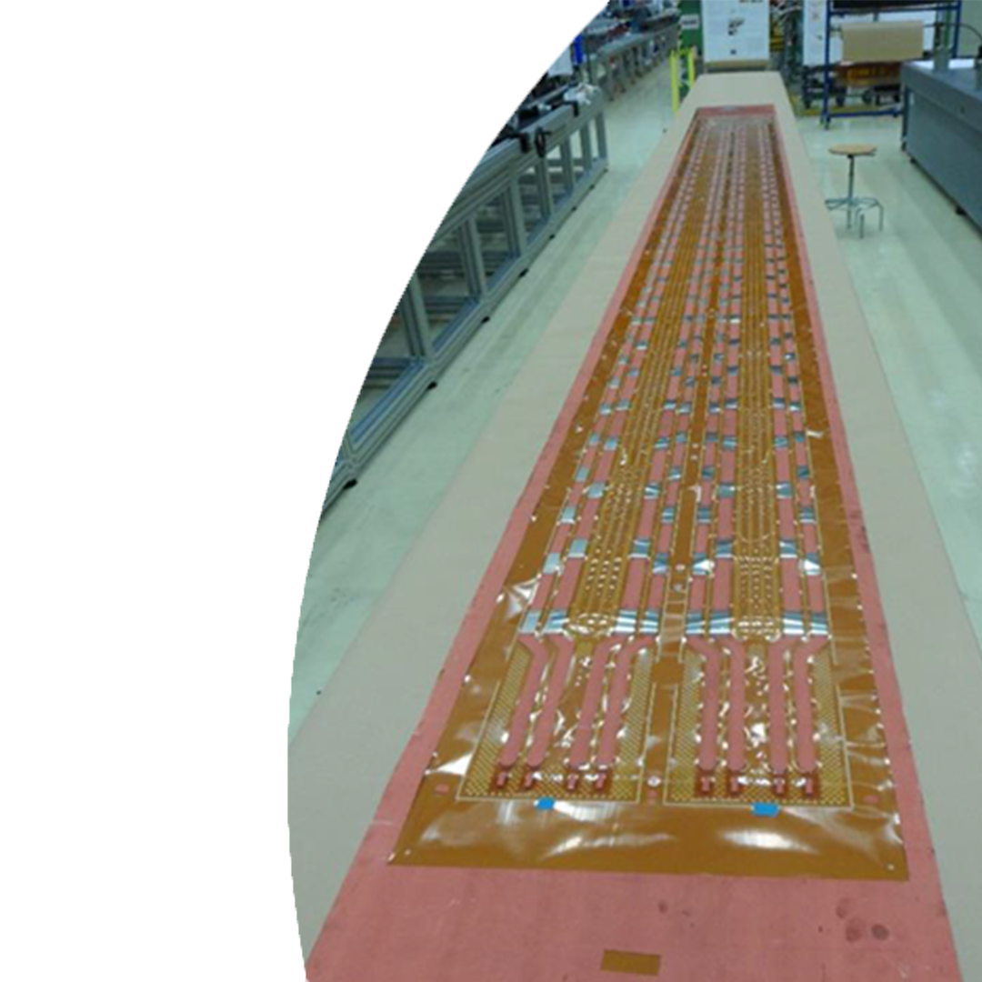
Current state of Art
Single layer / dual layer:
Max width: 24 inches (610mm)
Max length: 10 meters
Design possibilities:
Unique design over the entire stretch of 10 meters.
Copper thickness < 70µm
Material
Polyimide copper clad (Kapton)
Others (LCP, PEEK)
Thick copper

Slide 4
Targeted Markets
Space
Airbus, OHB, Thales Alenia SPace
Aerospace
Electric mobility Road / Air
Future public benefits in the cost effective manufacturing of electric vehicles.
Any application/ design where space and weight is a large cost driver. Looking at the total cost of ownership.

Slide 5
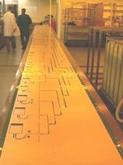
Current status:
In Space & Aerospace the long flex printed circuit is on the OEM technology roadmaps.
ESA
promotes the research for alternatives for cable harness through printed ciruits via ARTES:
Thales:
Design and development with OEM for cable/ wiring application.
Looking for additional projects to further develop and approve the technolohy for space applications.

Slide 6
Contact information
Thales GCC-PCB:
Your partner for innovative projects on core and complex PCB’s.
Engineering: Bas van Zalk
Bas.vanzalk@nl.thalesgroup.com
Sales : Robin Lemsom:+31 653 208 745
Robin.lemsom@nl.thalesgroup.com
General: sales-gccpcb@nl.thalesgroup.com

