Slide 1
Panel: Commercial Paradigm in Space Exploration
Alberto Accogli
Leoni Corporate Advisors (LCA)
Workshop on “Commercialization and Utilization of Space Exploration Technologies”
Turin, 15-16 March 2018

Slide 2
LCA in brief
Leoni Corporate Advisors (LCA) is global strategy advisory company with a consolidated footprint, specialized by region, industry and topic.
LCA has more than 15 years of experience and a successful track record in the Aerospace, Defense & Transportation
Workshop on “Commercialization and Utilization of Space Exploration Technologies”
Turin, 15-16 March 2018

Slide 3
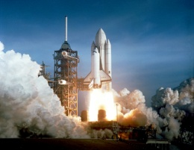
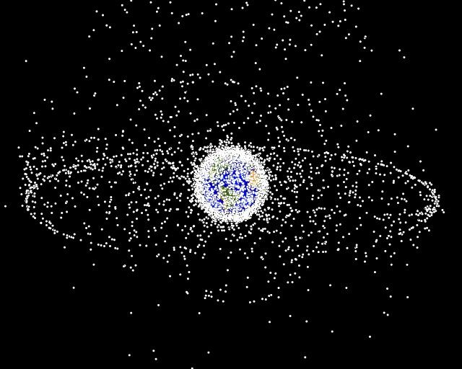
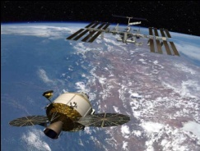
LCA Global Space Market Observatory
Considering the fast market evolution, LCA runs a Global Space Market Observatory to gather valuable strategic insight and always be up to date with current market trends and dynamics
LCA Global Space Market Observatory
Space
Transportation
Satellites & Services
Space Tourism
Space Exploitation
Space Exploration
Workshop on “Commercialization and Utilization of Space Exploration Technologies”
Turin, 15-16 March 2018

Slide 4
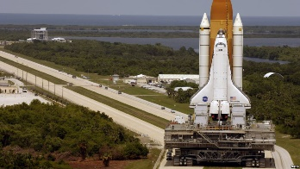
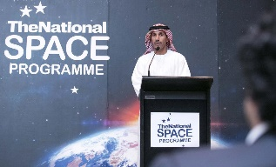
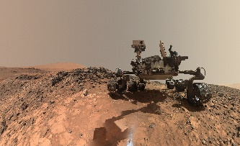
New Space represents a development enabler for Space Agencies as well as a business opportunity for Private Companies
Old Space
New Space
Mainly institutional players and missions, with Industry based on public budget
Consistent private investments and public-private partnerships (PPP, …), with sizeable socio-economic externalities
Direct investment of
Few Space Fairing countries
Newcomers entering the Space Industry, leveraging on private ventures and commercial applications
Heavily funded projects with longer
development and focus on technology maturity
Accelerated Time to Market with focus on economic sustainability
Countries with Space Programs 2005-2025
Private Investments in Space Ventures* 2007-2017 (B$)
60
80
x25
2,5 B$
Private Investment in Space Ventures over last 10 years
30
2005
2015
2025
“Old Space coasts on the glory of the Apollo era and isn’t entirely sure what to do next. [...] New Space is the opposite of all that. It’s wild. It’s commercial, bootstrapping, imaginative”
0,1 B$
Workshop on “Commercialization and Utilization of Space Exploration Technologies”
Turin, 15-16 March 2018
Sources: Euroconsult, ”Start-Up Space 2018”, Bryce

Slide 5
Private players are developing commercial applications opening an untapped service market thus reducing space utilization costs
Markets
Activities
Time to Market
Projected Revenues
Private Players*
ESTABLISHED
COMMECIAL EO
Crop fields management
Weather forecasts
Big Data / Advanced Analytics
2017
5 B$
2026
COMMERCIAL TELCO
Worldwide broadband coverage
2020
15 B$
2020
EMERGING
IN-ORBIT SERVICES
In-orbit Refuelling
In-orbit Servicing
In-orbit Repairing
2021
80 B$
2022
SPACE
MINING
Asteroid and Lunar Mining
Space-based Energy Generation
2035
3.000 B$
2050
* Players’ list per area of application not exhaustive
Workshop on “Commercialization and Utilization of Space Exploration Technologies”
Turin, 15-16 March 2018
Sources: Crunchbase, Spacenews, Euroconsult, Quartz, Fortune, NSR, Globe News Wire

Slide 6
Agencies will maintain a key role in New Space markets, acting as market enablers, development partners and customers
Services
Customers Clusters
Agencies’ Role
EMERGING
ON ORBIT SERVICES
Commercial Satellite Operators (refueling, repairing, station keeping, …)
Government Space Agencies (ADR, …)
Agencies Commercial Support: acting as “anchor tenant” with ADR missions, enabling the development of commercial OOS market
IN SITU RESOURCED UTILIZATION AND SPACE MINING
Traditional Commodity Traders
Commercial In-Space Manufacturers
Commercial and Institutional Space Settlements Operators
Agencies leveraging on current infrastructure (e.g. ISS) and acting as commercial customers for space miners
Agencies co-investing for the development of future space infrastructure: Private-Public Partnership schemes to deploy new settlements (e.g. Cislunar Outpost)
Workshop on “Commercialization and Utilization of Space Exploration Technologies”
Turin, 15-16 March 2018

Slide 7
Increasing maturity of investors in Space Companies signals increasing confidence in the market and higher potential ROI
Investment in Start-up Space by investment type, 2000-2017* (USD millions)
2000-2005
2012-2017
Total Investment: 1.110,9 USDM
Total Investment: 10.238,3 USDM
Seed/Prize/Grants
Venture Capital
Private Equity
Acquisitions
Public Offering
Workshop on “Commercialization and Utilization of Space Exploration Technologies”
Turin, 15-16 March 2018
Sources: Euroconsult, ”Start-Up Space 2018”, Bryce; *excluding debt financing

Slide 8
The space industry is currently going through a change of paradigm…
New Space is characterized by private investments, spurring technological improvement on emerging applications (e.g. In-Orbit Services, In-Situ Resources exploitation, etc.)
Private investments act as “market makers”, opening the Space Economy to new players and generating socio-economic benefits for countries and communities involved
Private players are not able to generate long term sustainable development without institutional support, which maintain a crucial role in merging institutional initiatives and funding with private endeavors
Private and public cooperation to enable «new space» economy
Co-existence of Direct investment and Commercial acquisition of services (Increased presence of PPP to open specific commercial market)
Government as enable, facilitator and final customer of new space players
(Agencies acting as anchor tenant and focusing on long term goals)
Focus on applications delivering economic and social benefits to society
Workshop on “Commercialization and Utilization of Space Exploration Technologies”
Turin, 15-16 March 2018

