Slide 1
Utilisation and Commercialisation of SpacePharma’s remotely controlled miniaturized laboratory for the Life Sciences Industry
Dr. Paul KAMOUN
Director, Business Development
SPACEPHARMA SA
Courgenay, Switzerland
Category A – Direct Commercialisation of Exploration Outcomes
Workshop on “Commercialisation and Utilisation of Space Exploration Technologies”
Turin, 15-16 March 2018

Slide 2
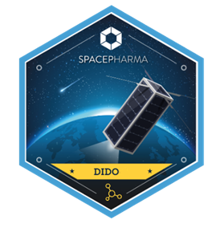
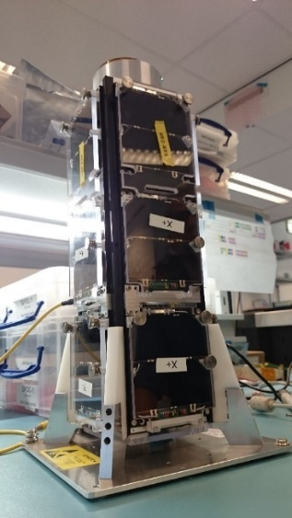
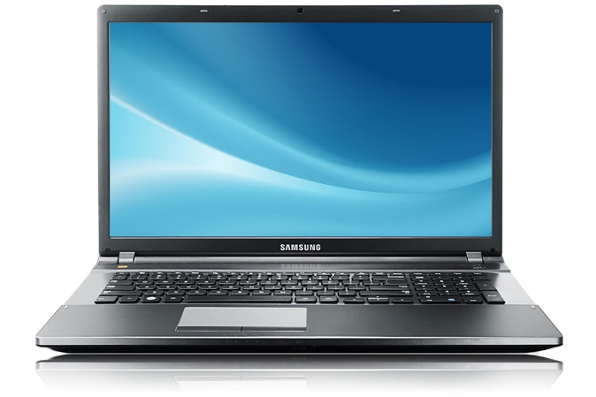
BUSINESS OPPORTUNITY: the Life-related Sciences and Industry market (pharmaceutical, cosmetics, biotechnology, materials, food, etc) needs a low-cost, bureaucracy-free and easily accessible platform to perform complex experiments and manufacturing in microgravity environments. Today there are very limited, often expensive solutions.
SPACEPHARMA’s SOLUTION: innovative miniaturized remotely controlled microfluidics chemistry/biology laboratory on nano-satellites and space station payload to perform R&D, manufacturing, shorten time-to-market and cut costs for innovative life science applications.
Low cost one-stop-shop end-to-end turnkey solution including:
a facility in orbit (research, development, production)
an operated ground station for remotely controlling the laboratory from earth,
a customer front-end allowing customers to monitor development, modify
experiment procedures and receive experimental data from their location.
return to Earth if needed
ADDED VALUE FOR REGIONAL DEVELOPMENT: SpacePharma’s laboratory is available for regions to boost their development through projects with their academy, national laboratories and industry.

