Slide 1
Panel: Commercial Paradigm in Space Exploration
Jeffrey Manber
CEO, NanoRacks
Workshop on “Commercialisation and Utilisation of Space Exploration Technologies”
Turin, 15-16 March 2018

Slide 2
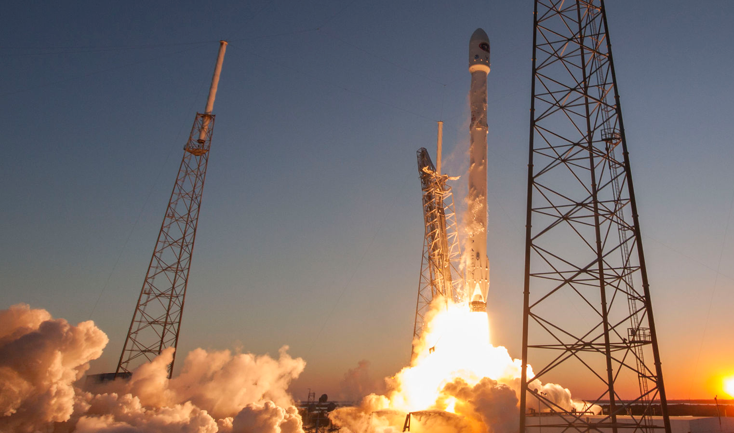
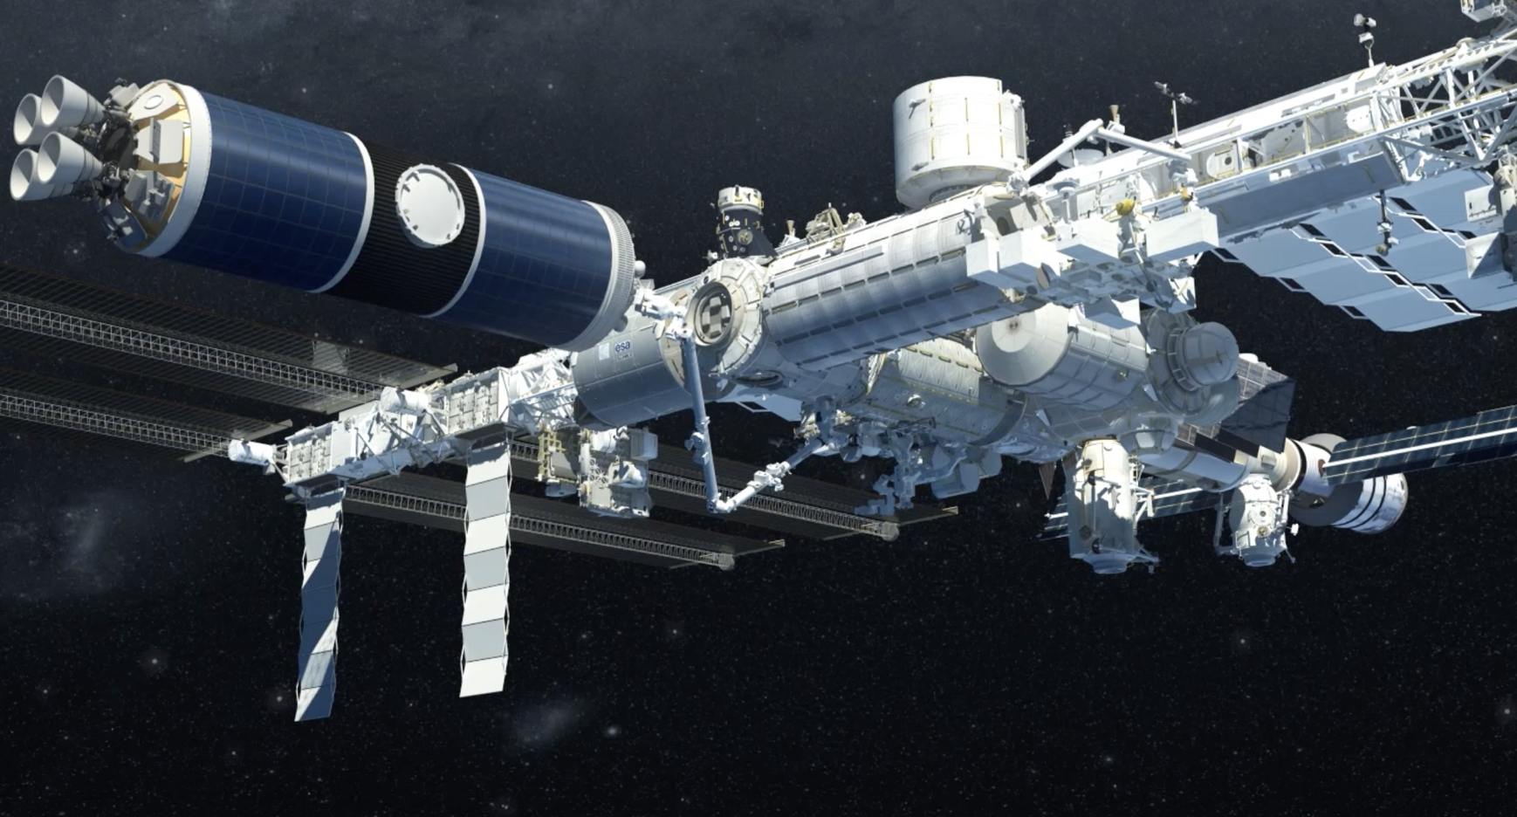
NanoRacks is the first commercial space station company with customers.
NanoRacks has achieved this market leadership on no more than $5M of investor capital.
XO Markets Proprietary and Confidential.
Workshop on “Commercialization and Utilization of Space Exploration Technologies”
Turin, 15-16 March 2018

Slide 3
Workshop on “Commercialization and Utilization of Space Exploration Technologies”
Turin, 15-16 March 2018

Slide 4
Workshop on “Commercialization and Utilization of Space Exploration Technologies”
Turin, 15-16 March 2018

Slide 5
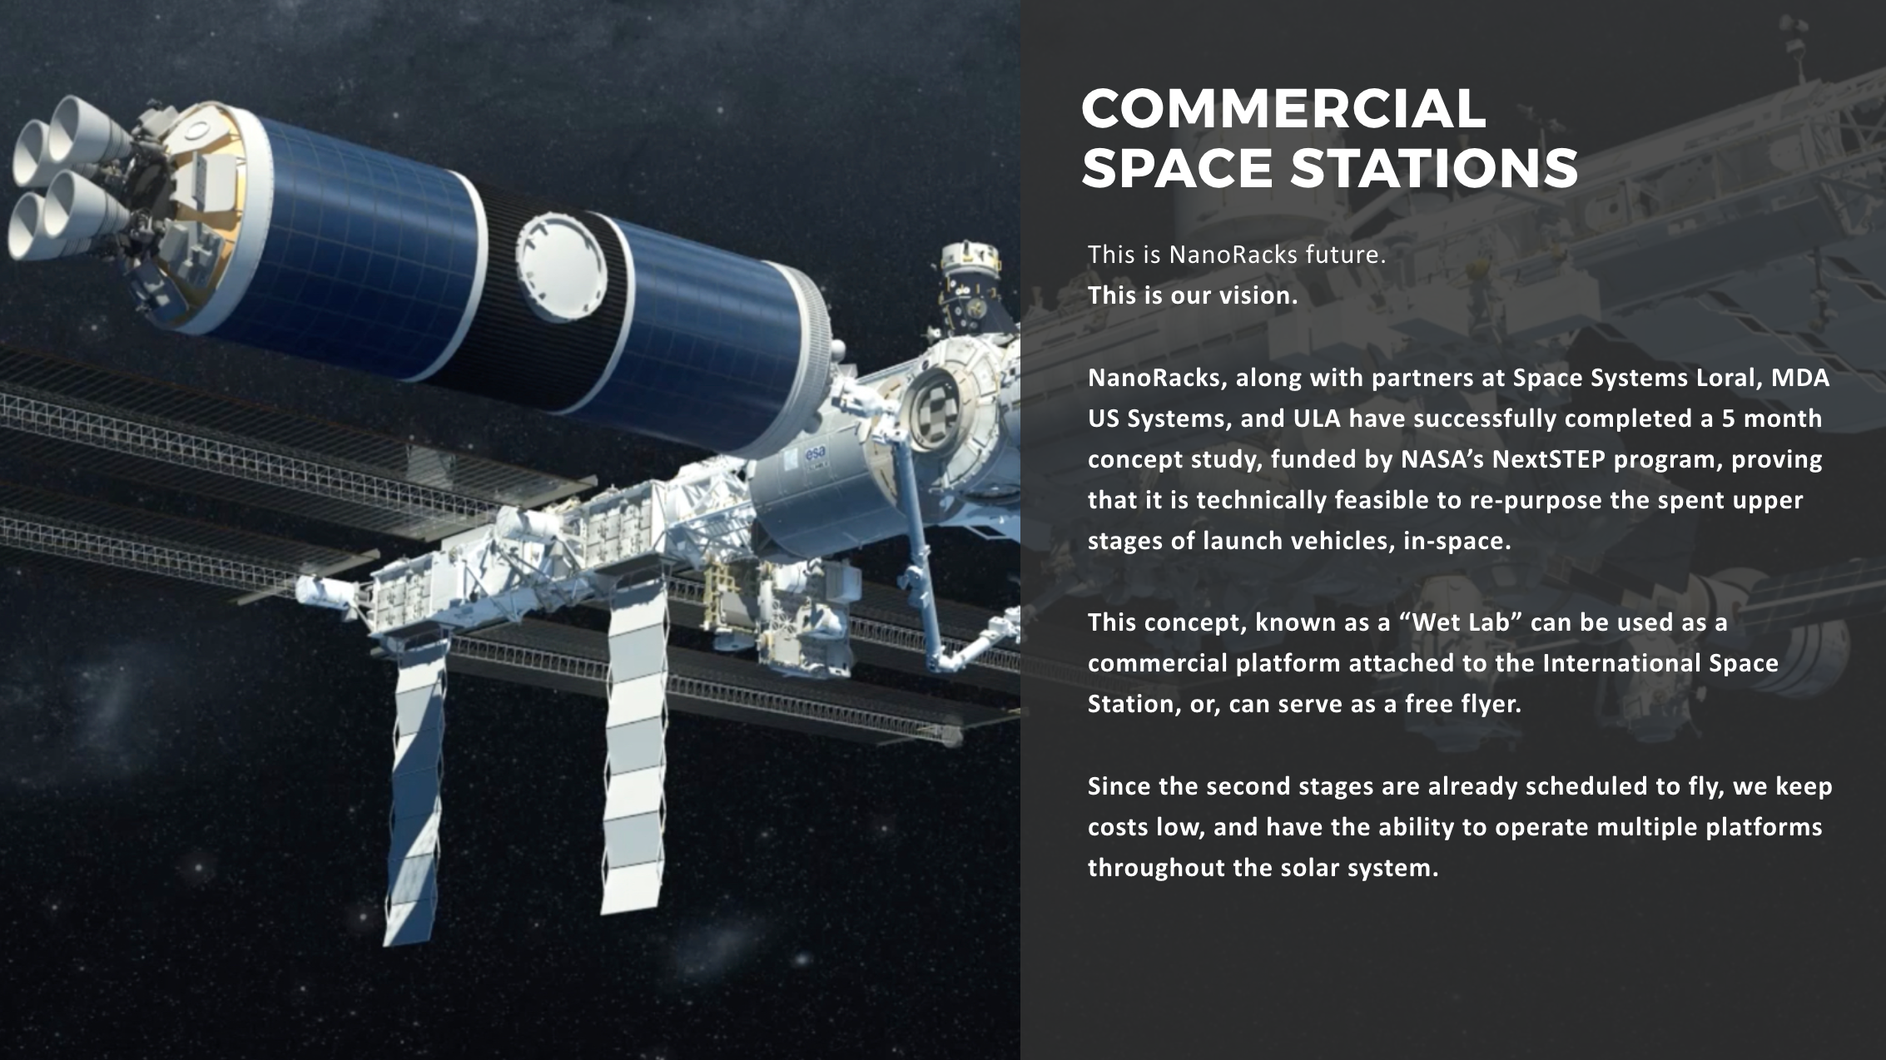
Workshop on “Commercialization and Utilization of Space Exploration Technologies”
Turin, 15-16 March 2018

