Slide 1
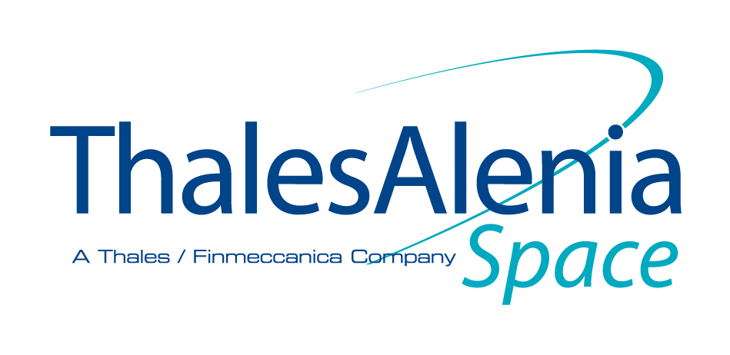
«BIOWYSE»
Vincenzo Guarnieri
Physicist, Thales Alenia Space Italia SpA
Category B – Indirect Exploitation of Exploration results in other sectors
Workshop on “Commercialisation and Utilisation of Space Exploration Technologies”
Turin, 15-16 March 2018

Slide 2
Category B – Indirect Exploitation of Exploration results in other sectors
Issue: need for reliable, rapid, significant and safe methods for preventing, monitoring and controlling biocontamination risk in water loops and humid areas in manned Space habitats
Solution: automated integrated portable prototype manufacturing and tests in laboratory and on the field, and design for a flight demo for testing gravity-dependent technologies in Spacecraft
Customer base: several manned space programs, and commercial applications in public and private sectors (Food, Pharma and Cosmetic industries, confined habitats, hospitals, greenhouses, tourism, and water systems)
Development status: All support equipment in TAS. Key modules quite ready. Tests at module level quite complete. System TRR planned 3-4 May
Benefits for citizens: Water is the most important resource of everyday life. Its biocontrol is crucial, also when special conditions happen (e.g.: epidemics, catastrophes, isolation)
Workshop on “Commercialisation and Utilisation of Space Exploration Technologies”
Turin, 15-16 March 2018

Slide 3
Category B – Indirect Exploitation of Exploration results in other sectors
Workshop on “Commercialisation and Utilisation of Space Exploration Technologies”
Turin, 15-16 March 2018

