Slide 1
The Greek Space Technologies
and Applications Cluster
Dr. Jorge-A. Sanchez-P.
si-Cluster Steering Board Member & Corallia CFSO

Slide 2
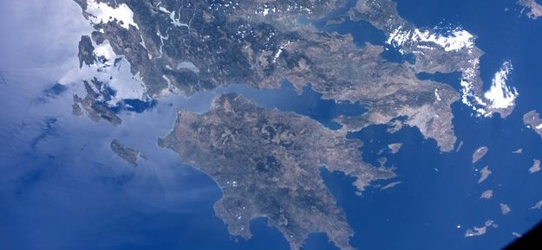
Our Vision
To create a world class cluster on space technologies and applications

Slide 3
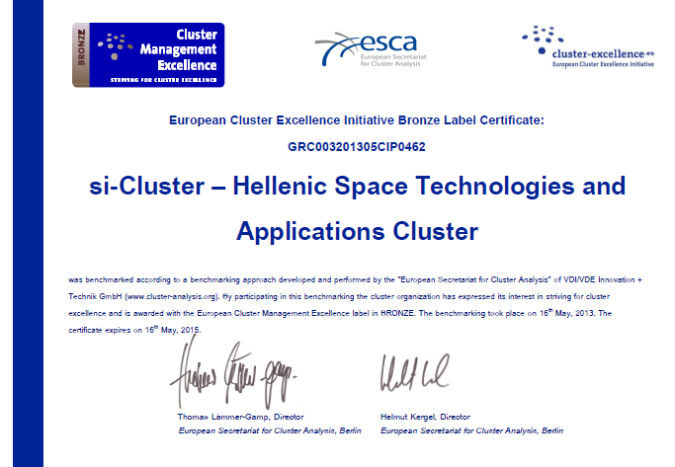
Achieving our Vision: Bronze Label
European Cluster Excellence Initiative

Slide 4
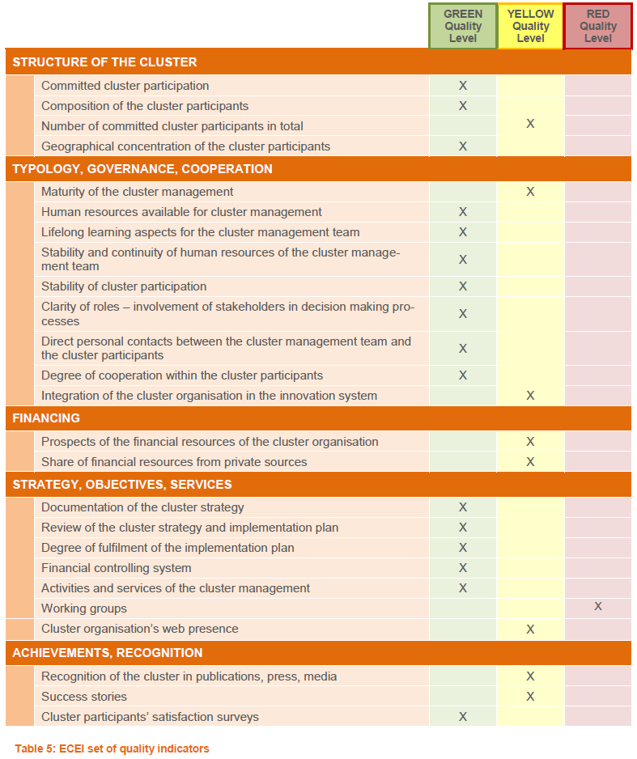
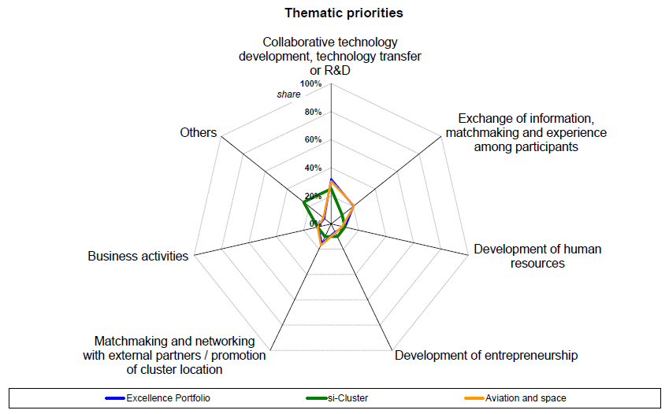
Achieving our Vision: Bronze Label

Slide 5
Our Mission
To place Greece amid the countries which currently develop cutting-edge space technologies and applications with a high international visibility, capable of developing and attracting high impact research, development and innovation and business activities

Slide 6
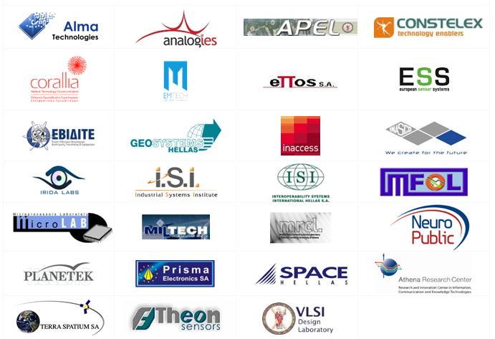
Our Members & Partners
27 Members, over 15 new applications

Slide 7
Thematic Focus
Microelectronics for Space
Earth Observation Applications
Materials and structures for Space
Low-Density Parity-Check Convolutional Codes for Satellite and Terrestrial Standards
Space-qualified optical fiber amplifiers
Laser sub-assembly, silicon photonic components
Science and Earth Observation magnetic cleanliness control based on magnetic dipole models
Conservative Parallel Discrete Event Simulator engine in Simsat
Linux & Multi Core Processor Technology for Simulators
Satellite Integrated Facility Management and Radio over IP Gateway
Structures of Nano-modified multifunctional pre-preg materials for near term space applications
Multifunctional layers for safer aircraft composite structures
New techniques for the Posidonia Oceanica mapping
Naval Traffic Statistics for Security
Resolution Satellite Imagery for Floodplain Mapping
Very high resolution DAC for space applications
Multi-functional Thin Film Coatings based on Nano-Structured Metallic Glasses and Composites
MEMS-SOI capacitive accelerometer with radiation hardened read out electronics
Flight Demonstrator for a MEMS Accelerometer for Launchers
Certified Code Generator for Space Applications Using ASN.1,
GNSSProbe for Creating Digital Maps of a High Accuracy and High Integrity
Satellite Aided Integrated Sea Border Security

Slide 8
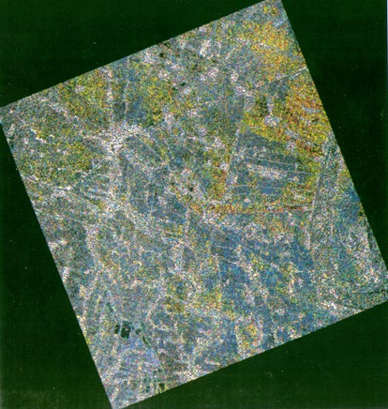
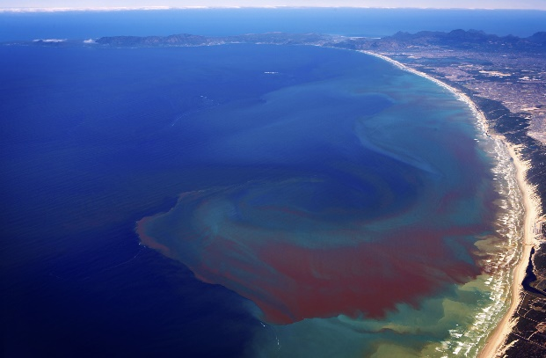
Collaborative Project ACRITAS
Space Technologies for Surveillance and Monitoring Integrated Applications

Slide 9
Collaborative Project ACRITAS
Development and validation of space-based integrated applications for surveillance and monitoring
Border Security
Critical Energy Infrastructure Monitoring
Coastal Environmental Monitoring
Agricultural Monitoring

Slide 10
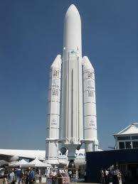
Collaborative Project MENELAOS
Inertial Measurement Unit (IMU) – Designed in Greece
THEON SENSORS
PRISMA
ANALOGIES
IRIDA LABS
EPOS
ESS
ISI
MICROLAB/NTUA
ISI/RC ATHENA
APEL/UPATRAS

Slide 11
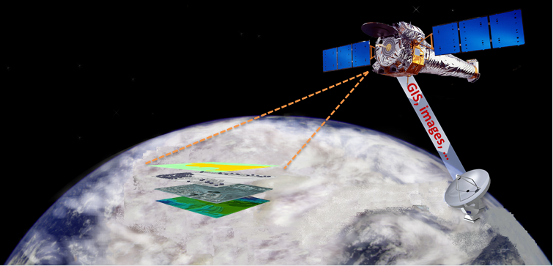
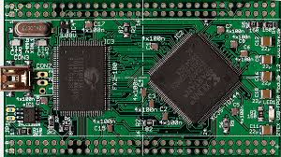
Collaborative Project CIDCIP
Image Data Compression Intellectual Property

Slide 12
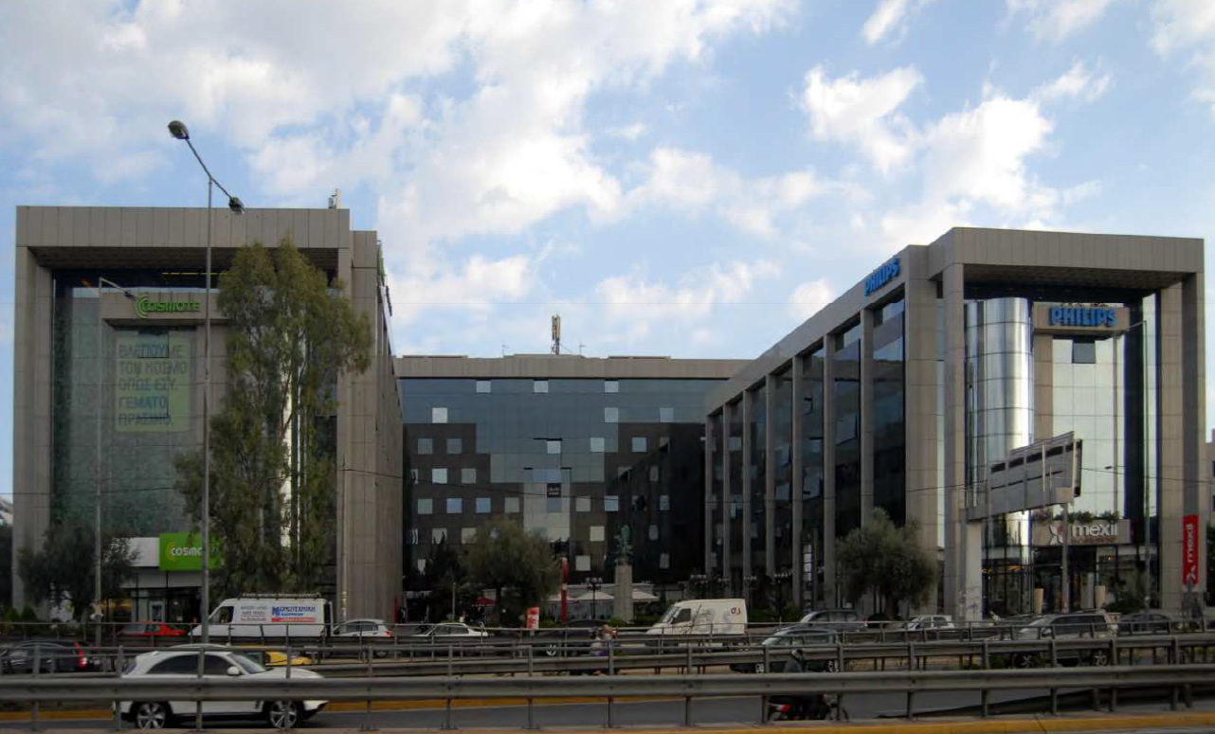
α2•InnoHub Athens Monumental Plaza

Slide 13
α2•InnoHub Athens Monumental Plaza
si-Cluster members relocation on the premises
Fully equipped business center
Deployment of the si-Cluster Business Area
Space R&D laboratory
Creation of the si-LAB for product – services development & R&D projects
Business Incubation Area
Incubation services for EMTECH, INASCO, PLANETEK, TERRA
Exhibition Area
Creation of a high-tech Exhibition Area

Slide 14
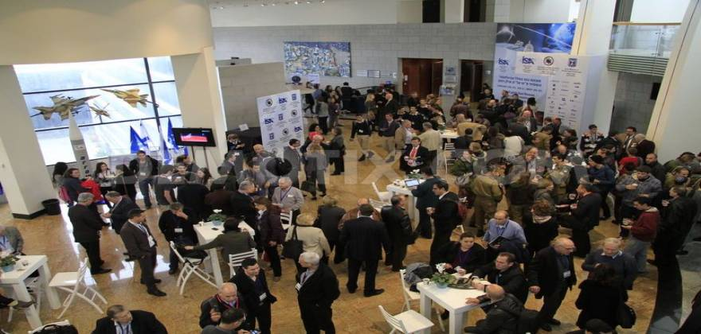
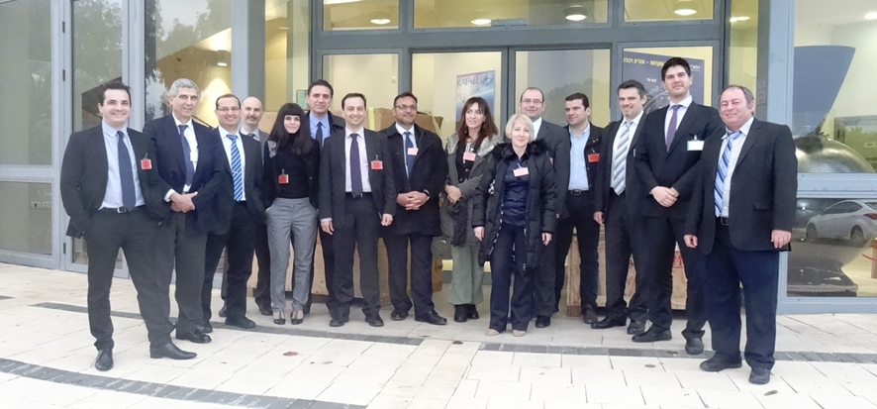
Roadshows China, Israel

Slide 15
Key Performance Indicators
No. | Indicators | 2-years' target | 5-years' target
1 | Number of committed cluster members | +59% | +127%
2 | Number of committed cluster members (SMEs) | +22% | +78%
3 | Number of committed cluster members (university labs and research institutes and units) | +233% | +300%
4 | Total turnover of cluster members (enterprises) | +13% | +19%
5 | Total exports of cluster members (enterprises) | +39% | +106%
6 | Total investments from private investors in cluster members (enterprises) | +12% | +30%
7 | % of R&D investments by cluster members as a share of total turnover | +67% | +167%
8 | Total number of patent applications filed by cluster members | +75% | +180%
9 | Total number of quality certifications of cluster members | +48% | +81%
10 | Total number of employees in cluster members (enterprises) | +10% | +26%
11 | % of postgraduate or PhD degree holders in the cluster members (enterprises) | +3% | +9%

Slide 16
si-Cluster | COPERNICUS
THANK YOU!
Follow us on www.si-cluster.gr

