Slide 1
Azorean Strategy for Space Projects
SPACE4REGIONS: Satellite solutions as a driver for innovation and growth
Networking Session, Copernicus - Sentinels Serving Society and the Environment
12-13 May 2014, EUGENIDES Foundation, Athens, Greece
Marlene Antunes - Azores Region
Governo Regional dos Açores

Slide 2
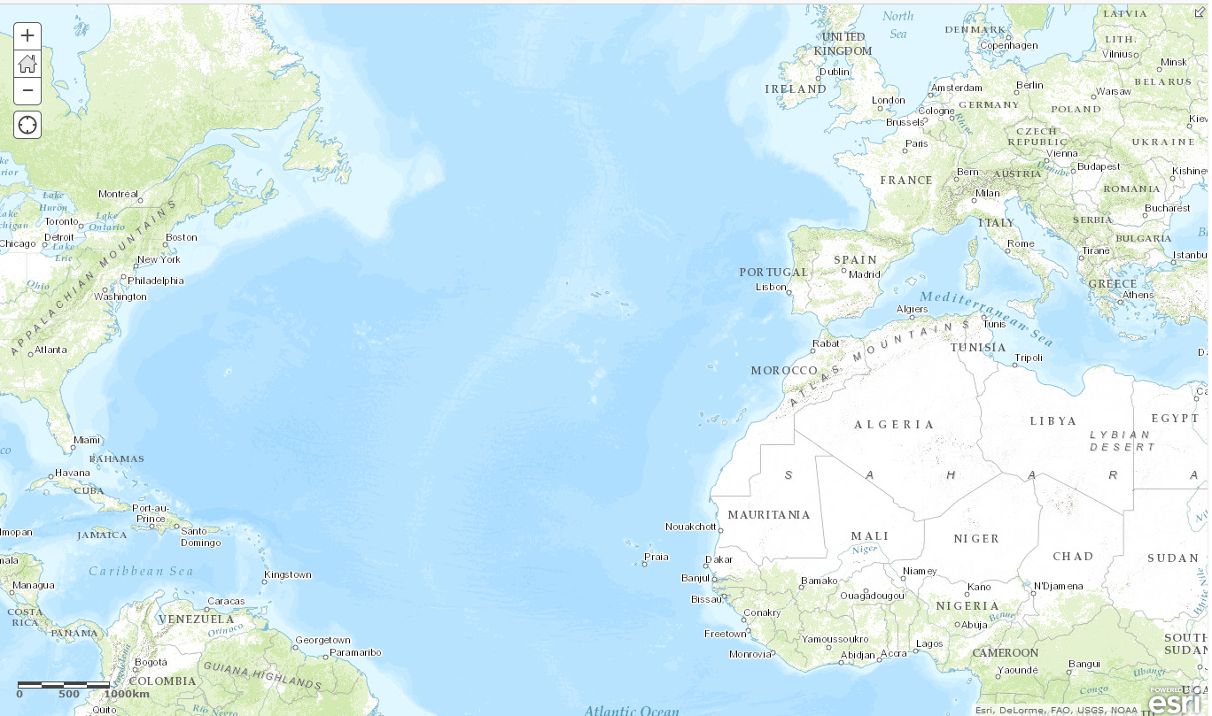
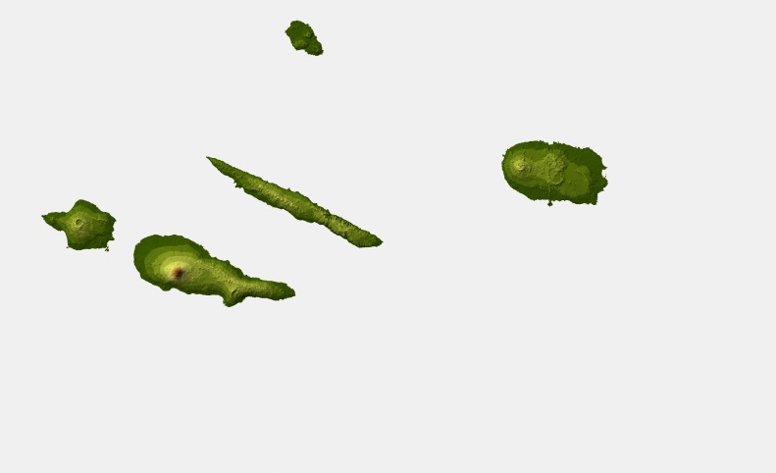
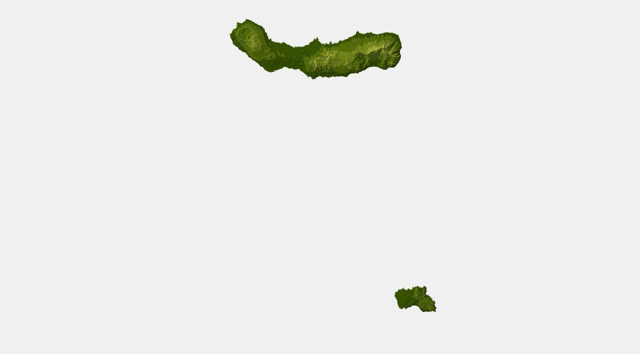
The Azores
Corvo
≈ 600 km
Flores
Graciosa
Terceira
Faial
S. Jorge
S. Miguel
Pico
Population: Aprox. 250 000
S. Maria

Slide 3
Azores Transformation
Enhance:
Service levels
Service Quality
Life Quality
Transform Azores in smart community
Technology
Transformation

Slide 4
Digital and Technology Agenda
RAA’s Digital and Technology Agenda
4 Intervention axes
Promote Knowledge and Information Society
Encourage of technology-based formation
Encourage technology transfer
Develop technological infrastructure
10
Programes
29
Measures

Slide 5
S³
Cluster
Agriculture, Livestock, Agroindustry
SUSTENTA
Sea and Fishery
OBSERMAR
Tourism
SMART TOURISM

Slide 6
Projects
ARM
SUPERDARN
REPRAA
GNSS-R
RAEGE
Climate Change
Atmosphere
CLC
Geodesy
Astronomy
Earth Observation

Slide 7
Copernicus
ESA Collaboration in Santa Maria
ESA/SMA Tracking Station
Earth Observation (Edisoft Station): Oil spils detection and alert mechanisms; Vessel detection trough satellite radar
Galileo Sensor Station In Santa Maria Island
CLC Azores
Need of high resolution data from Copernicus to small areas and regions like Azores (or Greece!)
ESA/NEREUS iniciative:“Improving Copernicus take-up among Local and Regional Authorities (LRAs) via dedicated thematic workshops”

Slide 8
Azorean Strategy for Space Projects
Thank you for your attention!
SPACE4REGIONS: Satellite solutions as a driver for innovation and growth
Networking Session, Copernicus - Sentinels Serving Society and the Environment
12-13 May 2014, EUGENIDES Foundation, Athens, Greece
Marlene Antunes - Azores Region
Governo Regional dos Açores

