Slide 1

GMES ROUND TABLE
Alan Wells, University of Leicester, East midlands, UK.
Sonia Nicolau, Azores region, Portugal.
Paola Carrara, CNR-IREA, Lombardia Regione, Italy,
Alain Podaire, Mercator-Ocean, Midi Pyrneees, France.
Volker Schumacher, CEON, Bremen, Germany.
Heuve JeanJean. GMES European Commission.

Slide 2
SCOPE
“25 Uses of GMES in the NEREUS Regions”
Mapping of GMES Assets and capabilities in the regions
DORIS_NET GMES Communication and Information network
Round Table Discussion

Slide 3
25 Uses of GMES in in the
NEREUS Regions
A regionally based consultation undertaken by the
NEREUS EO/GMES Working Group

Slide 4
Objectives for “25 Uses”
Provide reference to a representative sample of the GMES market in the regions.
Promote GMES to regional end users.
Inform “policy shakers and movers” about GMES markets applications.

Slide 5
Case Studies of actual current uses of GMES in the regions.
Wide regional interest to contribute
-34 case studies offered from 17 regions. 25 selected.
Strong motivation to identify regional involvements in GMES
-Wide diversity of applications have been presented.
Operational projects in support of regional priorities.
-Fire and Flood Risk, -Coast, Land and Water Management
Projects driven by EU directives and programmes
Mapping-CORINNE and GMES Urban Atlas
NATURA-biodiversity
Maritime Security
Civil Protection
Applications driven by research priorities.
Climate Change-regional impacts.
Urban Air Quality – Citizens’ Health.

Slide 6
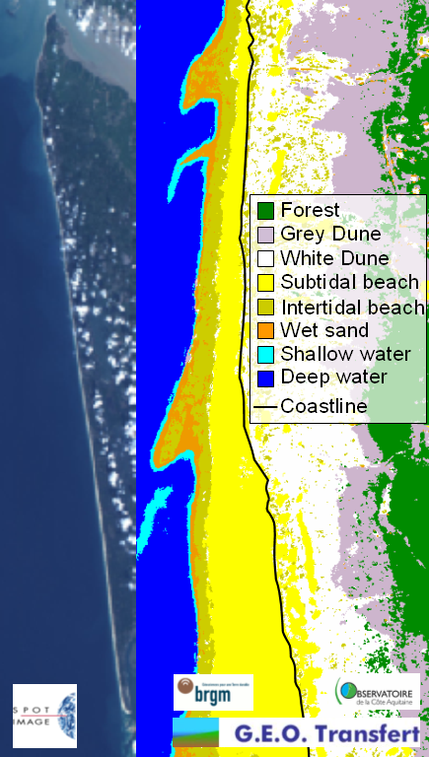
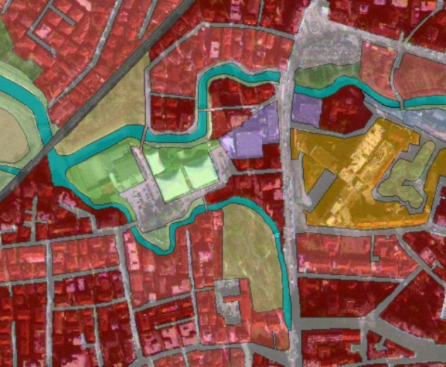
Mapping with GMES
Urban Atlas, Agricultural Land Use, Coastlines.
Monitoring Forest Clearance. Molise Region
GMES Urban Atlas. x10 Corinne Resolution. Veneto Region
Coastline Monitoring Aquitaine Region

Slide 7
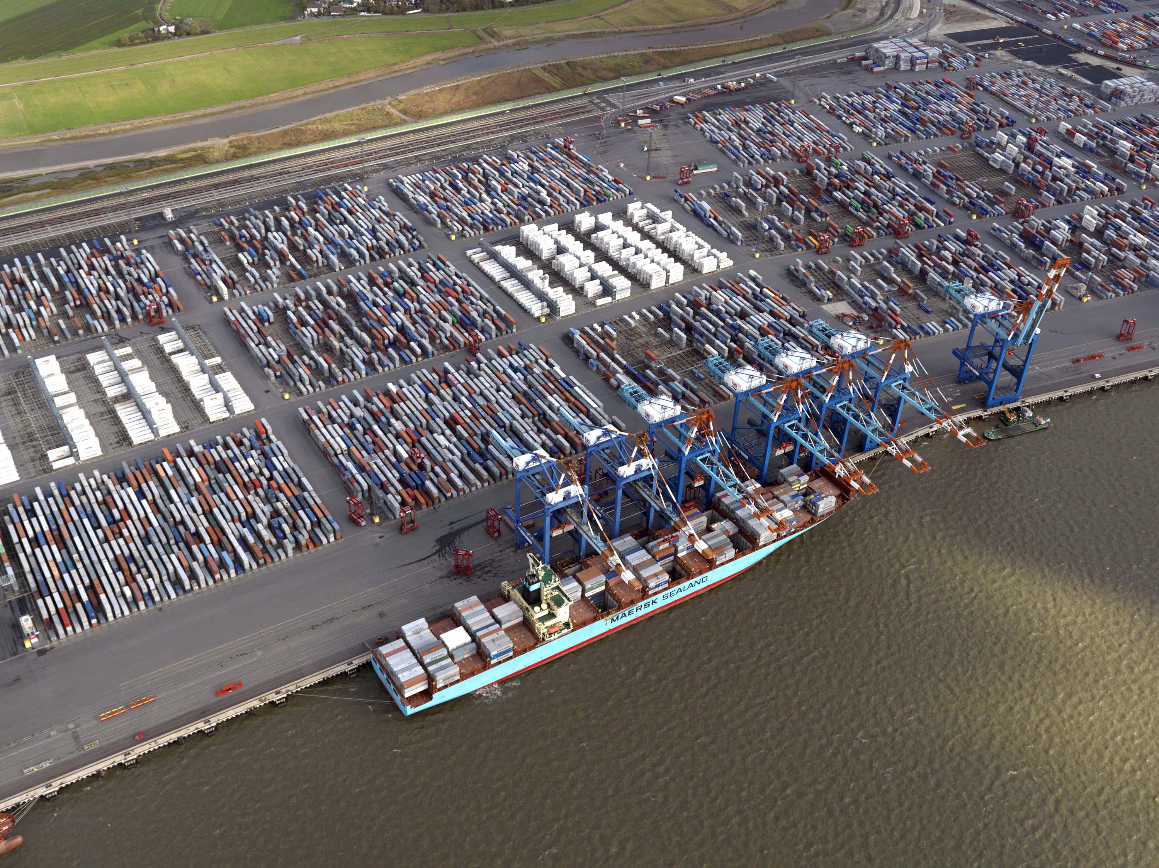
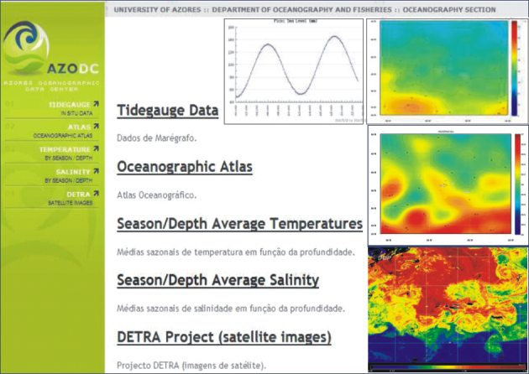
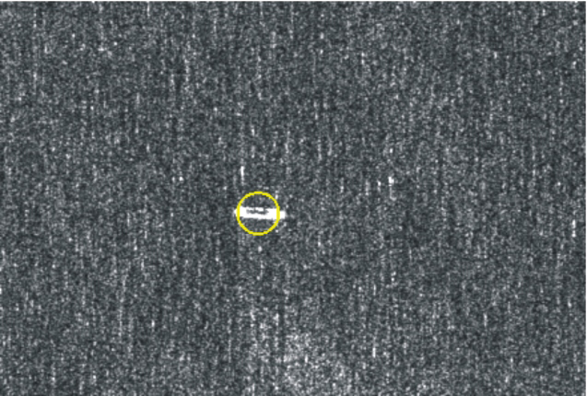
GMES for Maritime Security and Marine Economy
GMES services support major shipping economy of Bremen and Bremerhaven. (86000 jobs).
TerraSAR Imaging-Ship Detection Mecklenburg Vorpommern
Azores Oceanographic Data Centre. Satellite and in situ data sources.

Slide 8
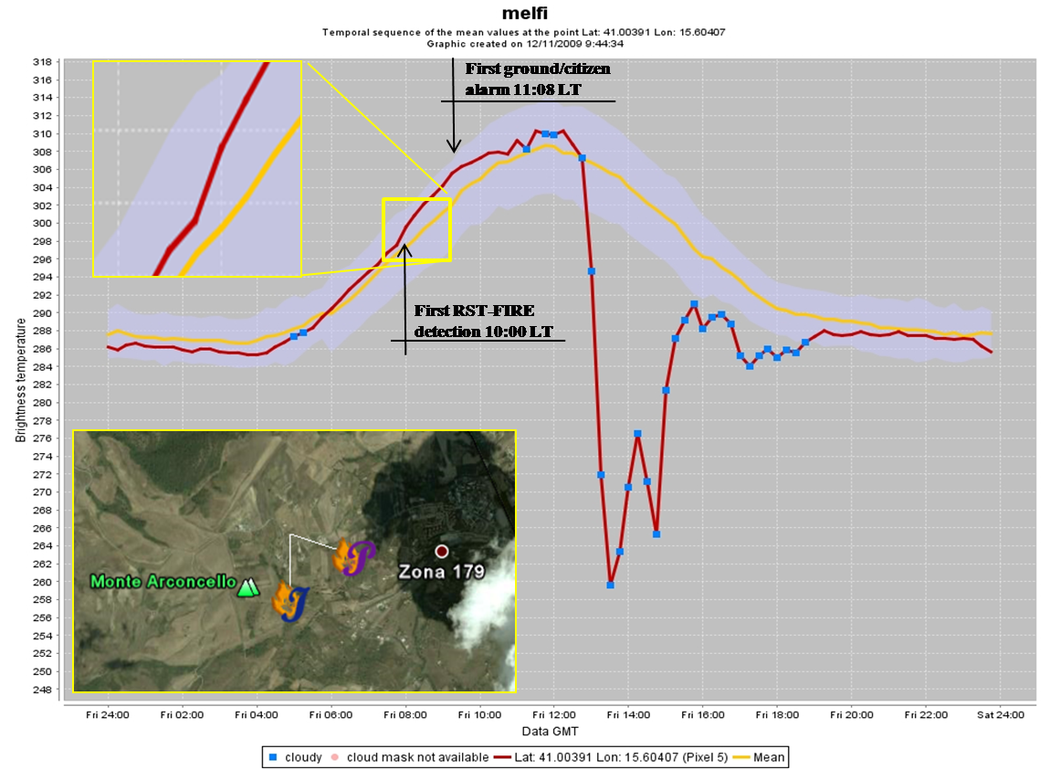
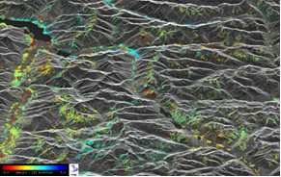
Civil Protection Measures
Fires, Floods, Landslip.
Forest Fires Early detection with Satellite Sensors. Basilicata region
Geological landslip detections from SAR radar scattering measurements. Lombardia.
Mapping of flooding from satellite images. Bavaria.

Slide 9
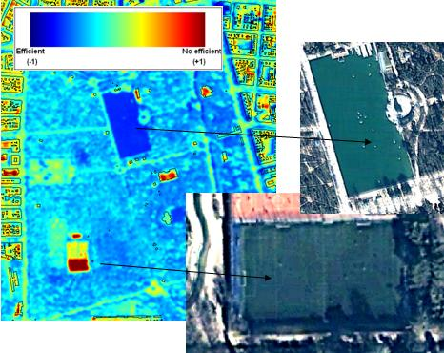
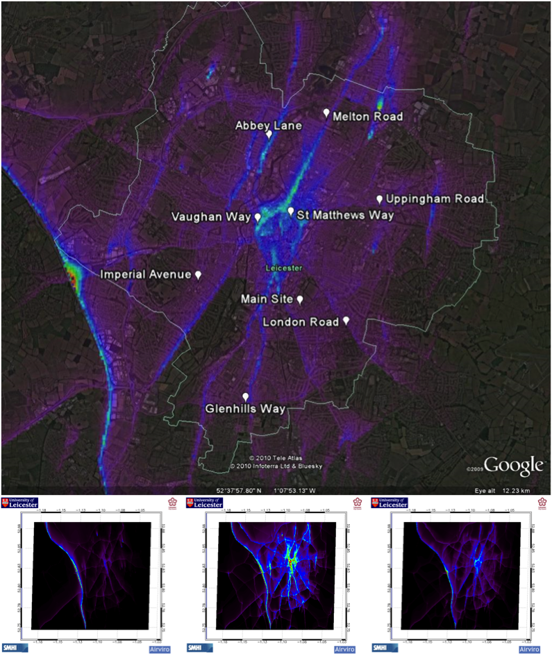
Urban Quality of Life
Air Quality and Urban Heat Islands.
Traffic induced NOx pollution emissions superimposed on background emissions imported from adjacent territories. In-situ and satellite data used with urban models. East Midlands Region, UK.
Urban Heat Island effects monitored with EO-derived thermal imaging. Madrid Region

Slide 10
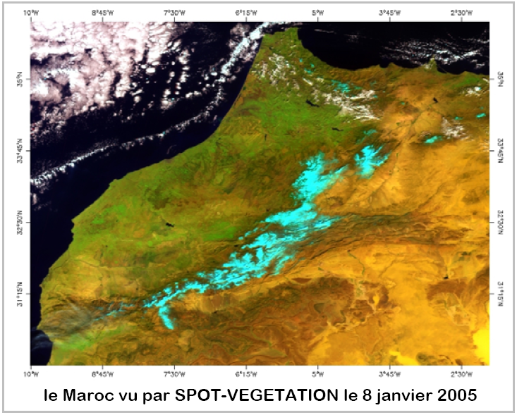
Water and Land Management
Fertliser Application managed based on EO hyper-spectral images in crop growth cycle
Operational snow cover monitoring with SPOT for water reserve forecasting. Midi Pyrenees

Slide 11
Provisional findings.
GMES systems and services from service providers are not always meeting the needs of regional and local administrations and potential end-users.
Regional/local administrations and commercial enterprises, as potential end users, may be unfamiliar with existing EO/GMES data systems and services and their potential for use outside the space sector.
Points to needs for more focussed communications, wider-based dialogue and better training facilities.
DORIS_NET

Slide 12
Regional Roles in GMES Operational Implementation Phase
“25 Uses” offers evidence that the regional connection offers a significant delivery mechanisms for enhancing exploitation of EO/GMES across Europe.
The regions are closely connected to a wider and more diverse range of potential end users.
NEREUS is ready to contribute to widening the scope of GMES in its forthcoming Operational Implementation Phase.
Target for 2012. “NEREUS identifies 50 operational uses of GMES in the Regions”

Slide 13
Emerging roles for Regional Consortia
Consortia constructed around industry (esp. SME’s) , academic, regional authority partnerships.
Different models
Different funding arrangements
Policy role: consortia members as advisers to regional authorities on uses of EO/GMES capabilities to deliver regional development strategies.
Consortia delivering pre-operational demonstration projects.
Regional technology demonstrators a key step towards the wider market.

Slide 14
What could NEREUS do for public sector bodies and regional policy makers that they could not do themselves?
Answer: Serve as a source of authoritative information
What could NEREUS do for enterprises that they could not do themselves?
Answer: Promote and encourage projects and inter-regional partnerships .
Questions from 1st Meeting of EO/GMES Working group.

Slide 15
DISCUSSION POINTS
How to identify and promote GMES related priorities in the participating regions?
How to serve as an information source for GMES- related Commission Programmes?
How to facilitate inter-regional cooperation in joint proposals?
How to communicate regional interests in dialogue with the Commission. NEREUS cannot be seen as a commercial lobby?
What issues need to be addressed regarding GMES data access for the public and private sectors respectively?

