Slide 1
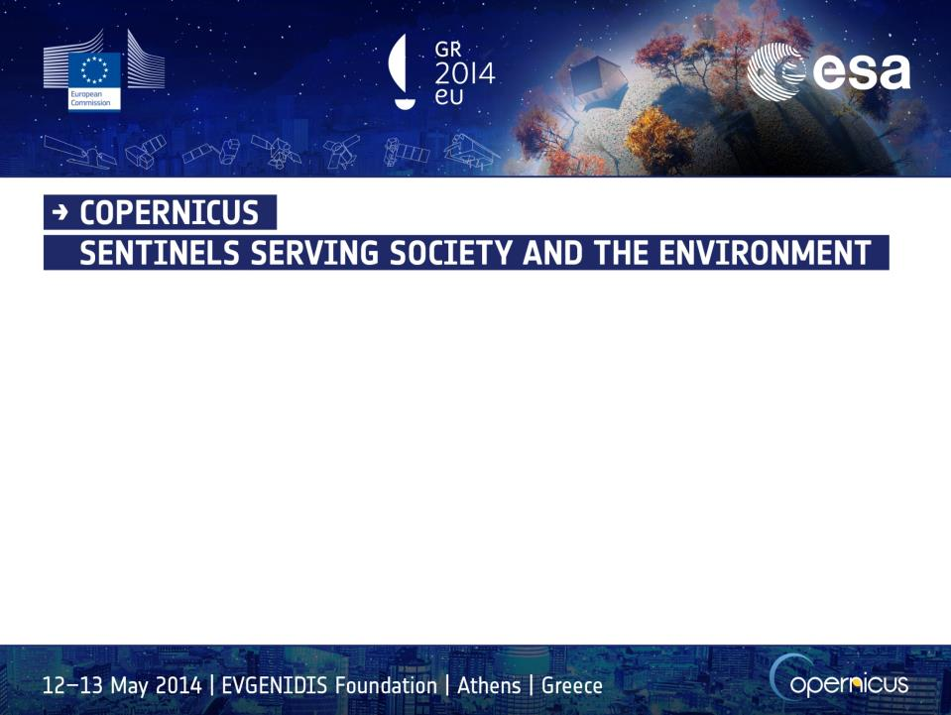
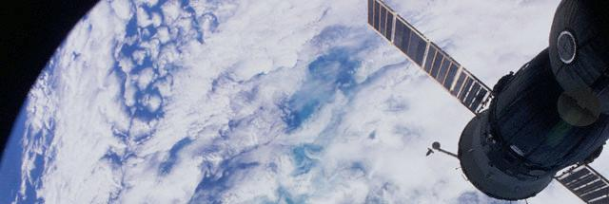


The Basilicata Earth Observation cluster (TeRN) and its internationalization activities:
the NIBS project
Side Event “SPACE4REGIONS: Satellite solutions as a driver for innovation and growth”
Networking Session 13 May 2014, Athens
Valerio Tramutoli
University of Basilicata – School of Engineering
TeRN Consortium

Slide 2
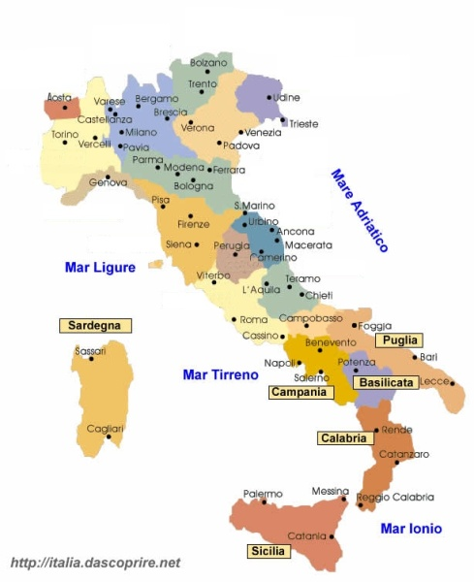
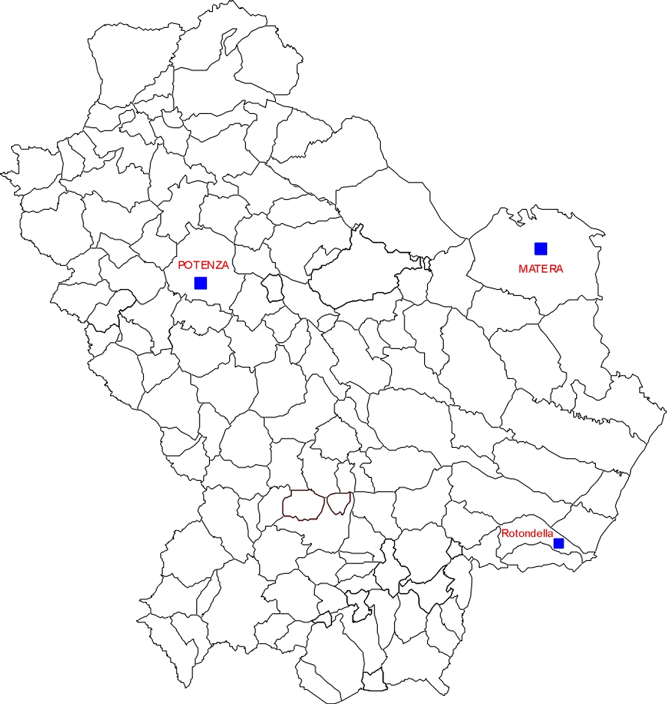



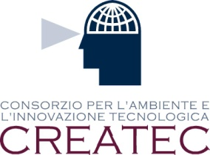


The R&D Space Sector in Basilicata
Ente per le Nuove tecnologie, l’Energia e l’Ambiente

Slide 3
Basilicata in FP7
SPACE (37%)+ENVIRONMENT (18%)+SECURITY = 67%

Slide 4
The TeRN district
TeRN = Technologies for Earth and Natural Risks Observations
Framework Programme: Agreement between
- Ministry of Education,University and Research,
- Ministry of Economy and Finance
- Basilicata Regional Authority
Strategic Objective APQ
development of industrial research and pre-competitive development aiming at creating a technological area in Basilicata region.
Scientific characterization
research, development and innovation in the field of EO technologies for monitoring, preventing and mitigate
natural, environmental and technological risks

Slide 5
The TeRN district
TeRN = Technologies for Earth and Natural Risks Observations
Triple helix model
The triple-helix organization
(research- local authorities- enterprises)
of the Consortium is in agreement with the European policies which concern technological clusters.
The purpose of such a model is the generation of local and international high-level knowledge infrastructure through the systematic exchange of information.
LRAs
SMEs
Academia

Slide 6
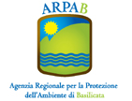





The TeRN district
TeRN = Technologies for Earth and Natural Risks Observations
Triple helix model
Regional Agency for Environmental Protection of Basilicata Region
(ARPAB)
LRAs
National Agency for New Technologies, Energy and the Environment
SMEs
Academia
Consortium for Environment and Technological Innovation
National Research Council (CNR)
Company formed by
ASI and Telespazio
RELUIS
Network of University Laboratories for Earthquake Engineering
University of Basilicata

Slide 7
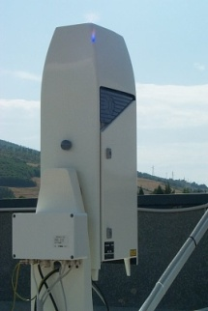
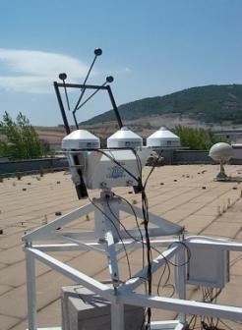
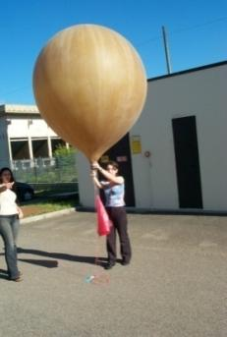
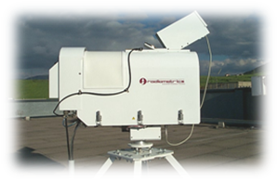
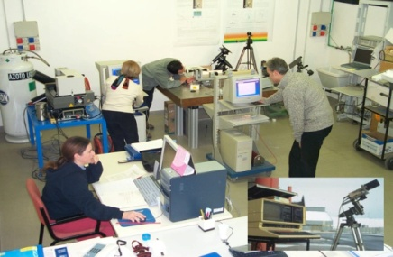
TeRN Capabilities
Atmospheric Observatory – CNR-IMAA

Slide 8
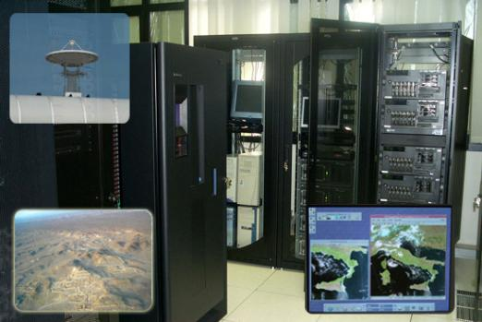
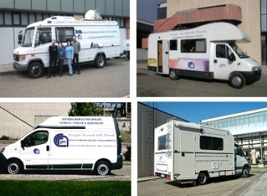

TeRN Capabilities
Marsico Nuovo CNR: HYDROGEOSITE
Satellite receiving and processing facilities
International lab for the study hydrogeophysical processes
Mobile Labs

Slide 9
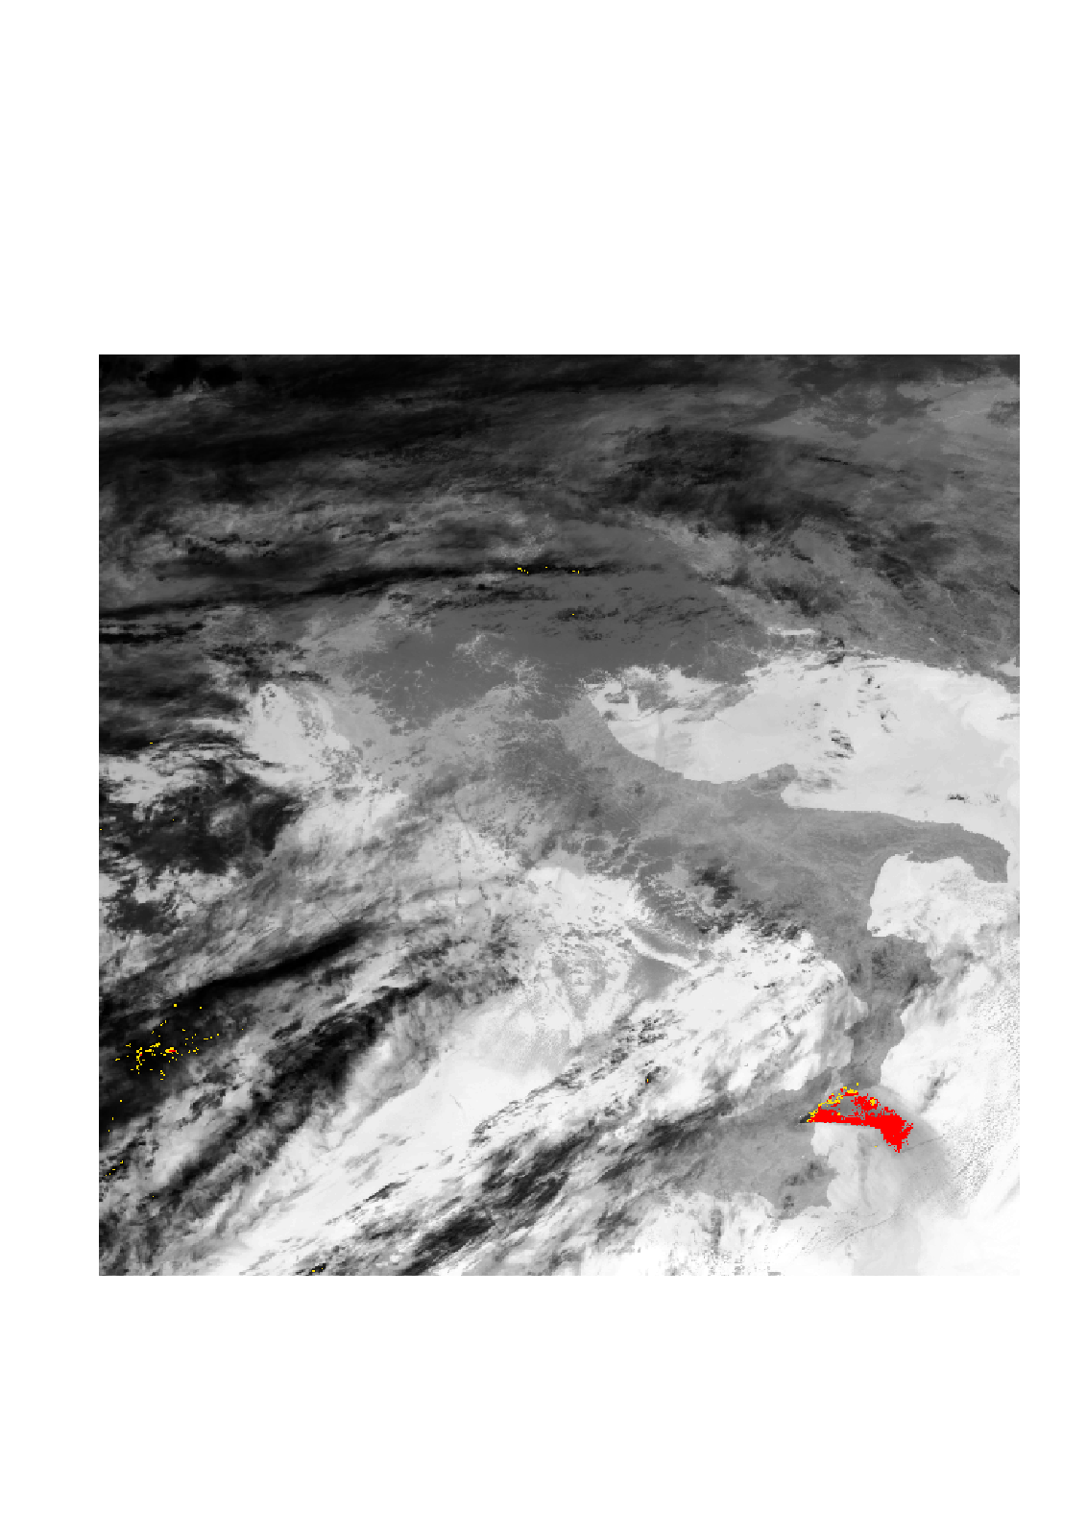
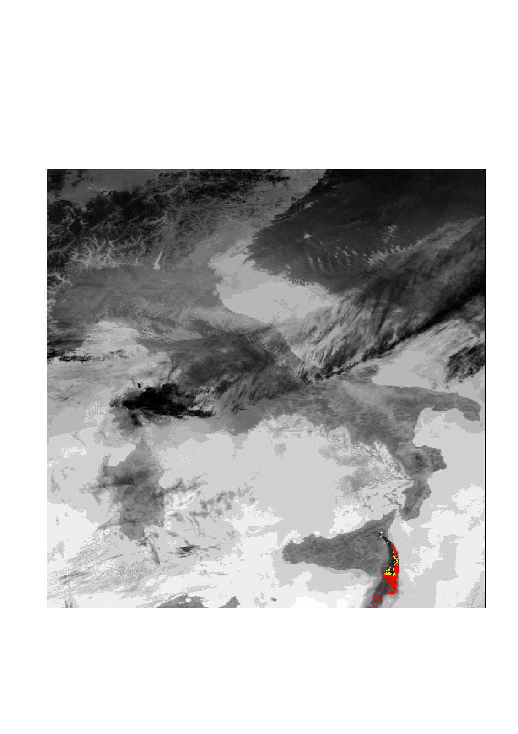
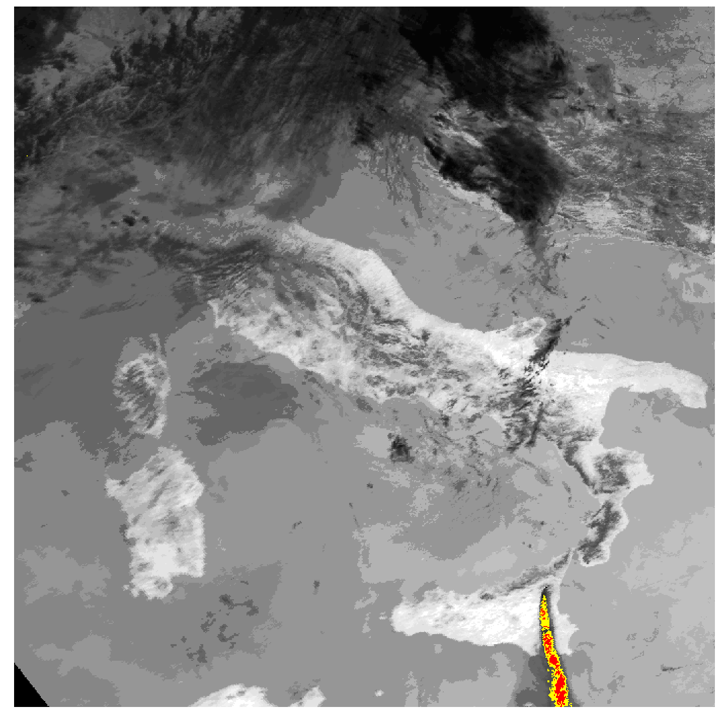
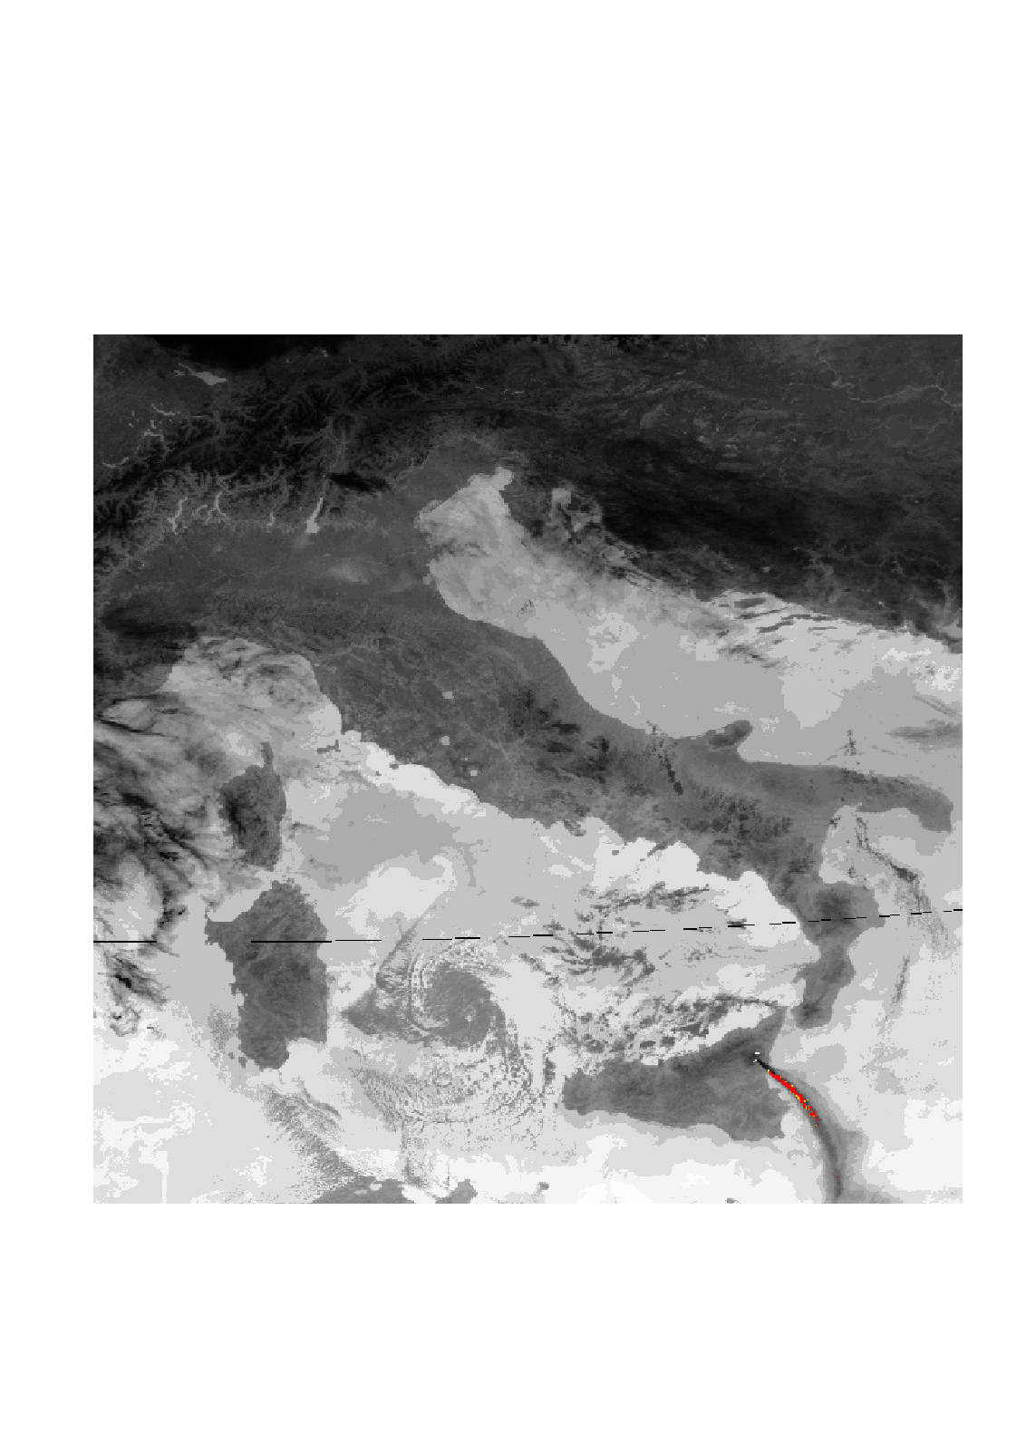
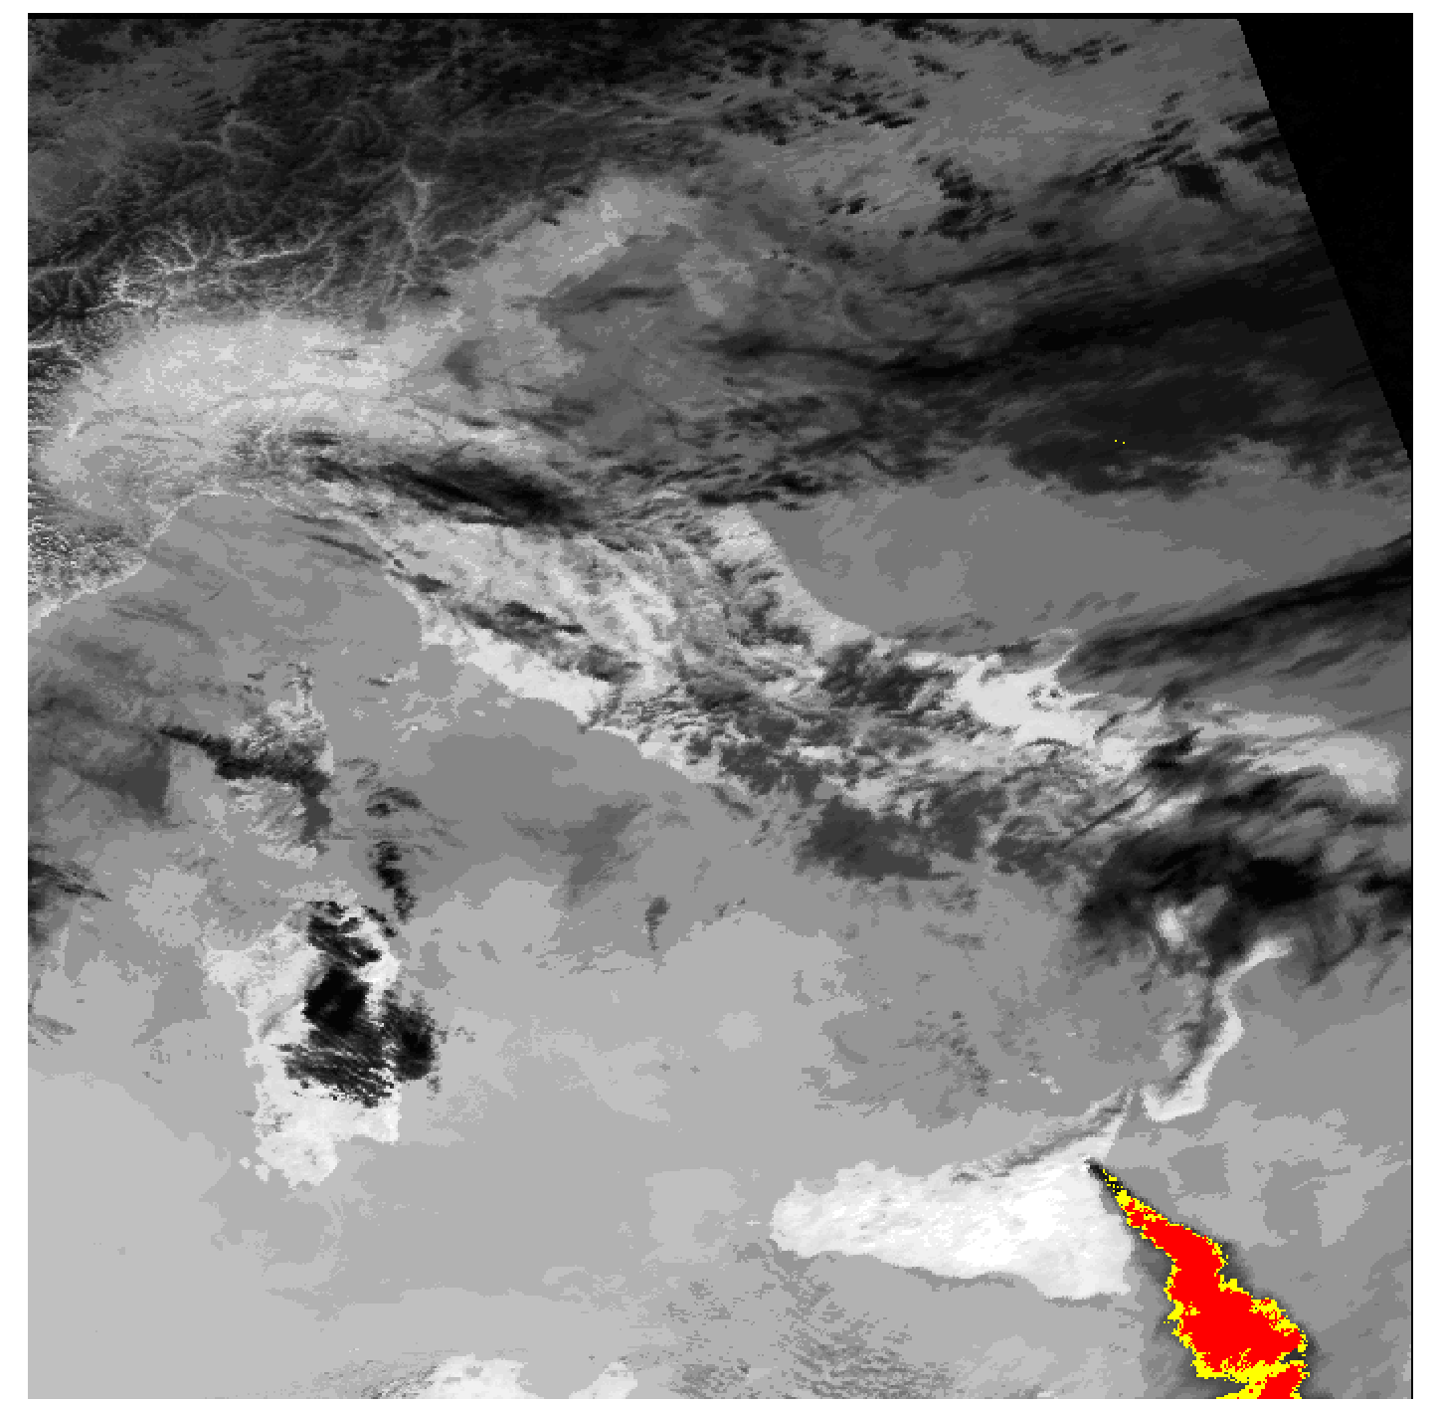
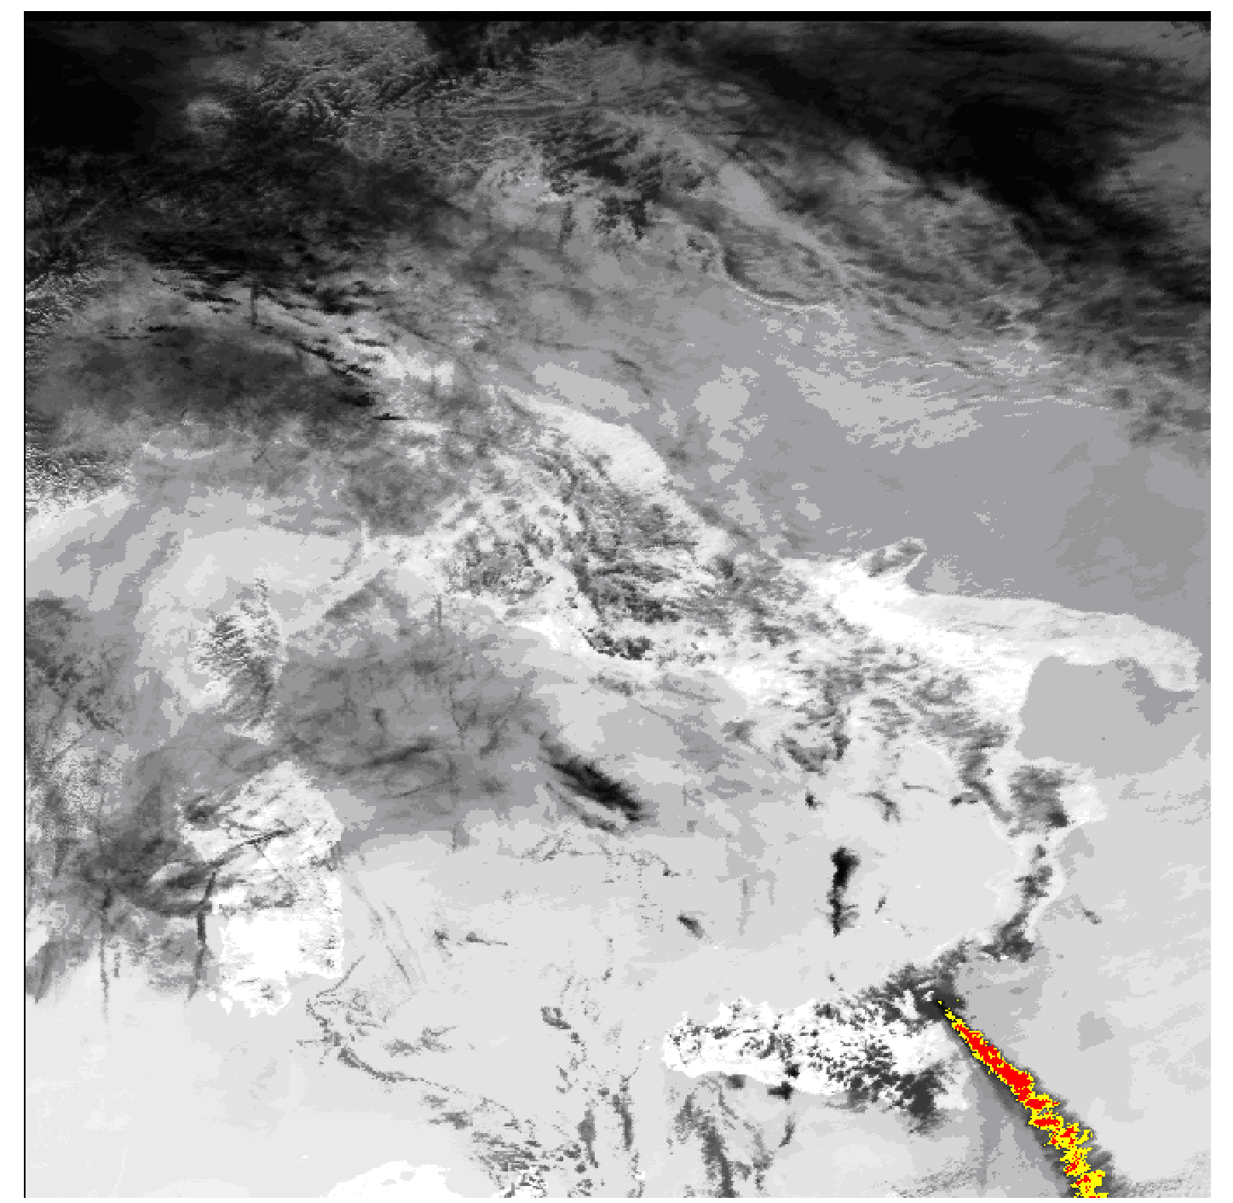
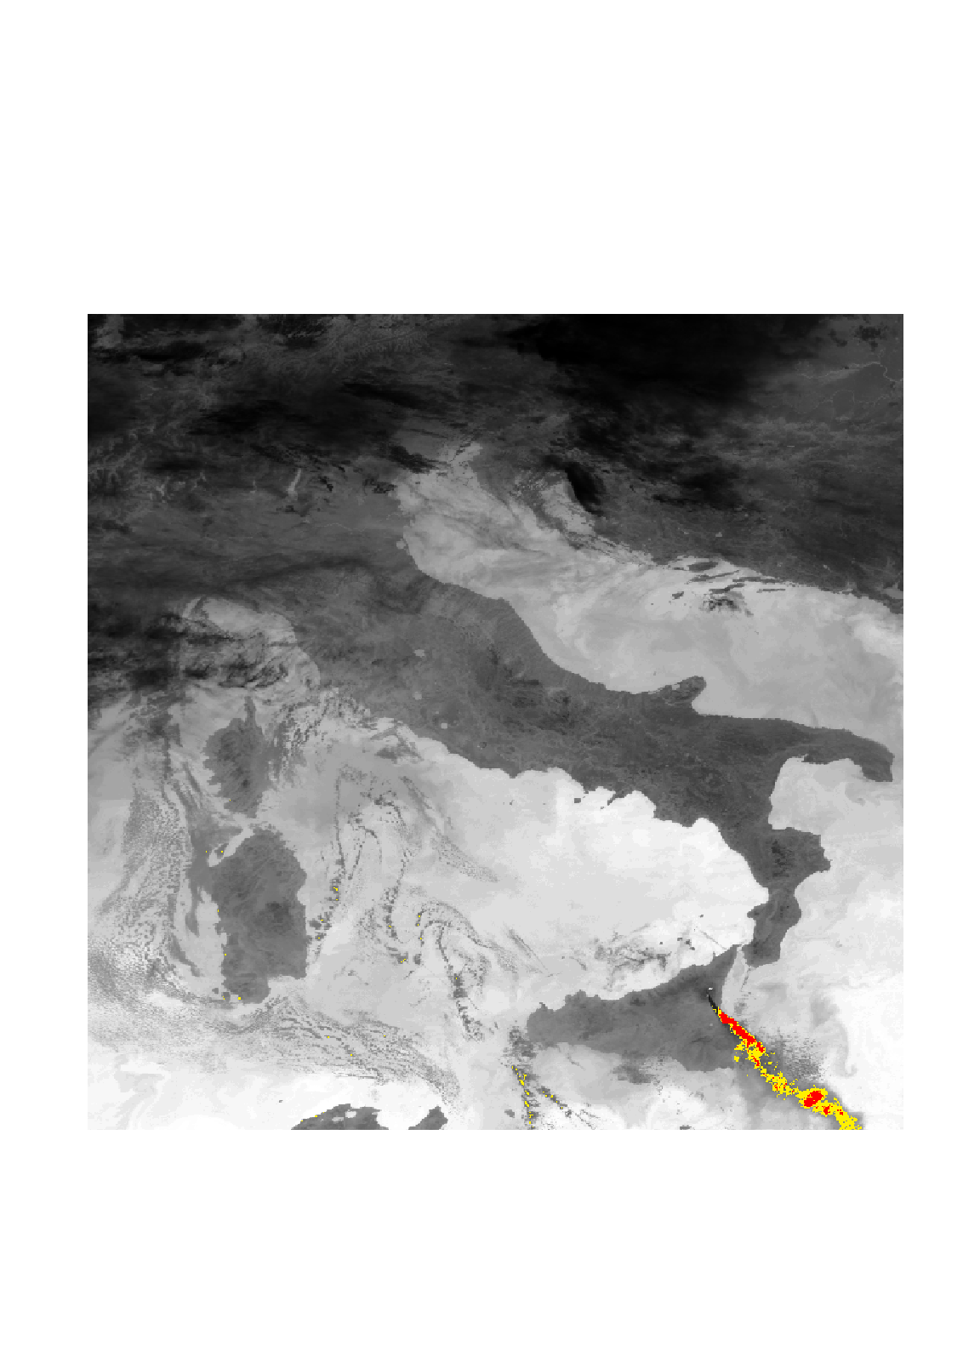
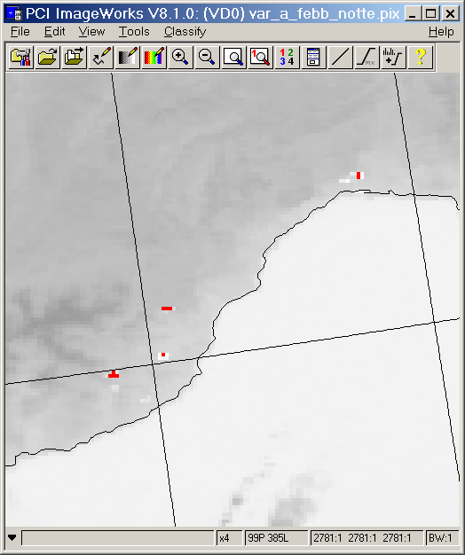
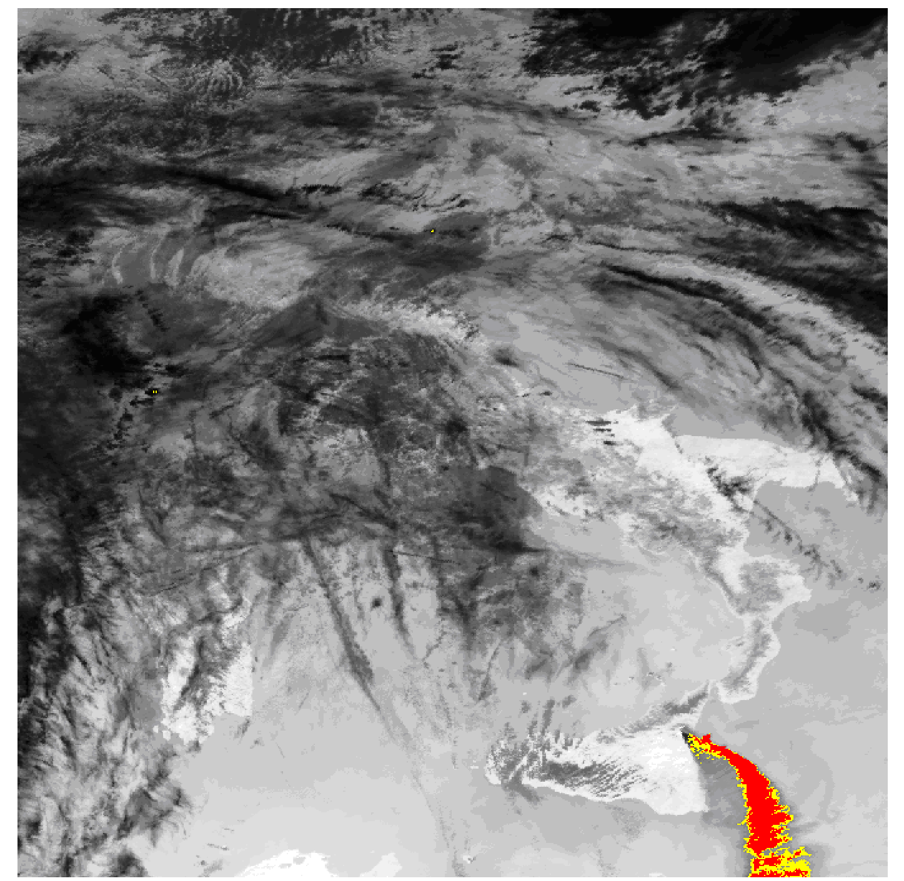
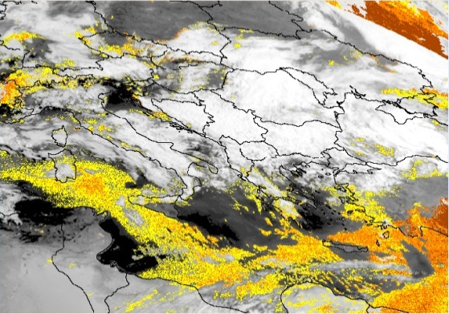
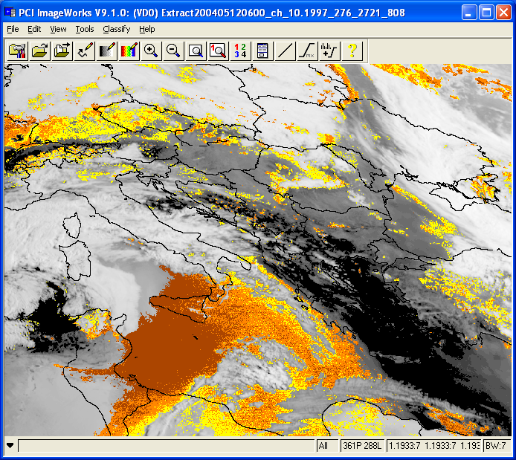
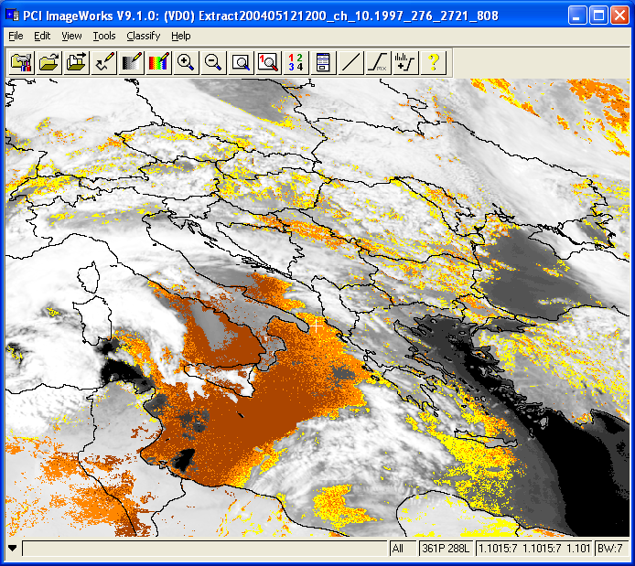
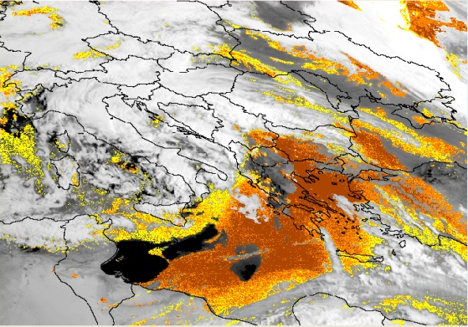
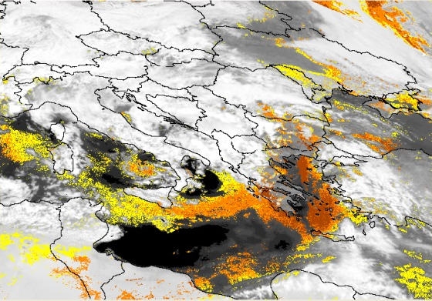
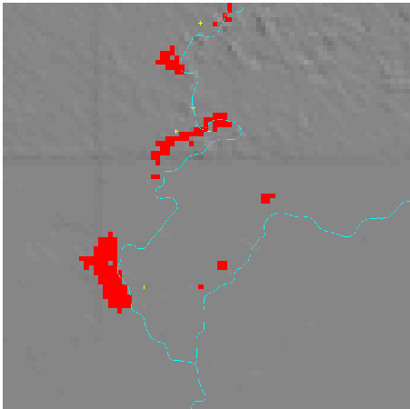
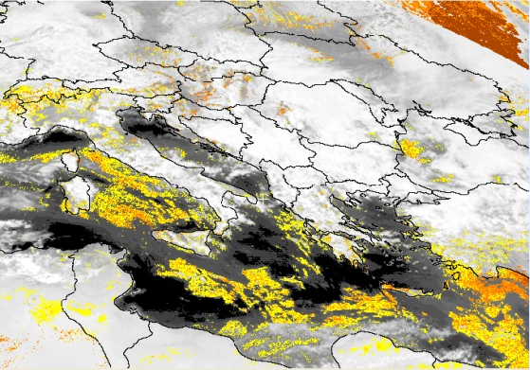
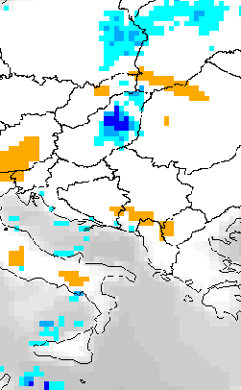
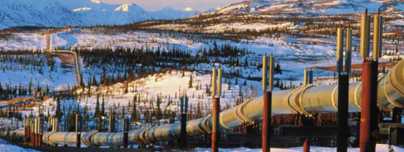
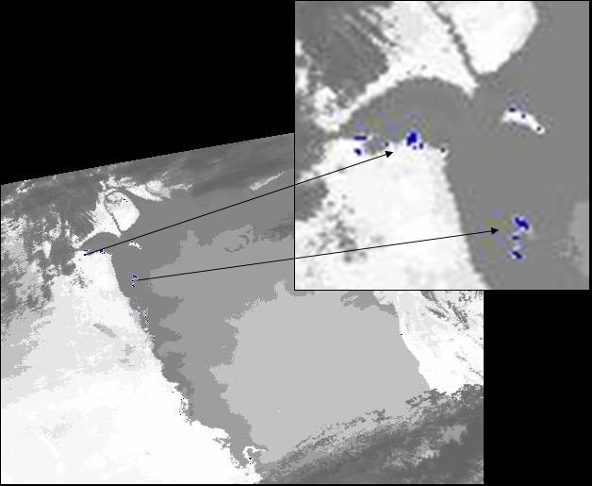
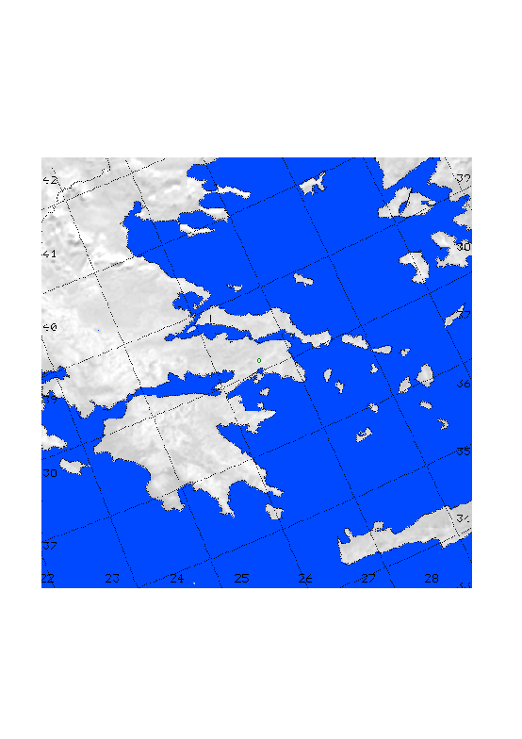
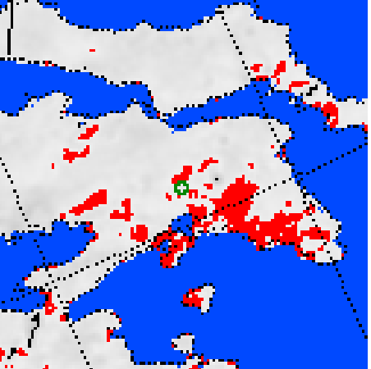
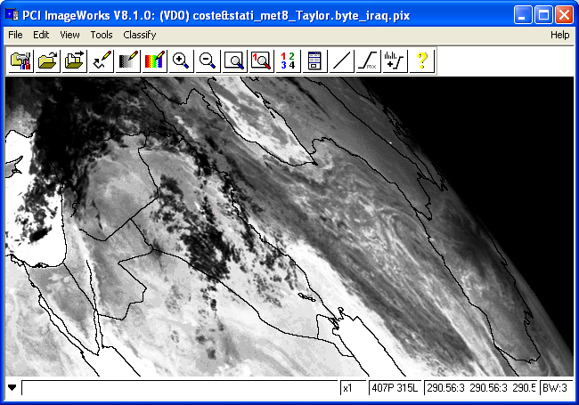
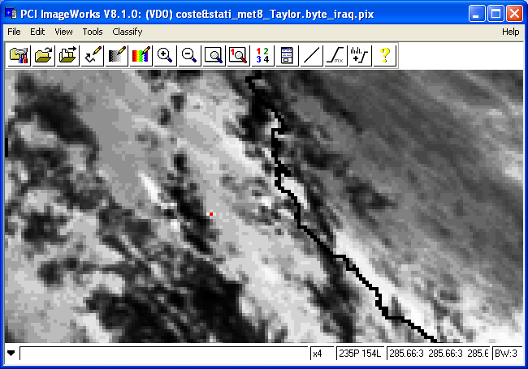

TeRN Capabilities
Development of advanced satellite techniques for:
Forest fires
Volcanic Eruptions
Floods
Dust storms
e.g. Fires in Italy, February 2005
e.g. Etna eruption Oct 2002
e.g. Ungary flood, April 2002
e.g.Libia 13 May 2004
SZOLNOK
SZOLNOK
SZOLNOK
SZOLNOK
Voltri
SZOLNOK
TISZA
TISZA
TISZA
TISZA
TISZA
TISZAVARKONY
TISZAVARKONY
TISZAVARKONY
TISZAVARKONY
TISZAVARKONY
TISZAJENE
TISZAJENE
TISZAJENE
TISZAJENE
TISZAJENE
VEZSENY
VEZSENY
VEZSENY
VEZSENY
Erli
VEZSENY
Casanova Lerrone
TISZASAS
TISZASAS
TISZASAS
TISZASAS
TISZASAS
TISZA
TISZA
TISZA
TISZA
Carpasio
TISZA
fires
Ash Clouds
Flooded areas
Dust clouds
Oil spills
Soil wetness
Earthquakes
Security (pipelines))
e.g. Oil spill in the Persic Gulf, January 1991
e.g. Carpathian Basin, April 2000
e.g. 7 September 1999 Athens Earthquake
e.g. 18 October 2005 IRAQ
3 days before EQ
Raining Clouds
Weakly wet
Moderately wet
Oil spill
Extremely wet
Thermal anomalies
Explosions

Slide 10
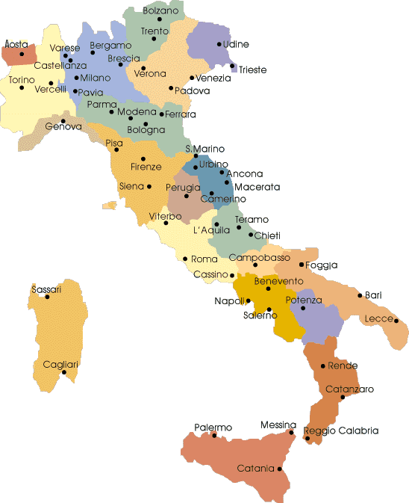

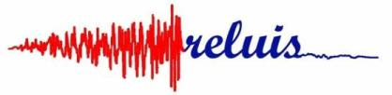
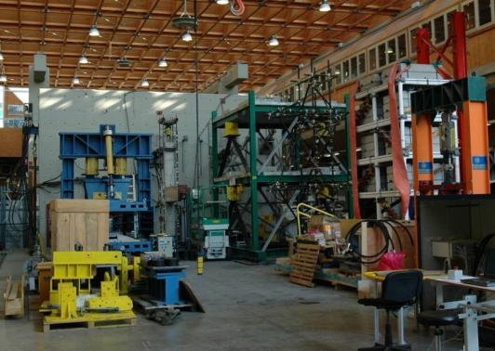





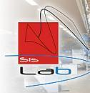


TeRN Capabilities
Network of University Laboratories for Earthquake Engineering
Napoli Parthenope
JetPacs Units

Slide 11
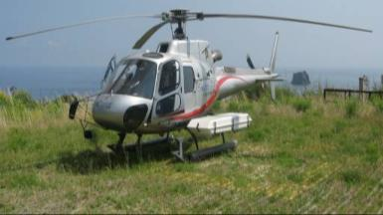
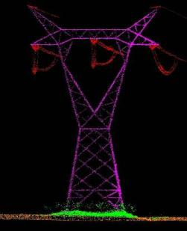
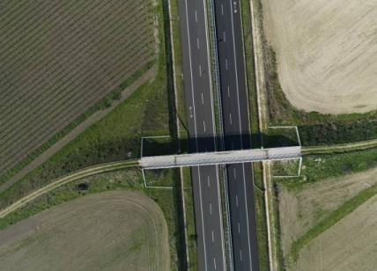
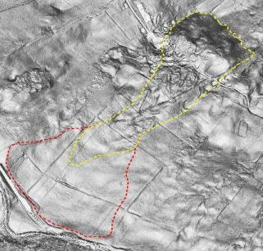
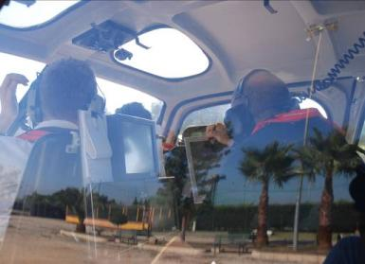
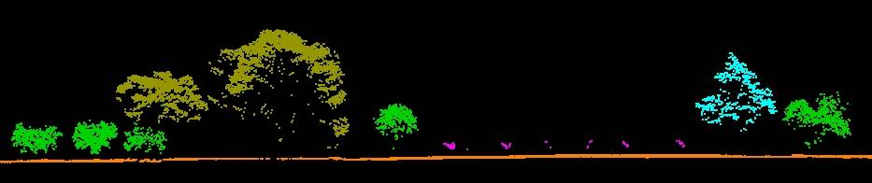

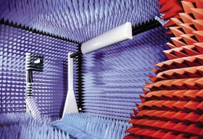

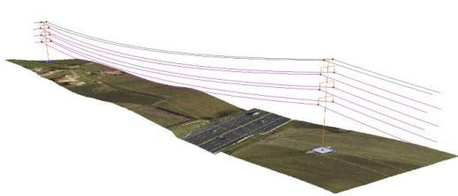
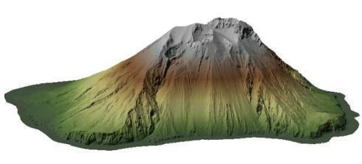
TeRN Capabilities
AERIAL SURVEYS application
Anechoic chamber
11

Slide 12
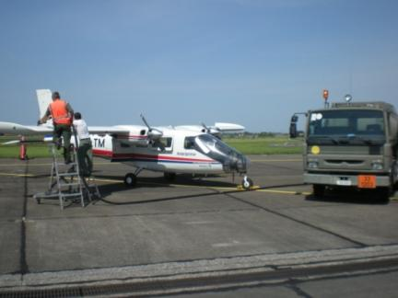






TeRN Capabilities
Aircraft Instruments
DINSAR
HYPERSPECTRAL
LASER SCANNERS

Slide 13




TeRN Capabilities
Matera SPACE CENTER
Activities:
- Remote Sensing
- Geodesy
- Cosmo-SkyMed User Ground Segment

Slide 14










TeRN Services
Volcanic hotspot detection
Ash cloud detection and tracking
t
NRT Products generation

Slide 15








TeRN Services
Satellite and Lidar observations for ash cloud monitoring (FP7-ACTRIS Project)

Slide 16



TeRN Services
ROBUST SATELLITE TECHNIQUES (RST) FOR EARLY WARNING OF FOREST FIRES
SEVIRI Thermal anomaly map
Peschici, 24 July 2007: 3 casualties
MODIS – Terra, 24/07/2007 10:25GMT
NOAA-AVHRR fire product on GoogleEarth
24 July 2007
MSG-SEVIRI daily curve of BT
Fire warning
First RST detection

Slide 17

TeRN Services
Advanced Satellite Techniques
for extreme
hydrological
events
monitoring
romano@imaa.cnr.it

Slide 18
TeRN Services
Soil moisture variations monitoring by AMSU-based soil wetness indices
10-year assessment analysis at Basin scale
AMSU-based Soil Wetness Index
c)
a)
b)
d)
Lacava et al., (2010). Remote Sensing of Environment, 114 , 2317–2325.

Slide 19



TeRN Services
Strategic civil infrastructures monitoring by web-sensors (from ground and space).

Slide 20


TeRN Services
Monitoring coastal water by multispectral techniques
(from ground and from space).
www.spettri.imaa.cnr.it‏
Santini et al., (2010) .Remote Sensing of Environment, 114 (4), pp. 887-898.

Slide 21


Landslides monitoring (FP7 - DORIS (www.doris-project.eu)
Deformation speed maps for Assisi (Perugia, Umbria) obtained by SAR data processing (Bonano et al., 2011)

Slide 22





TeRN Services
Hyperspecal Techniques for environmental monitoring
October 4th toxic red sludge in western Hungary, releasing approximately 700,000 cubic meters of stinking caustic mud from the ruptured wall of the red sludge reservoir of the plant in Kolontar (Hungary,2010) - Collaboration with EU Hyperspectral Working Groups.
CHRIS-Proba (13/10/2010)
ASD
MIVIS
Reflectance
CHRIS
N
1 Km
Aerial photos (5/10/2010; Gyoergy Varga)
Wavelength (μm)
pignatti@imaa.cnr.it

Slide 23











TeRN Services
Early (3h-15min repetition) detection and continuous monitoring of oil spills by optical satellite techniques
t
y
x
MODIS CH31
Modis ch31 (11μm) - ch32 (12μm)
DAY
25.04.10 17.15 GMT
11.15 LT
tramutoli@unibas.it , pergola@imaa.cnr.it

Slide 24



TeRN Main Projects
SESAMO
“Integrated information system for the acquisition, management and sharing of environmental data for decision support”
The main objective of SESAMO project is the development of an ICT platform that can manage spatial information coming from heterogeneous sources in order to provide advanced monitoring services that can support decision.
tramutoli@unibas.it , pergola@imaa.cnr.it

Slide 25


TeRN Main Projects
ISTIMES
“Integrated System for Transport Infrastructures surveillance and Monitoring by Electromagnetic Sensing”
The main purpose of the project is to design, assess and promote an ICT-based system, exploiting distributed and local sensors, for non-destructive electromagnetic monitoring in order to achieve the critical transport infrastructures more reliable and safe.
This has the overall aim to developing a high situation awareness by providing detailed information and images of the infrastructure status in a fast time and so to improve decision support for emergency and disasters stakeholders.
The integration of electromagnetic technologies with new ICT information and telecommunications systems enables remotely controlled monitoring and surveillance and real time data imaging of the critical transport infrastructures.
tramutoli@unibas.it , pergola@imaa.cnr.it

Slide 26


TeRN Main Projects
DORIS
“Ground Deformations Risk Scenarios: anAdvanced Assessment Service”
Is an advanced downstream service for the detection, mapping, monitoring and forecasting of ground deformations, at different temporal and spatial scales and in various physiographic and climatic and environments.
Integrates traditional and innovative Earth Observation (EO) and ground based (non-EO) data
delivers innovative products at the regional and local levels, tailored on the needs of national and local Civil Protection authorities.
Exploits the unique ESA ERS-1/2 and ENVISAT C-band Synthetic Aperture Radar (SAR) archives to provide unprecedented, very long time-series of ground deformations. DORIS will evaluate new SAR sensors, or constellation of sensors, including ALOS, COSMO-SkyMed and TerraSAR-X.
tramutoli@unibas.it , pergola@imaa.cnr.it

Slide 27


TeRN Main Projects
SMART BASILICATA
“Smart Cities and Communities and Social Innovation”
Systemic approach to the region as the "city widespread“ in order to make it "intelligent community“ through the use of modern technologies for Earth Observation and ICT
The project aims at identifying and developing technological and innovative solutions in order to manage:
Efficiently environment;
Energy;
Mobility;
Culture and Tourism;
Social participation;
tramutoli@unibas.it , pergola@imaa.cnr.it

Slide 28

TeRN Main Projects
DORIS_NET
“Downstream Observatory organized by Regions active in Space network”
DORIS_Net has set up the European network of Copernicus-GMES Regional Contact Offices (RCOs) to raise awareness and strengthen regional involvement in Copernicus-GMES.
The Downstream Observatory facilitates links between both regional and European level GMES stakeholders;
The regional users and service providers are supported by dedicated interfaces as well as a network of Regional GMES Contact Offices (RCOs) which create the European GMES Downstream Service Platform
This Platform allows more effective coordination of individual activities both within and between the regions of Europe and European GMES governance which is vital for growth in the downstream service sector.

Slide 29


The NIBS project

Slide 30

The NIBS project
Objectives
To structure and consolidate the supply chain of Space Technology in Basilicata
To promote technology transfer from the research system to the private sector;
To promote the internationalization of the SMEs and the research system;
To promote and support the demand for products and applications in the STS.

Slide 31
The NIBS project
Wp1
Management
Advisory
Board
Wp2
Support
Actions
WP3:
Harmonization
Products/processes
WP4
Promotional
Actions
WP5
NEREUS
Basilicata
Technological
Trasfer
Products/services
Catalogue
Support to Local
Partnership
NEREUS-Basilicata
Coordination
Exchange of
Know-how
Expertise
Products Integration
Support to
Interantional
Partnership
NEREUS-WG
participation
Sustain to the
demand of
ST-based
services
Mapping of
Demand
Emerging
Markets
Support to
IPR
Scouting

Slide 32
The NIBS project
The NIBS Catalog (GMES4Regions tassonomy)
R1 | Management of Urban area
r 1.1 | Urban planning and management
r 1.2 | Renewable energies
r 1.3 | Urban Energy efficiency
r 1.4 | Waste management
r 1.5 | Water management
r 1.6 | Ports and Harbours management
R2 | Sustainable developement and nature protection
r 2.1 | Renewable energies
r 2.2 | Forest and green areas
r 2.3 | Natural resources managemen
r 2.4 | Urban Energy efficiency
r 2.5 | Coastal Management
r 2.6 | Protected areas management
r 2.7 | Biodiversity and ecosystem wardship
R3 | Regional and local planning
r 3.1 | Urban planning and management
r 3.2 | Rural planning and management
R4 | Agriculture, Forestry and Fischeries
r 4.1 | Soil moisture
r 4.2 | Crop Classification and Monitoring
r 4.3 | Agricultural Pollution Monitoring
r 4.4 | Water Scarcity
r 4.5 | Forest monitoring
r 4.6 | Phytoplankton detection
R5 | Health
r 5.1 | UV Exposure
r 5.2 | Air quality and humidity
r 5.3 | Water quality
R6 | Emergencies
r 6.1 | Natural disaster management
r 6.2 | Early Warning
r 6.3 | Industrial risk management
r 6.4 | Search and Rescue Operations
r 6.5 | Maritime Surveillance
R7 | Infrastructure, Transport and Mobility
r 7.1 | Transport and Network Management
r 7.2 | Air quality /traffic management)
r 7.3 | Industrial risk management
r 7.4 | Maritime Surveillance
R8 | Tourism
r 8.1 | UV Exposure
r 8.2 | Air Quality
r 8.3 | Bathing Water Quality and Temperature

Slide 33





The NIBS project
Developing/validating new products with end-users
Prof. Marouane Temimi
(Institute of Science and Technology di Masdar City - Abu Dhabi)
Regione Basilicata- Gorj Province (Romania)
Education and training of students and professionals
Course on Spatial Technologies
at Cape Town
FORMAT-EO Summer School
(Leicester 19-Luglio – 1 Agosto 2013)
Course on Spatial Technologies for forest fires monitoring to Civil Protection personnel and volunteers at University of Basilicata

Slide 34





The NIBS project
Developing/validating new products with end-users
Research Product | Application | End-User | Service
RST-FIRES algorithm for forest fire detection | Early detection of forest fires | 3 Regional Civil Protection Services | Continuous (15 min update) forest fire alerts release
RST-ASH algorithm for Volcanic ash detection | Volcan ash detection and monitoring for air trafic safety | VAACs (Volcanic Ash - Advisory Centres) Airport Authorities Airways Companies | Continuous (15 min update) volcanic ash alerts release
RST-DUST algorithm for Saharan dust detection | Saharan dust monitoring | Regional Agency for Protection of the Environment | Application of European directive on PM10, PM2,5
RST-PM10 algorithm for detecting anomalies in PM10 records | Detection of anomalous PM10 transients in ground bases measurements | Regional Agency for Protection of the Environment | Early identification of Air Quality degradation
Regional Agency for Environmental Protection of Basilicata Region
(ARPAB)
RST_{ASH}
RGB_DUST LONDON-VAAC

Slide 35
THANK YOU FOR YOUR ATTENTION

