Slide 1


Bringing
the benefits
of space uses
to regions
and their citizens
Activity Report 2016/2017 and Outlook 2017/2018
By Roya Ayazi, Secretary General

Slide 2
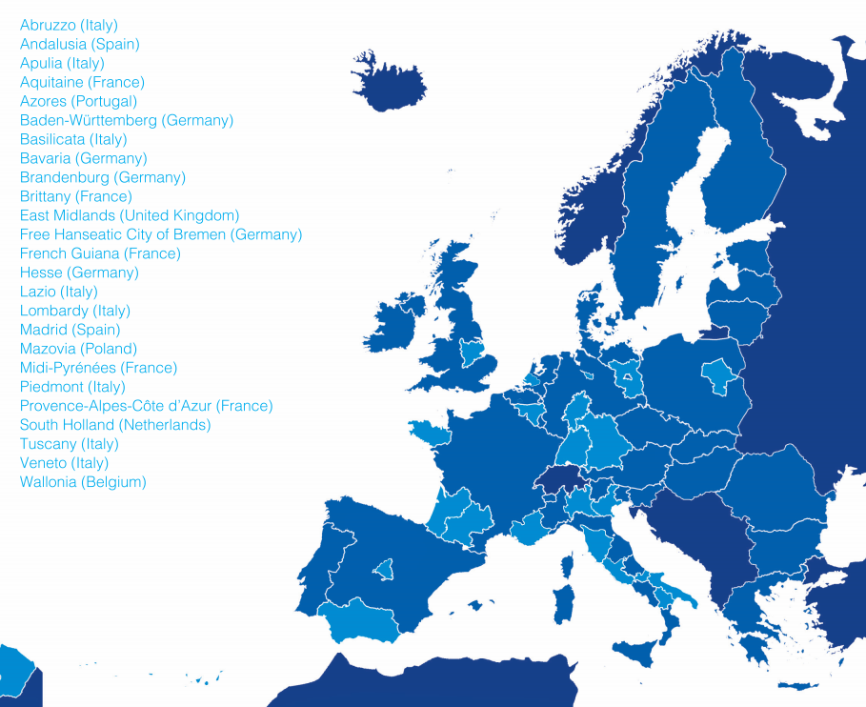

26 Regions and
36 Associate Members
NEREUS
Network of European Regions
Using
Space Technologies
Podkarpackie region (PL)

Slide 3
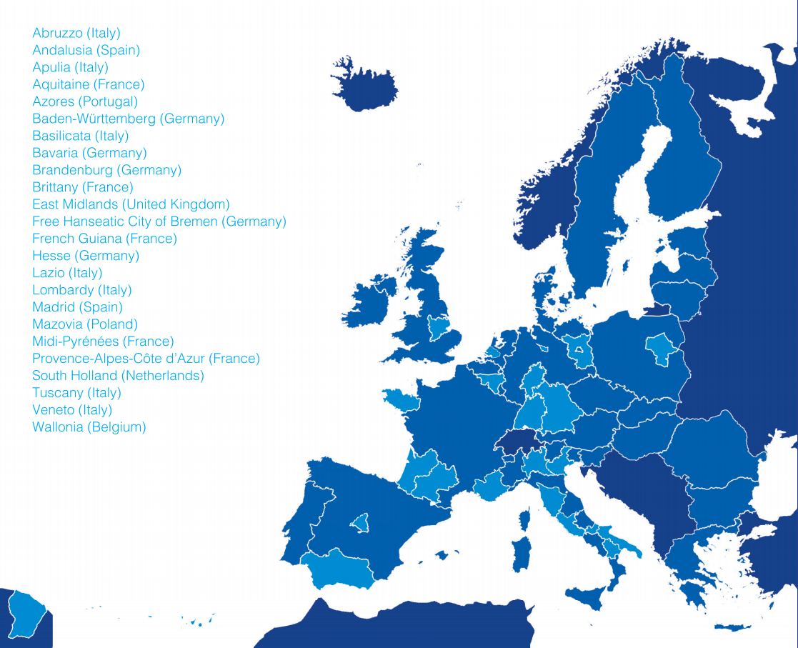
10th Anniversary of Signature of Political Charta
SAVE-THE-DATE:
29th November 2017
Large festive Event
Notes:
-In 2006 in Midi/Pyrénées Region Workshop around the question : “What could be the role of European regions in the GMES programme?”
-18th December 2007 signature of Political Charta in Toulouse Martin Malvy, President of the Midi-Pyrénées Region, Michel Delebarre,
then President of the Committee of the Regions, Jean-Jacques Dordain, Director General of ESA and representatives of the EC and of the different regions involved. 23 regions from 9 countries were represented;

Slide 4
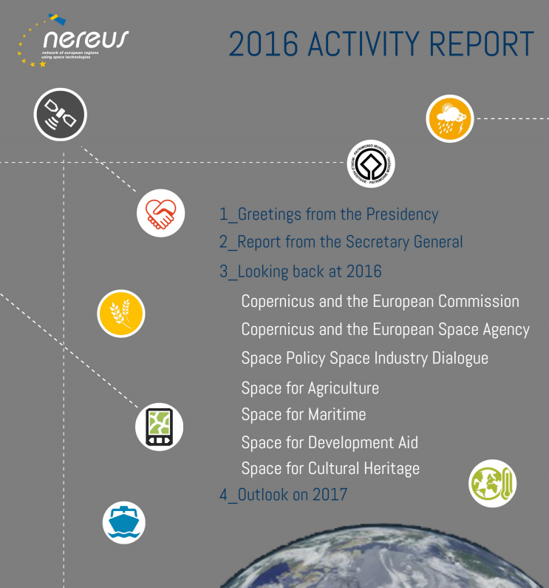
Annual Report 2016
Look into your hand-out!

Slide 5
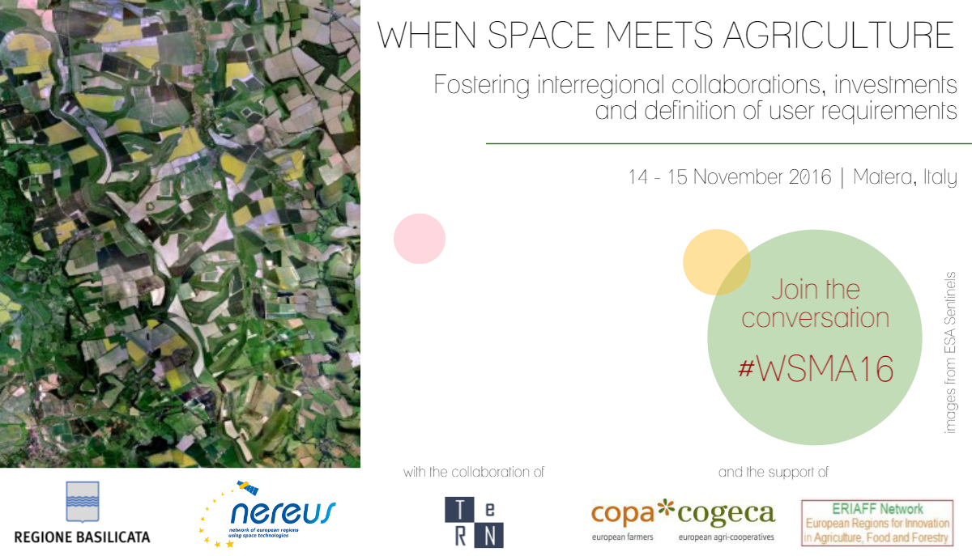



Regional Workshops in NEREUS-Member Regions
Regional Workshops
Space Industry Policy Dialogue in Bavaria
NEREUS-Workshop in Podkarpackie/Poland
09th May 2017

Slide 6
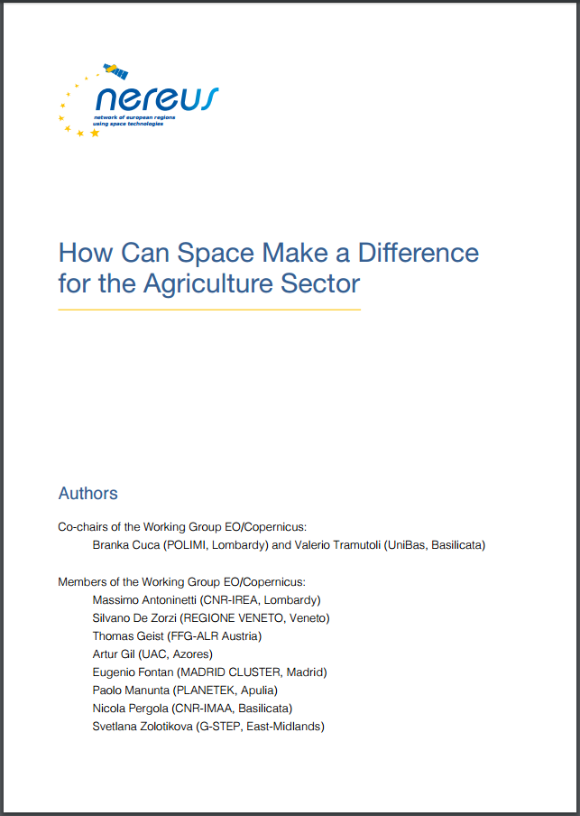
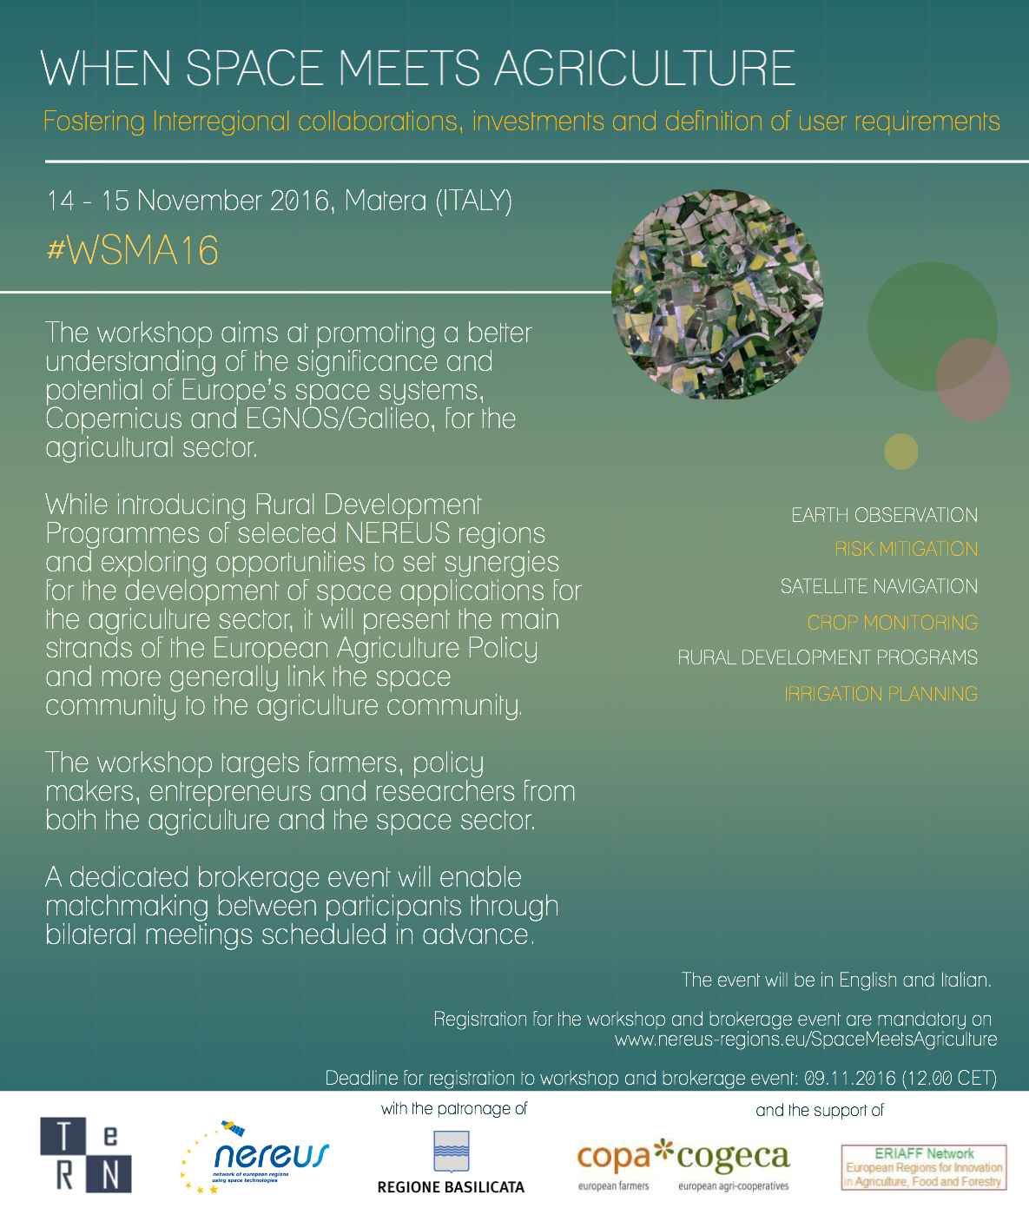
Regional Worskhop
in Basilicata/Italy
in 2016
Space4Agri
WS in Basilicata/Italy November 2016
Building partnerships with relevant regional and sectorial player: Copageca, ERIAFF, Farmer Association etc.

Slide 7
Planned Regional Worskhop
in Veneto /Italy
in October 2017
Next Steps
Copernicus for Coastal Zone Management
Copernicus for Land Monitoring
Copernicus for
Cultural Heritage
Copernicus for Agriculture
Copernicus for Emergency Management Service

Slide 8
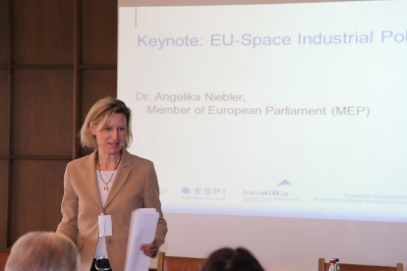

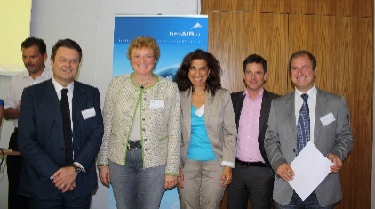
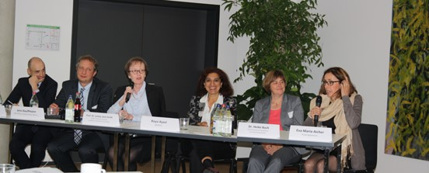
Space Industry Policy Dialogue
Space Industry Policy Dialogue
SPID 2016
SPID 2017
SPID 2014
SPID 2015
SPID 2016
Administration
Local space community-
Industry, SME, cluster, start-ups
Politicans
SPID 2017 :
24th May 2017 in Taufkirchen

Slide 9
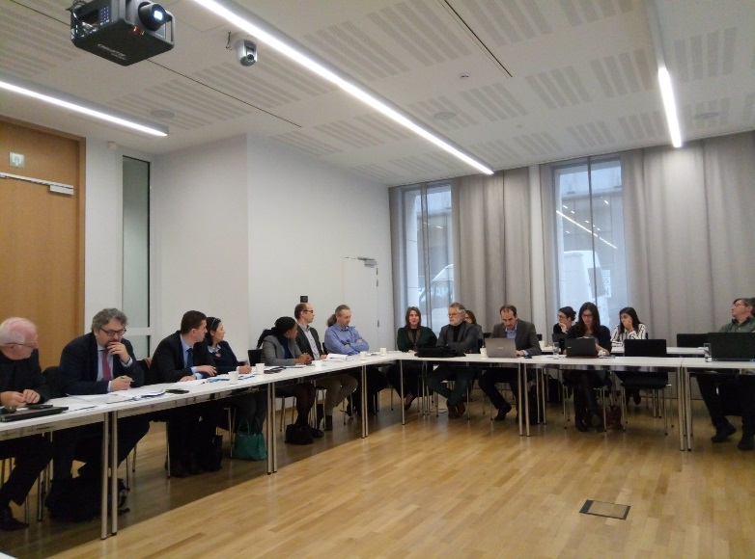

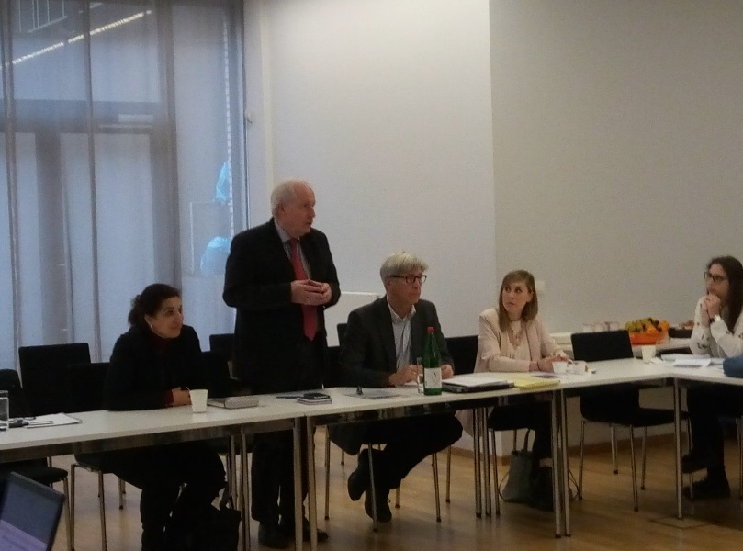
Earth Observation for Sustainable Development -Building of partnerships between Europe and Africa
SPACE4 Development Cooperation
8th December 2016: Working Breakfast with interested network partners
Workshop Earth Observation for Sustainable Development, BREMEN, 13-16 February 2016
⇨ Follow-up Meeting in Brussels for interested network partners and Brussels-based community on 15th June 2017

Slide 10
Impact of involvement in EU and ESA-funded activities
Networking and Visibility impact
Involvement in EU and ESA-funded activities
Impacts of project activities for the network on different levels
Community Building
Tangible outcomes
Additional Resources

Slide 11
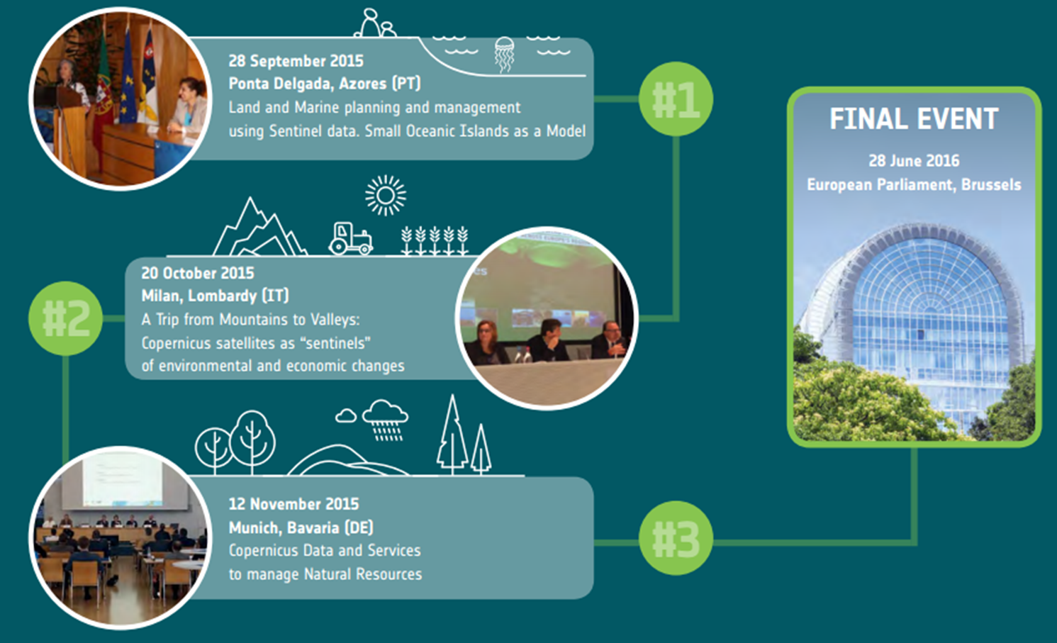
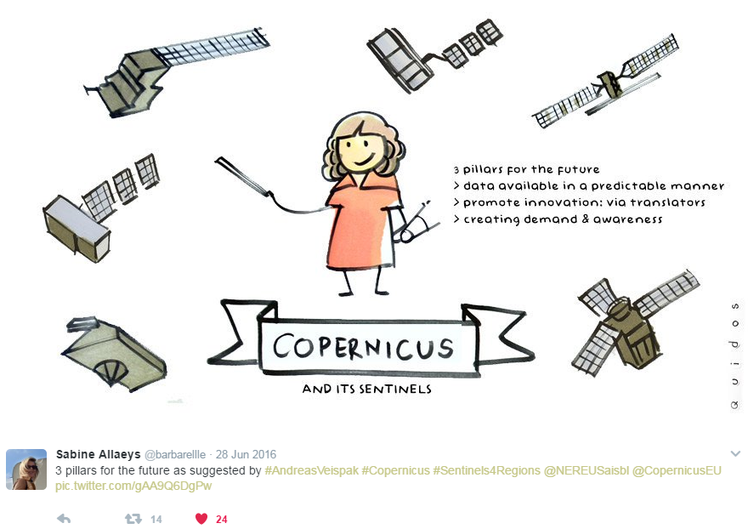
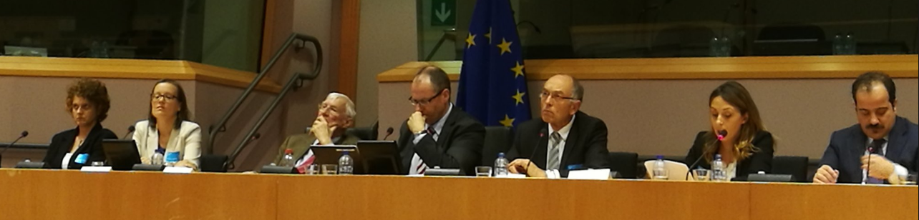
NEREUS/ESA-Partnership with respect to promoting Copernicus at regional level
(1)
NEREUS/ESA-Parliament Event – SENTINELS4REGIONS
June 2016

Slide 12

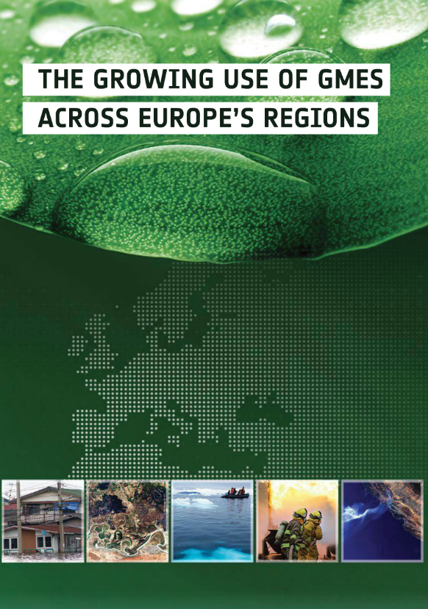
Ambitious approach:
67 Uses in 2012
⇨ Target: min.100 Uses in 2017
New Publication/
Up-date planned for 2017
Copernicus-User-Uptake (1)
Partnership with ESA/ESTEC
Call for abstracts across Europe
Focus of user-expriences of public user – local and regional authorities
EP-Event
Thematic interregional
Working
Sessions
Language support
Videos

Slide 13
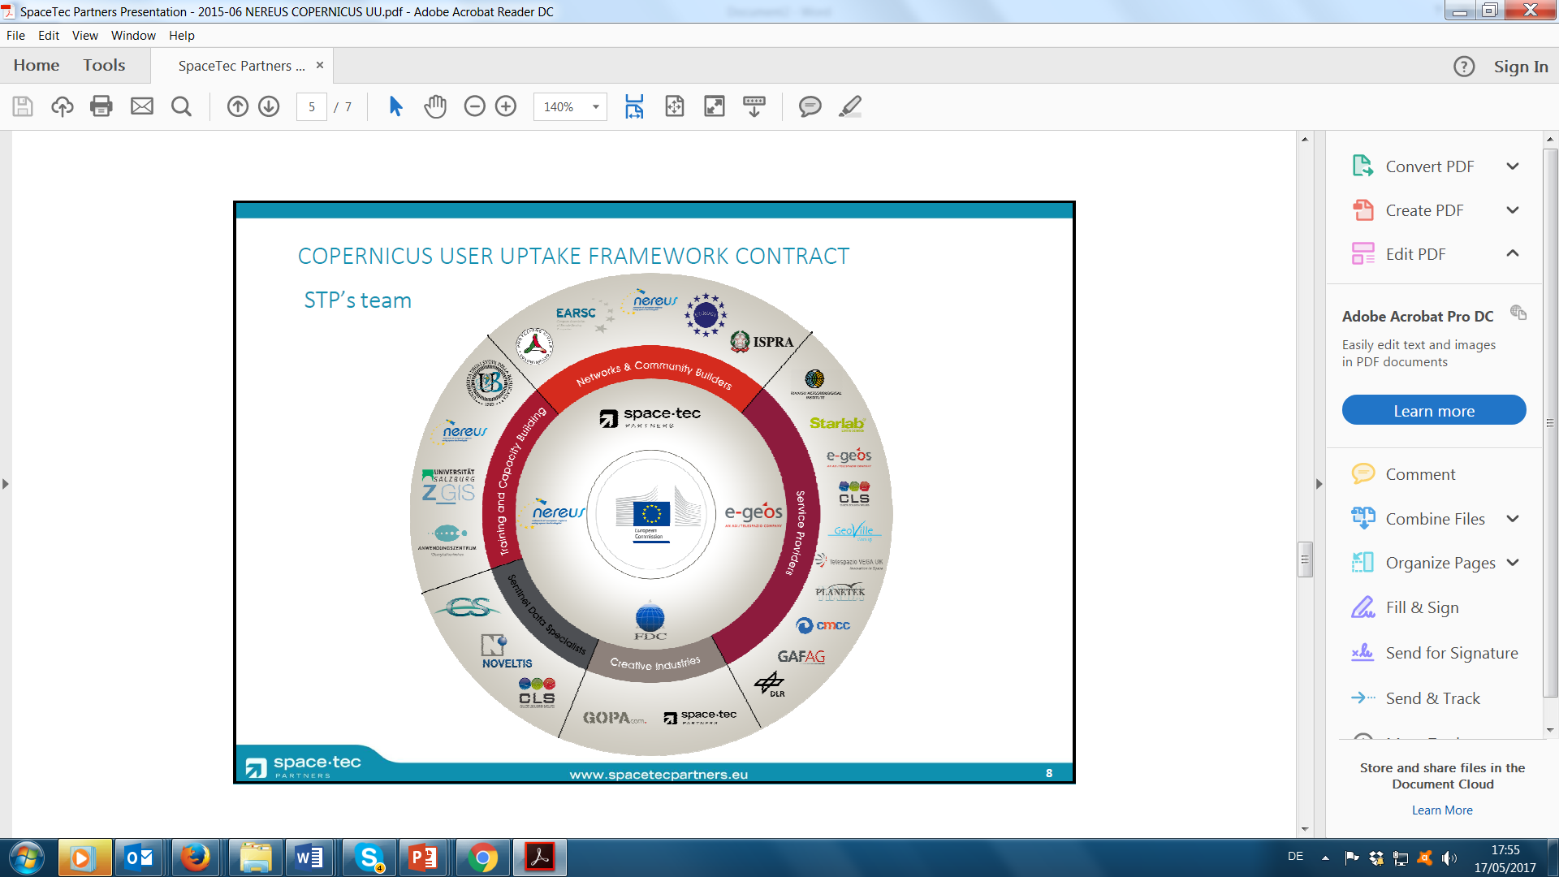
Multiannual (4 years) Framework contract
NEREUS is in successuf consortia lead by Consultancy SPACETEC
Implementation of Framework Contract via Specific Contracts
12 NEREUS-partner involved in activitiy (many former RCO-partner)
COPERNICUS UPTAKE FRAMEWORK CONTRACT (1)
By European Commission
Notes:
European Commission → Copernicus Uptake Framework Contract

Slide 14
Framework Contract is implemented via specific contracts:
Specific Contract: Study on Copernicus-Uptake in Europe
Specific Contract: -
Specific Contract: Coperncius-Value Chain WS
Specific Contract: Training and Info Session in EU-28 MS
COPERNICUS UPTAKE FRAMEWORK CONTRACT (2)
By European Commission
Notes:
European Commission → Copernicus Uptake Framework Contract

Slide 15



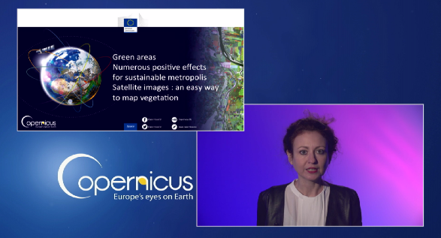

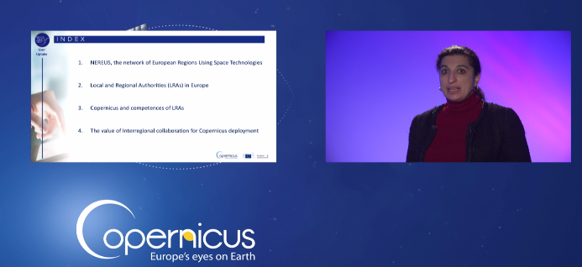


COPERNICUS UPTAKE FRAMEWORK CONTRACT
By European Commission
Notes:
European Commission → Copernicus Uptake Framework Contract

Slide 16
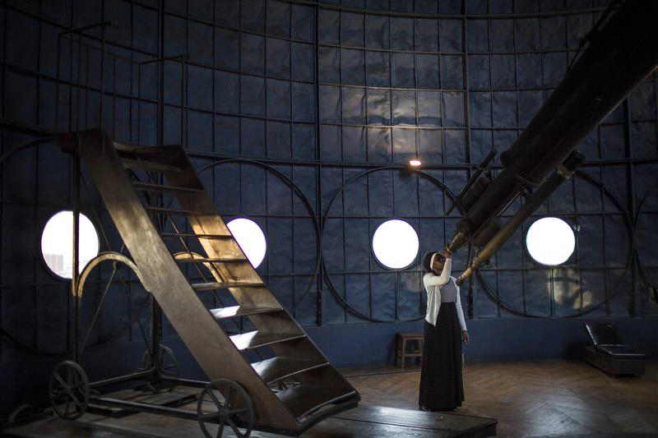
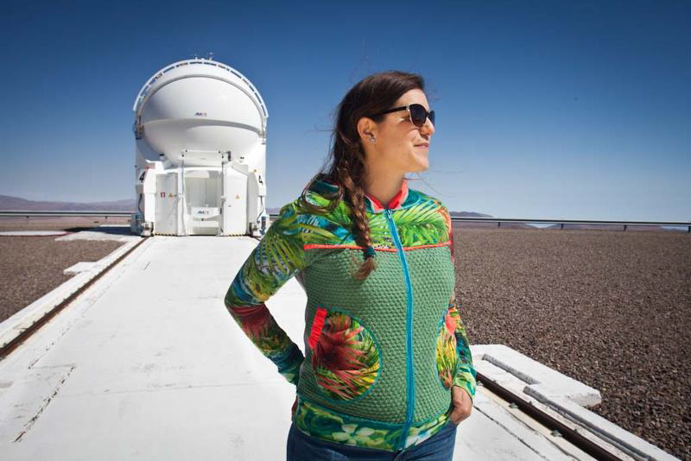

SPACE GIRLS/
SPACE WOMEN
Mobile Photo-exposition
(1)
40 photo portrays of girls and women of three different generations and different continents with their heads in the stars who choose space as a career, work or study option
Supported by Sipa-Press and ESA (NEREUS is together with CNES, Cité de l'Espace, Universpace and GSA sponsoring partner);
Following events in Brussels and Paris exhibition tours through NEREUS-regions

Slide 17
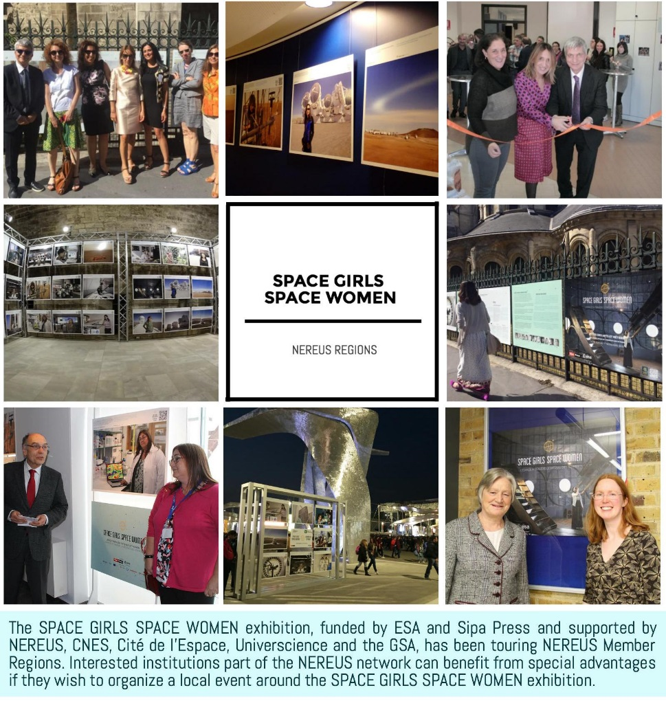
In 2016 the SPACE GIRLS/SPACE WOMEN exposition toured through several NEREUS-Regions:
Leicester, East Midlands (8-18 March 2016, University of Leicester)
Santa Maria, Azores (20 April 2016, Vila do Porto)
Matera (14-15 November 2016, Matera)
Bring the exposition also to your
region!
SPACE GIRLS/
SPACE WOMEN
Mobile Photo-exposition

Slide 18
THANK YOU!
Roya Ayazi
rayazi.nereus@euroinbox.com

Slide 19

WHAT DOES NEREUES OFFER ITS MEMBERS?
A JOINT PLATFORM
for developing joint positions and voice them
for building partnerships and networking at a European scale
for facilitating the involvement in EU/ESA-funded activities
for accessing crucial information in advance
providing enhanced visibility of the Region at European level

