Slide 1
How Europe Could Help Increasing the Impact of Regional Investments
8 Major Recommendations
Notes:
We have looked at the specific features of the downstream business models.
Now, we need to look at the upstream part of the driving belt !
What should be done by the space community counterpart of stimulate the development of such downstream markets ?

Slide 2
INTRODUCTION : PEGASE Project ID
FP7 Coordination and Support Action ("Support" type) for the GSA
Two partners : France Développement Conseil & Capital High Tech
Started on 01/12/08 for 24 months duration
One of major PEGASE Objectives :
Elaborate "Guidelines for coordination and exploitation of regional initiatives” :

Slide 3
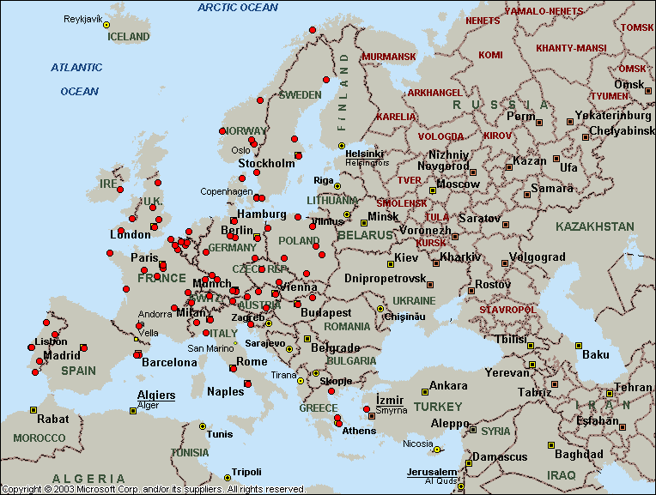
Strategic Background
Due to the high potential of the GNSS market, more and more national, regional or local actors have decided to launch proactive economic development policy in the field of GNSS.
The implementation of adequate coordination mechanisms and the permanent exchange of information with such initiatives are seen as very necessary by the GSA in order to maximize the benefits of regional investments while accelerating even further SATNAV Business development opportunities at the European level.

Slide 4
Regions
EU Institutions
APPLICATIONS MARKET DEVELOPMENT
1 + 1 > 2

Slide 5
Overall Process
A GNSS Regional Advisory Board was set up.
Major issues addressed:
How to help the European GNSS Programme better capitalizing on Regional Initiatives?
How to increase the efficiency of the Regional Initiatives through a better coordination at European Level?
NEREUS | Alain BENETEAU, NEREUS President
 | Roya AYAZI, Nereus Secretary General
 | Stephan HOLSTEN, CEON General Manager
 | Hélène BARON, Region Midi-Pyrénées
ENCADRE | Juergen VOGEL, Grunder Regio
 | Sven BRUNSMANN, bavAIRia e.V.
ESINET | Philippe VANRIE, ESINET Manager
 | Fulvio Sansone , ESINET Advisor
GSA | Boris KENNES , Market Monitoring
 | Carmen AGUILERA, Market Monitoring
8 major recommendations were provided as ‘Guidelines for a better coordination with GNSS regional initiatives’

Slide 6
HOW REGIONS CAN STIMULATE GNSS APPLICATIONS DEVELOPMENT
Notes:
In order to do so, one must understand what are the key specificities of Business Models at the downstream level.
Indeed, the analysis of 30 business models of European companies created over the last 5 years in the satellite applications sector let us think that several specific features need to be taken into account

Slide 7
REGIONS HELP BRIDGE THE GAP BETWEEN SERVICE PROVIDERS AND END-USERS IN OTHER INDUSTRIES
The GNSS segment per se does not exist but is embedded within a large number of industrial activities: Telecommunications, GMES, agriculture, avionics, insurance, ICT, telecoms, logistics, railway, ICT, maritime, tourism.
Because the regions host all these industrial communities, they appear to have the good geographical scale to stimulate such networks efficiently and thus to open new market opportunities for GNSS service providers in the other industrial sectors.
In this perspective, some of them invest in the implementation of ‘SATNAV applications promotion centres’ which behave as one-stop shop entities in order to explain and demonstrate to users why they might use space applications for.

Slide 8
REGIONS BOOST THE DEVELOPMENT OF GNSS APPLICATIONS
Convinced of the economic opportunities to be expected from the GNSS applications markets, many Regions have decided to foster the emergence of innovative GNSS applications proactively using one or several of the following ‘instruments’:
The implementation of GNSS specialised clusters in order to stimulate creativity and foster technology transfers among the various actors of the knowledge triangle (education, research and industry
The allocation of specific Regional R&D financing lines to support SMEs in the building up of first proofs of service concepts
The creation of specific incubators to support the emergence and growth of new ventures in the field and the launch of Business models contests.

Slide 9
REGIONS CAN STIMULATE THE DEVELOPMENT OF GNSS MARKETS
Regions can behave as real springboards to launch new applications business from.
Regions implement applications demonstrations areas on which the SMEs have the opportunity to demonstrate the benefits of their GNSS application on the field towards their first customers.
Since time to market is a key issue, such demonstration areas are seen as key stepping stones for SMEs willing to accelerate their business development.
2. Regions per se can also be seen as potential GNSS service customers over a wide range of possible applications : regional tourism promotion, regional transport organisation (car sharing, bus and regional railway traffic, emergency services oprimisation, monitoring of elderly persons in rural areas, trash collection organisation ...

Slide 10
AREAS FOR A BETTER COORDINATION / EXPLOITATION OF REGIONAL INITIATIVES
Notes:
In order to do so, one must understand what are the key specificities of Business Models at the downstream level.
Indeed, the analysis of 30 business models of European companies created over the last 5 years in the satellite applications sector let us think that several specific features need to be taken into account

Slide 11
STIMULATING THE MARKET DEMAND
Major challenges at stake
In order to foster the development of GNSS applications, promotion, education and awareness raising are needed, not only as regards citizens, but also as regards industrial and innovation networks.
Regions insist on the importance to raise market demand and to bridge the gap between GNSS applications providers and potential end-users in other industrial communities.
Regional added value
The Regions represent the ideal geographical scale to implement such a promotion efficiently !
organisation of road shows
setting up of regional Satellite Applications Promotion Offices to educate end-users about the GNSS functionalities

Slide 12
STIMULATING THE MARKET DEMAND
Recommendations / Major action lines expected from EUROPE
R1 Europe should offer ‘harmonized communication materials and back-up office servicing
for promoting the GNSS capabilities in the non space clusters
for supporting the organization of road shows and the daily operations of local promotion offices.
R2 Europe should communicate much more dynamically about the EGNOS and GALILEO programme on a mass market mode, with the ultimate objective to reach both the common citizens and the local politicians.
’

Slide 13
FOSTERING SMEs DEVELOPMENT
Major challenges at stake
Once SMEs have developed a first proof of concept for an innovative GNSS application, their key next challenge is to access quickly to the market and to expand their services on a European if not global scale
Regions insist on the importance to create the best environment for the SME development and commercial exploitation of the new product or service, with the ultimate goal for them to build a marketable, viable, trustworthy, stable and robust business.

Slide 14
FOSTERING SMEs DEVELOPMENT
Regional Added Value
Regions have invested in the development of one or several of the following instruments
GNSS specialised clusters
Dedicated SATNAV incubators
Business models contests
Demonstration areas or living labs
Expertise centre
Regional R&D financing lines

Slide 15
FOSTERING SMEs DEVELOPMENT
Recommendations / Major action lines expected from EUROPE
R3 Europe would multiply the efficiency of GNSS regional initiatives if it could make them more visible and accessible to SMEs and to other Regions through
The set-up of a regional GNSS web portal
GSA Stamped Quality Labels For Regional Initiatives
Compilation of regional good practices
In turn, this would allow to instigate pan-European fertilisation and to improve initiatives consistency
’

Slide 16
FOSTERING SMEs DEVELOPMENT
Recommendations / Major action lines expected from EUROPE
R4 Europe should develop GNSS specific innovation methodologies and supporting mechanisms for SMEs to access quicker to the market.
In line with the EGNOS GSA strategy, tool boxes should also be proposed to application developers.
Regional innovation intermediaries should be educated and accredited to use these various tools.
’

Slide 17
INSTIGATING THE EMERGENCE OF EUROPEAN LEAD MARKETS
Major challenges at stake
Regions are often the first market stepping stones which local SMEs start their business development from :
Regions implement applications demonstrations areas on which the SMEs have the opportunity to demonstrate their application on the field towards potential customers.
Regions per se are also potential GNSS service customers : some of them have implemented procurement mechanisms to purchase the customised GNSS applications they need : tourism promotion, transport organisation, emergency services optimisation, monitoring of elderly persons, trash collection...
Yet, regional markets are not large enough to sustain the development of new companies - SMEs need to exist also on the European if not global competition scene.

Slide 18
INSTIGATING THE EMERGENCE OF EUROPEAN LEAD MARKETS
Recommendations / Major action lines expected from EUROPE
R5 Europe should help instigate commercial domino effect from one Region
Those GNSS applications which are already developed in one Region should be made visible at the European level.
R6 The harmonisation of the various regional procurement schemes would also boost the development of Lead Markets in Europe while stimulating the development of critical mass offers at the European level.
analysis of common needs
organisation of specific forum to debate about procurement specifications
’

Slide 19
FINANCING
Major challenges at stake
10M€ is estimated as being the minimum entry ticket for any Region willing to stimulate the development of GNSS applications over its territory.
Although the Regional R&D funds might be used by SMEs to develop first application prototypes, additional financing is needed to help them industrialise their offer and to sustain their commercial development.
But Regions stress the difficulty for GNSS service providers to raise money from the private financing community.

Slide 20
FINANCING
Recommendations / Major action lines expected from EUROPE
R7 Regions would welcome EU based capital funding instruments.
The involvement of the European Investment Bank should also be considered as a very valuable way to convince the regional financial communities to invest in GNSS areas while reducing their investment risk through adequate guarantee schemes.
R8 Lobbying as regards DG Regio is seen as a key priority and should be conducted at the European level.

Slide 21
Florence Ghiron fghiron@chtech.fr CAPITAL HIGH TECH Pascal Campagne pascal.campagne@fdc.eu France DEVELOPPEMENT CONSEIL
Notes:
In order to do so, one must understand what are the key specificities of Business Models at the downstream level.
Indeed, the analysis of 30 business models of European companies created over the last 5 years in the satellite applications sector let us think that several specific features need to be taken into account

