Slide 1


European Space Agency (ESA) and International Development
Anna Burzykowska
Projects Specialist
Directorate of Earth Observation Programmes
ESA/ESRIN
December 2015.

Slide 2

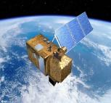


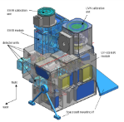
Copernicus Dedicated Missions: Sentinels
Launch S-1A 03 April 2014, 21:02:31 UTC
"Carpet" coverage, "data monsters"!
Development and Deployment of
A & B units (2.3 B€)
Free, open and easy access to data
Long-term continuity of observations (25+ years)
Used together with VHR (Very High Resolution) national European missions
Sentinel 1 – SAR imaging
All weather, day/night applications, interferometry
2014, 2015
Sentinel 2 – Multispectral imaging
Land applications: urban, forest, agriculture, etc.
Continuity of Landsat, SPOT
Launch S-2A 23 June 2015, 01:52:00 UTC
2015, 2016
Sentinel 3 – Ocean and global land monitoring
Wide-swath ocean colour, vegetation, sea/land
surface temperature, altimetry
2014, 2015+
Sentinel 4 – Geostationary atmospheric
Atmospheric composition monitoring, trans-
boundary pollution
2018+
Sentinel 5 and Precursor – Low-orbit atmospheric
Atmospheric composition monitoring
2015, 2020

Slide 3
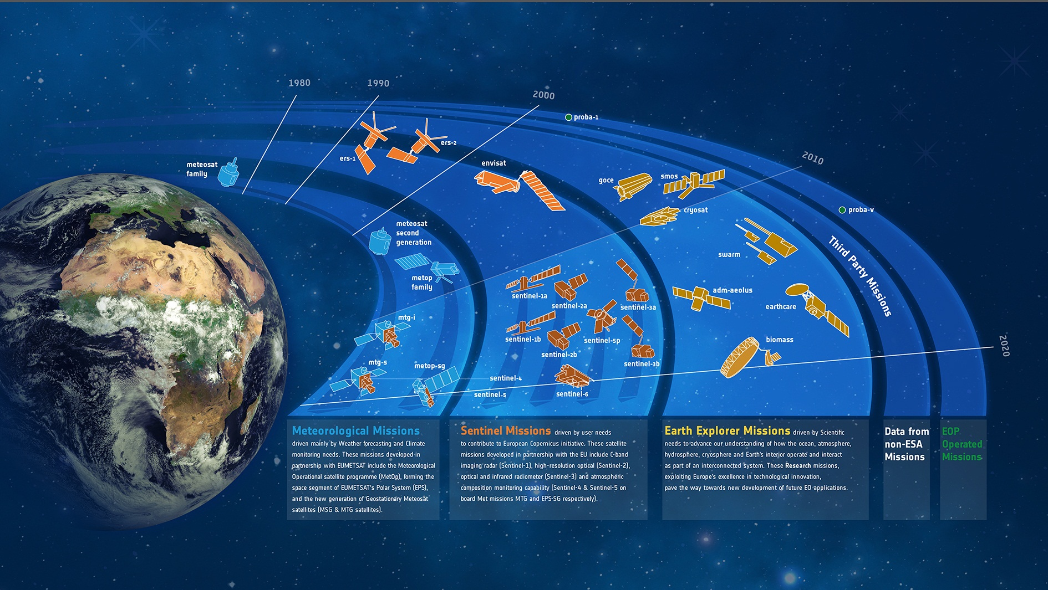
Assets in orbit

Slide 4
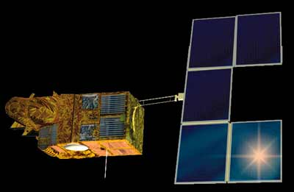
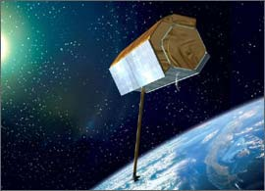
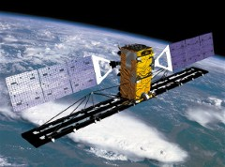
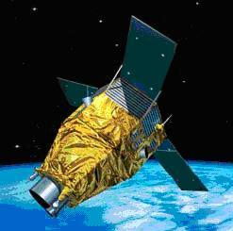
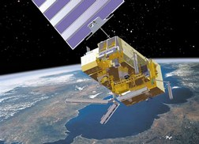
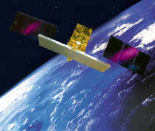

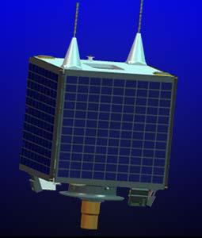
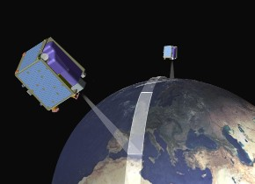
ESA Third Party Missions Program
SPOT
Terrasar-X
Radarsat
Pleiades
METOP
Jason-2
UK-DMC
Cosmo Skymed
RapidEye
+ many others

Slide 5
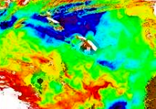
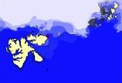
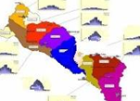
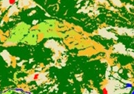
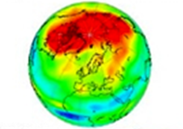
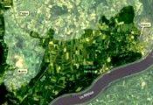

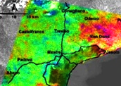
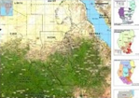

EO Service Portfolio
In Preparation of GMES - Copernicus
Services with formal specifications, standards, validation
Developed (via SLA) in collaboration and agreement of 400+ national user organisations
Qualified service suppliers
2003–2012 (130 M€)
Marine & Coastal
Polar & Sea Ice
Soil, Water & Urban
Forest Monitoring
Atmosphere
Flood & Fire Risk
Food Security
Land Motion
Humanitarian Aid
Maritime Security

Slide 6
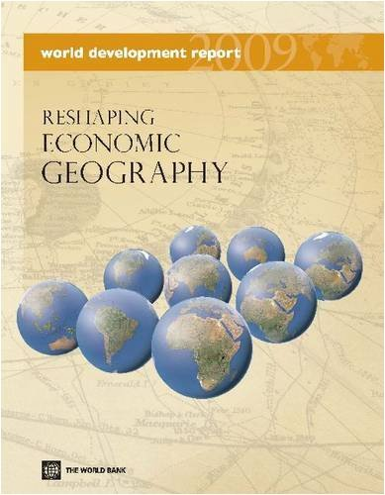

To which Development Issues is EO Relevant?
Sustainable Agriculture and Food Security
Rural Development
Water
Clean Energy
Oceans Living Resources
Sustainable Cities
Forestry (REDD)
Transport
Ecosystems Valuation
Health
Climate Resilience
Disaster Risk Reduction and Recovery ……..+

Slide 7




International Financing Institutions:
How could they use EO ?
Information Drivers
Information Uses
Green Growth
  Environmental impact / sustainability of economic development investments
Climate Resilience / Proofing
  Long-term durability of development investments
Natural Capital Valuation
  Economic valuation of Ecosystems for National and Global accounting (GDP)
Open Development
  Increasing drive towards transparency in knowledge resources
In support directly to Programs / Projects
  concept definition, planning, implementation
  close-out and remission
  as part of capacity-building in developing countries
In support of monitoring & evaluation methodologies
  as best-practice to harmonize M&E tools:
    Feasibility
    Environmental Impact Assessments
    Audits
In support of policy & planning
  sectorial analyses
  country development planning
  recent financial approaches to valuation of natural capital

Slide 8
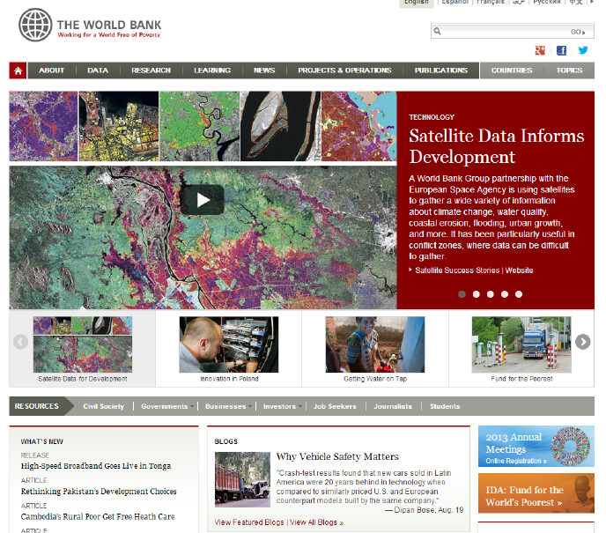
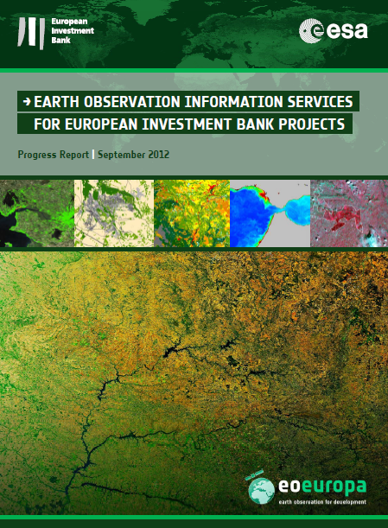
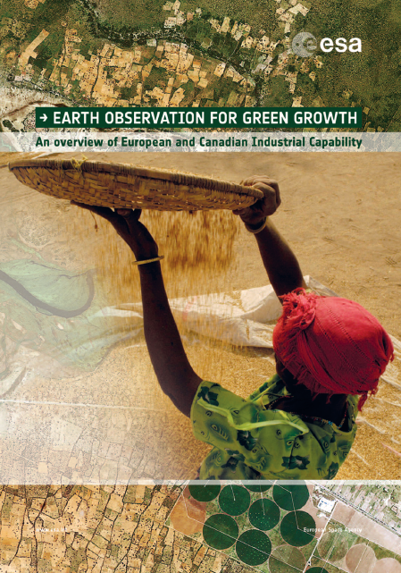
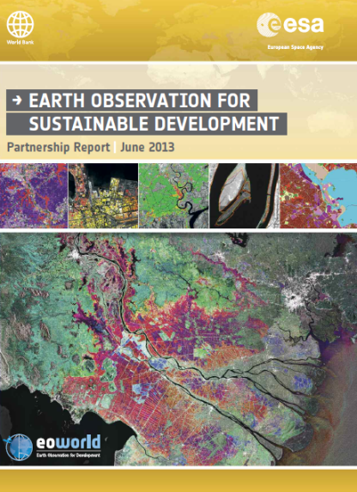
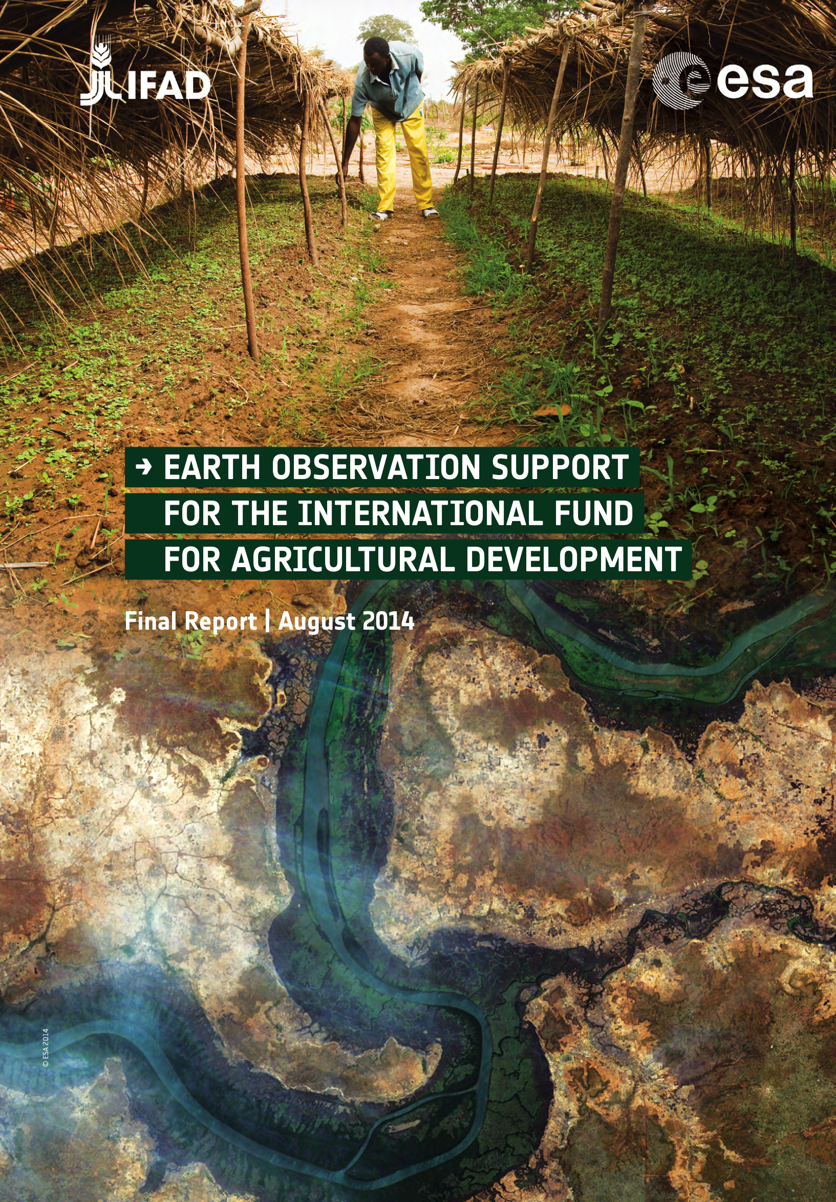
International Development :
EO as ‘best-practice’ environmental information
65 small-scale demonstrations (local-level, each 100K€) of EO products with Bank staff since 2008,
These activities have established the interest & potential for a wide range of EO information products about may different aspects of the Earth’s environment (terrestrial, marine, atmosphere, cryosphere)
Notes:
This idea is based on active collaboration over the last 5 years with the main International Development Banks (World Bank, Asian Development Bank, International Fund for Agricultural Development, etc – logos on bottom of the slide),
The opportunity is to establish EO-based information as ‘best-practice’ environmental information in the planning, implementation and monitoring of Bank project activities in the developing countries (typically large infrastructure developments),
More than 65 small-scale demonstrations of EO-based environmental information have been carried out in support of actual Bank development projects (the impact and benefits of using EO are documented in the reports on the right of the slide),
This has raised significant interest from the Banks to engage in larger-scale, longer-term activities to transfer EO information into their working practices (home page of the World Bank web-site with special feature on the use of EO in August last year),
There are also first signs of the Banks using their own resources for integrating EO-based information into their activities (e.g. 2 M US$ action from the Global Environment Facility GEF for Forest mapping in the context of REDD+)

Slide 9
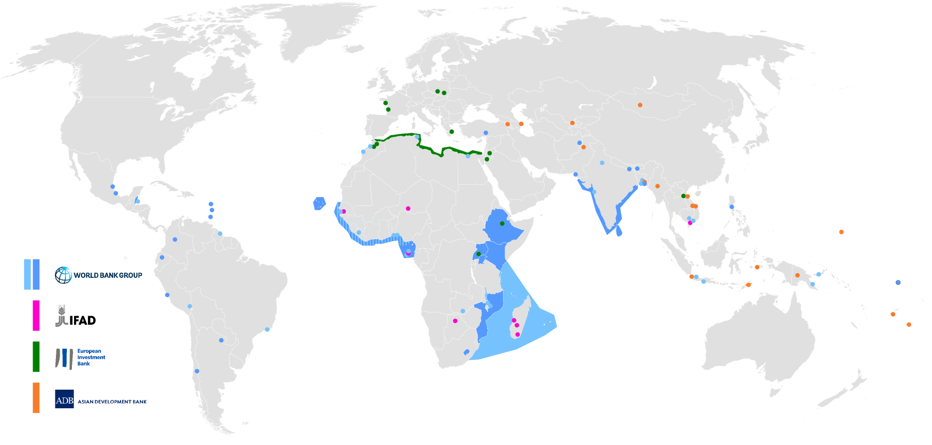
65 small-scale demonstrations :
Responding to specific geospatial information needs
Land Urban Infrastructure, Land Cover, Forest, Crops, Soil erosion, In-land Water,
Marine Oil-spill, Fishing, Coral Reef, Coastal Change, Sea-level Height, Ocean Currents,
Risk Floods, Land Motion Histories for Subsidence / Landslide / Seismic events.

Slide 10
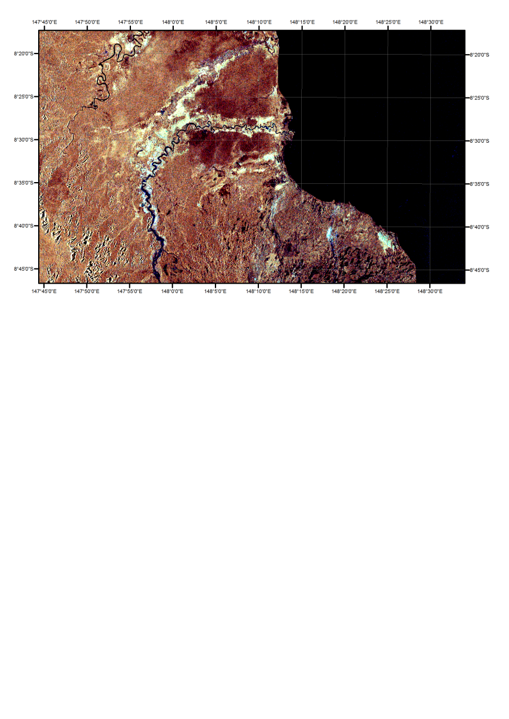
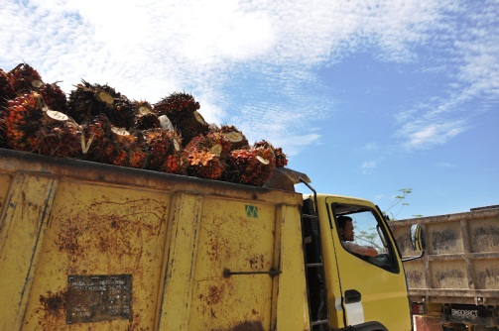

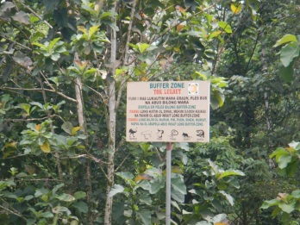
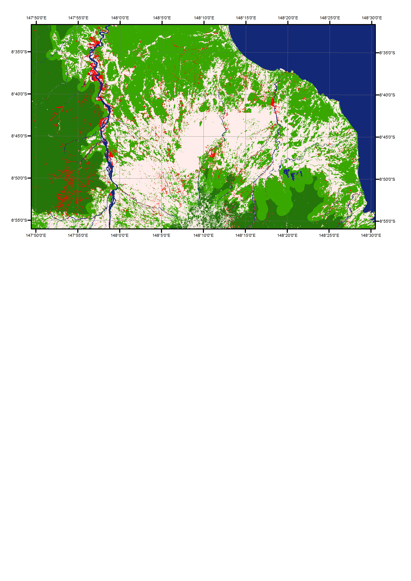
ESA – World Bank Collaboration
Environmental Audits in PNG: 2011 - 2013
Eoworld project provides new information previously unavailable and highlighted some information, for example, concerning wetlands that SADP did not focus on before. We would like to see that project developing further and get an additional information
Mike Scott, PNG Oil Palm Industry Corporation
Figure : EO based information: deforestation in Oro province ,PNG (2005-2009), buffer zones along the rivers and SAR image of potential wetlands. Credit: SARVISION for ESA/World Bank, RapidEye data © Rapideye, ALOS data © Jaxa

Slide 11
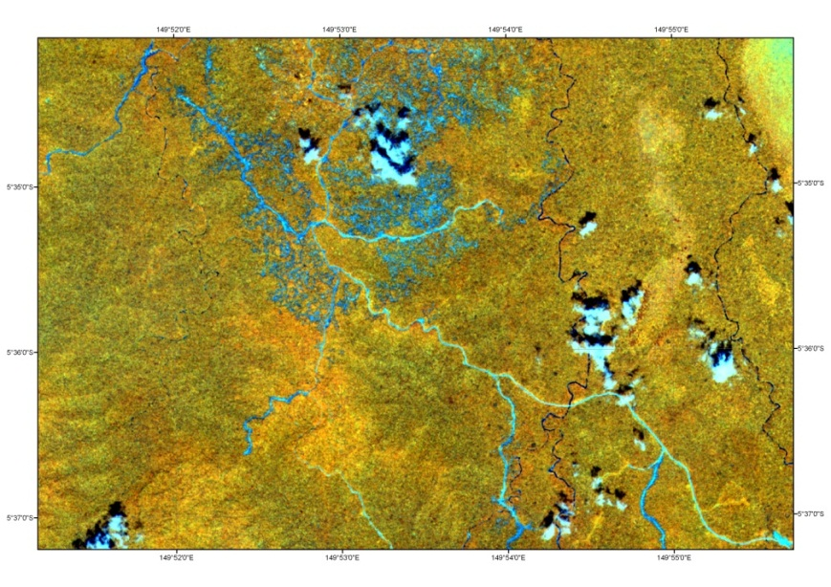
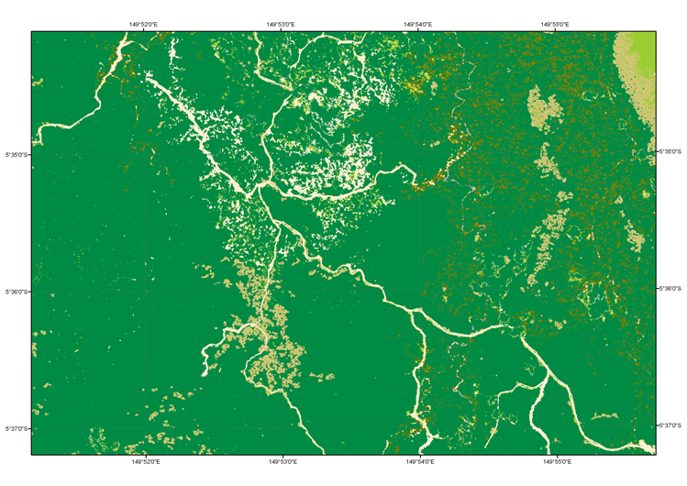
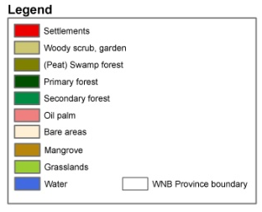
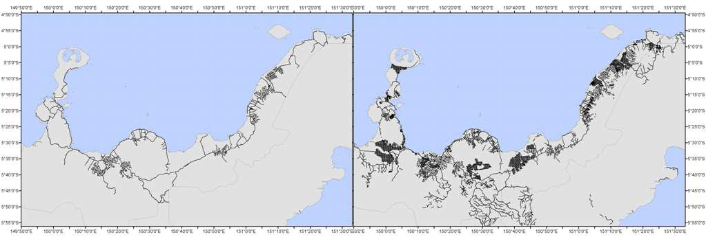
ESA – World Bank Collaboration
Environmental Audits in PNG: 2011 - 2013
Secondary and logged-over forest
Example of detailed road dataset produced for West New Britain
LEFT: Previously available roads dataset released in 2009, courtesy of the PNG Remote Sensing Centre. RIGHT: detailed and up-to-date road network dataset for 2011 produced during the eoworld project. Credit: SARVISION for ESA/World Bank, RapidEye data © Rapideye, ALOS data © Jaxa

Slide 12
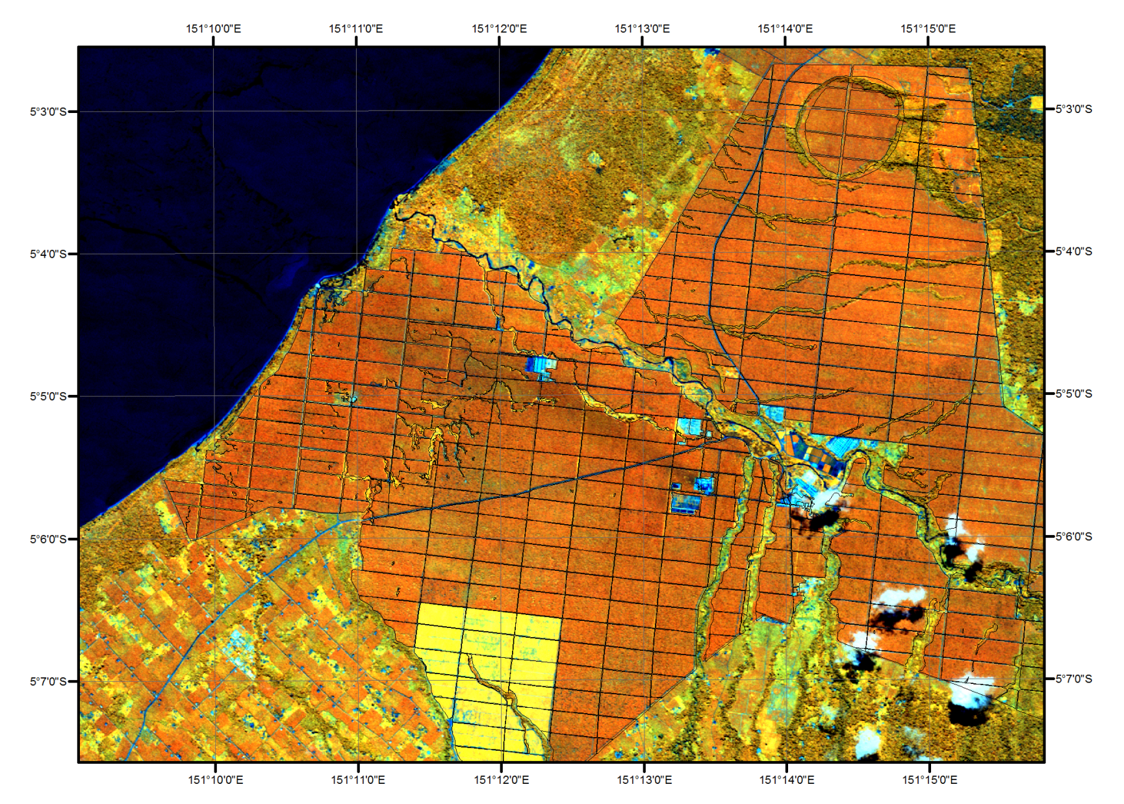
ESA – World Bank Collaboration
Environmental Audits in PNG: 2011 - 2013
Figure : Roads datasets in one of the plantations in West New Britain. Previously available dataset and dataset produced in the framework of eoworld project overlaid on the satellite data . Credit: SARVISION for ESA/World Bank, RapidEye data © Rapideye, ALOS data © Jaxa

Slide 13
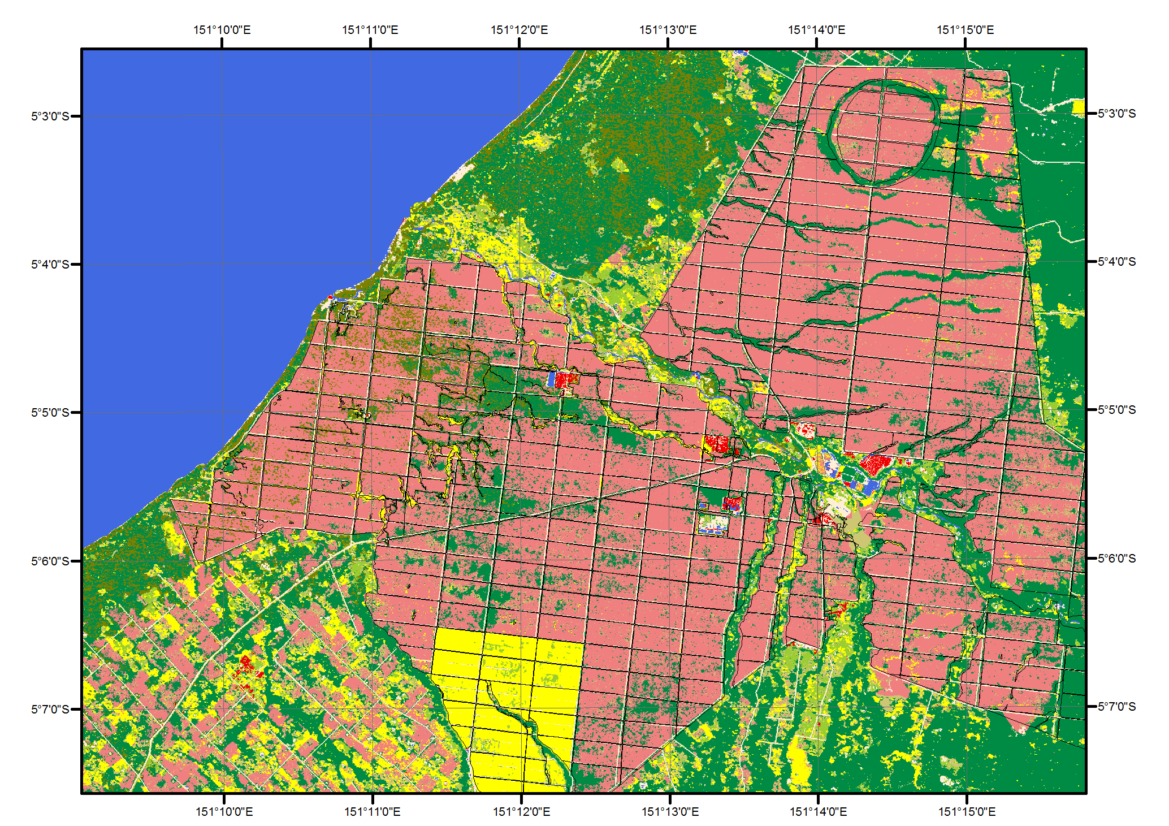
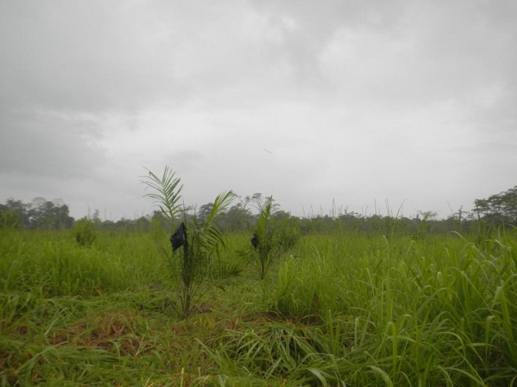
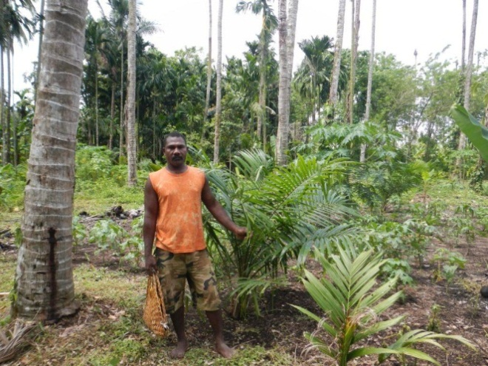
ESA – World Bank Collaboration
Environmental Audits in PNG: 2011 - 2013
Figure : Roads datasets in one of the plantations in West New Britain. Previously available dataset and dataset produced in the framework of eoworld project overlaid on the satellite data . Credit: SARVISION for ESA/World Bank, RapidEye data © Rapideye, ALOS data © Jaxa

Slide 14
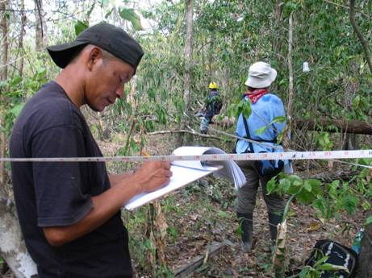
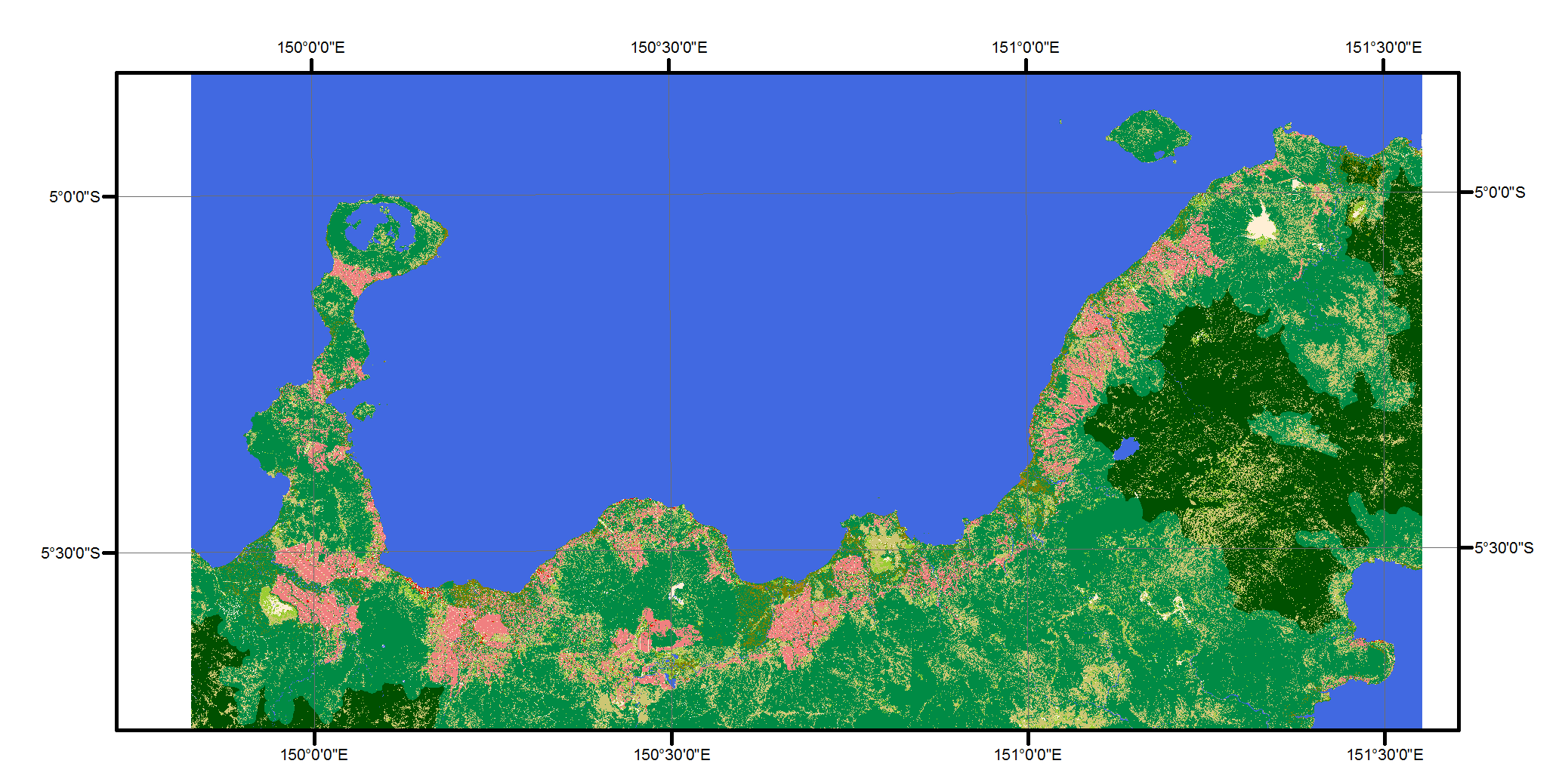
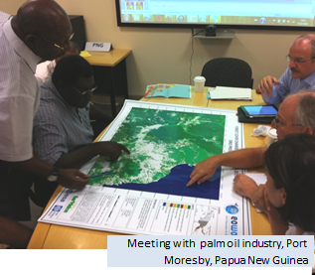
ESA – World Bank Collaboration
Environmental Audits in PNG: 2011 - 2013
Figure : West New Britain land cover map 2011. Credit: SARVISION for ESA/World Bank, RapidEye data © Rapideye, ALOS data © Jaxa

Slide 15



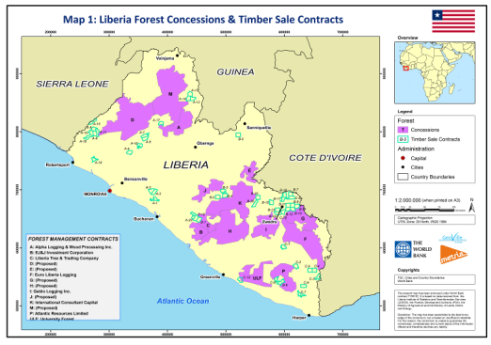


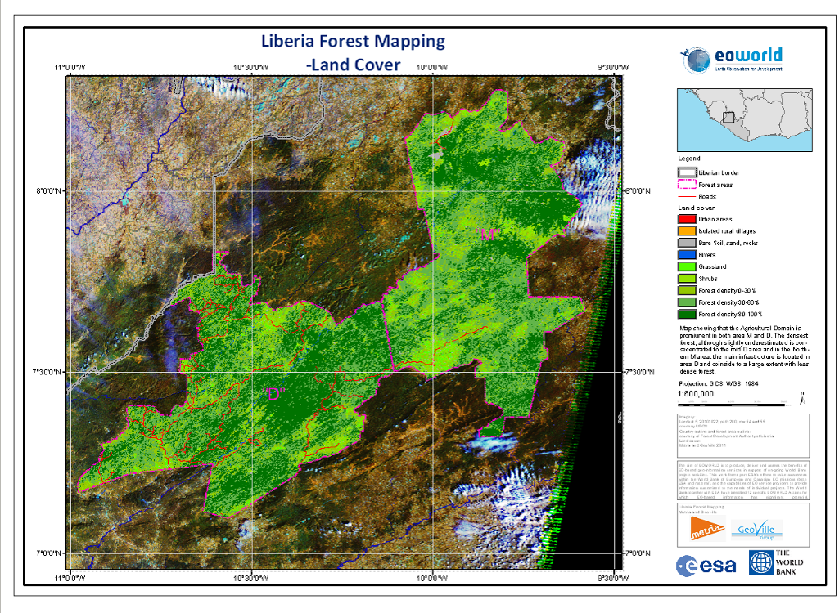
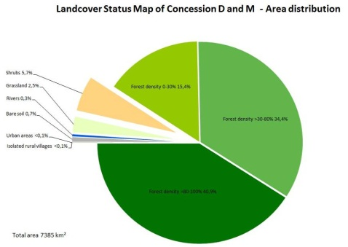
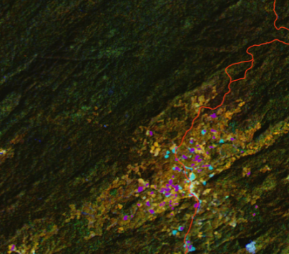
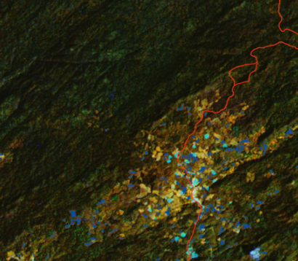
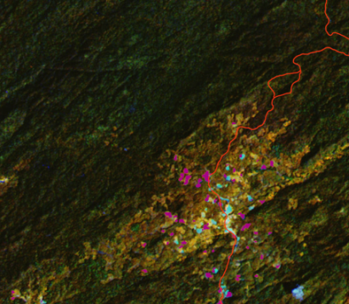
ESA – World Bank Collaboration
Forest Mapping 4C Forest in Liberia: 2013 - 2015
ESA pilot Technical Assistance projects (2012-2013)
  Forest concessions (Liberia)
    Forest map / forest change map in NW Liberia
    Assessment of the forest available in the areas TB allocated to commercial concessions
    Land cover
Forest Area | Clearing 2002-2007 | Re-growth 2007-2009 | Clearing 2007-2009
"D" | -0,15% | 0,53% | -0,28%
"M" | -0,29% | 0,66% | -0,35%
Figure : Land cover map over the M and D areas in North Western Liberia. Credit: Metria/Geoville for ESA/World Bank

Slide 16
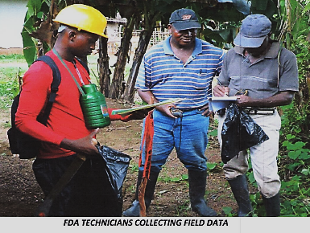
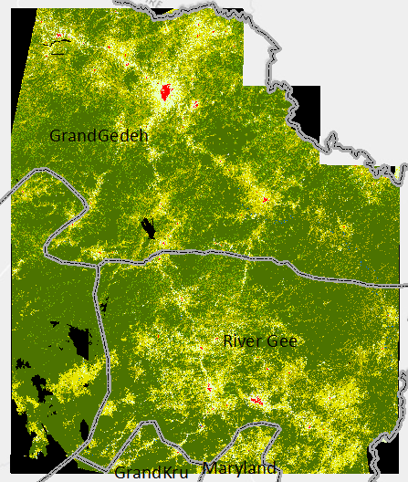
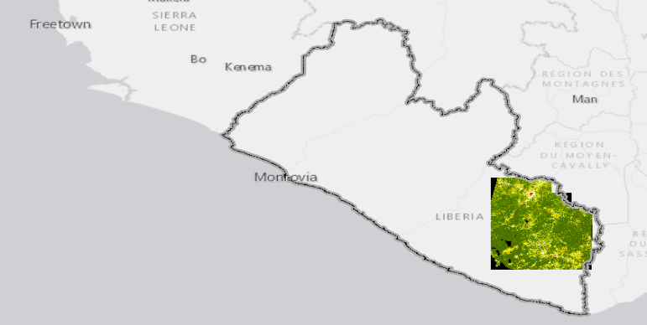
ESA – World Bank Collaboration
Forest Mapping for REDD in Liberia: 2013 - 2015
Follow on the initial activity High resolution nation-wide mapping of Liberia Forest and Land Cover (National wall-to-wall coverage )
    FCPF REDD Readiness Grant
    Strategic Environmental and Social Assessment (SESA) to inform land use options
    Specifications
    0.5 ha mapping unit
    Validation, accuracy assessment (90%)
Capacity building and trainings for the staff of the Forestry Development Authority, LISGIS and other relevant stakeholders, enabling a participatory approach to digital mapping of forest cover and its changes
Elaborate requirements on software tools for handling of geospatial raster data needed for operational land cover and forest mapping and monitoring in the longer term.

Slide 17



ESA – World Bank Collaboration
Forest Mapping for REDD in Liberia: 2013 - 2015
Figure : Significant improvement of information detail in the satellite-based land cover map compared to the existing 2004 land cover map. Credit: Metria Geoville for World Bank/FDA

Slide 18




ESA – World Bank Collaboration
Forest Mapping for REDD in Liberia: 2013 - 2015
Forest domain | Forest >80% Forest 30-80% Forest <30%
Rural, agricultural and particular domain | Mangrove & swamps Settlements Urban (>2500 inhabitants) Rural (< 2500 inhabitants) Surface Water Bodies Grassland (Savannah) & Shrubs Bare soil Ecosystem complex (rocks & sand) Slope classes (<10%, 10-20 %, 20-30 %, >30 %) Elevation classes
Infrastructure | Road and railway network Primary road (paved) Secondary road (unpaved) Tracks (backroads) Railways
Figure : Preliminary results of forest cover. Credit Metria/Geoville for World Bank /FDA
Figure : Rapid Eye coverage 2011-2013
Figure : Landsat 8 coverage Dec 2014-Jan 2015

Slide 19


ESA – World Bank Collaboration
Forest Mapping for REDD in Liberia: Opportunities
Natural Capital Accounting & examples focused on rubber trees : estimation of location, health and age. Can be used for plywood? wood fuel?
Figure : Credit Geoville for ESA GECOMON project

Slide 20




ESA – World Bank Collaboration
Forest Mapping for REDD in Liberia: Opportunities
Image examples focused on oil palm plantations
Figure : RapidEye 2013-01-01
Figure : Google Earth 2015
Figure : Landsat 8 2015-01-07
New oil palm plantations are established in the cleared areas

Slide 21
Africa Dry Forest Mapping
Initiatives by GIZ, ESA and World Bank/GEF
The GIZ-financed SADC REDD MRV Project conducted from 2012-2015
  The overall objective was to design a SADC regional REDD+ Monitoring Reporting and Verification (MRV) test sites of 26,000km² in each country (3 ecosystems Miombo, Mopane and Baikieae)
    Botswana,
    Malawi/Zambia (trans-boundary site),
    Mozambique,
    Namibia.
The ESA-financed project to address technical challenges of using EO for Dry Forest mapping
  Phenology of woodlands, Seasonality, Addressing limitations of current EO sensor systems with Sentinels
    Malawi, Zambia
The WBG-GEF5 financed research project to fill knowledge gaps and enhance the capacities of the countries to map and monitor these ecosystems
  Dry tropical forest
  Forest degradation

Slide 22



An Example : Marine Pollution Control in the
Western Indian Ocean
Impact: from the Bank perspective
  5 months operations,
  38 polluter incidents tracked and investigated
Credits: CLS

Slide 23

Satellite based fisheries surveillance for West Africa

Slide 24








Maritime Security data integration
SAR Image L1B
2009-07-15 05:16:14
Ship Detection Report
Terrestrial AIS
Satellite AIS
VMS
Not Correlated Ships
COSMO-SkyMed
© ASI
EO SAR - Satellite AIS –terrestrial AIS & VMS integration
COSMO SkyMed 2009-07-15 05:16:14

Slide 25






Satellite based fisheries surveillance for West Africa Example of the first outputs
Figures : Vessels Reporting System. In October, the project held workshops and meetings in Senegal with participants from the national fisheries control and protection agency (DPSP), maritime security agency (HASSMAR) and the Senegalese Navy. The Senegalese authorities together with technical experts from the project, analysed SAR, AIS and VMS data against known fishing areas, in order to identify possible illegal fishing operators

Slide 26

Platform for Urban Management and Analysis
World Bank EAP Regional Urbanization Flagship // support tool

Slide 27






List of cities mapped using Urban Atlas methodology
Mapping/monitoring principles:
Two to three decades of urban growth 1990, 2000, 2010
At least 13 urban classes
Showing land conversions across classes
Using the same definitions for comparable results
Delhi
Dhaka
Mumbai
Lima
Bogota
Quito
Jalalabad
Karachi
Chittagong
Colombo
Ho Chi Min City
Yogyakarta
Georgetown (Guyana)
Rio de Janeiro
Manila
Cebu City
Hai Phong
Surabaya
Ulanbaatar

Slide 28



Global Coverage 2011/2012
Baseline data
East and Central Europe
Africa
South East Asia
Credit: DLR/German Space Agency Global Urban Footprint, Satellite data: TerraSarX/TandemX mission

Slide 29


2014 ESA Innovators Project led by DLR
Phase 1 (2015-2016) :
i) the past urban extent (2002-2003) with ASAR WSM data for East Africa;
  75m spatial resolution built-up extent
  It includes entire Uganda, Rwanda, Burundi and Kenya in addition to big parts of Somalia, Ethiopia, South Sudan and Zambia
ii) the current urban extent for Addis Ababa, Dar es Salaam and Nairobi from Sentinel-1 IW GRDH data acquired in 2014-2015.
Phase 2 (2016-2017):
i) the past urban extent (2002-2003) with ASAR WSM data of the remaining part of the African continent;
ii) the current urban extent for Kigali and entire Uganda (including Kampala) from Sentinel-1 IW GRDH data acquired in 2014-2016

Slide 30










Benin
Lagos
Nigeria
Non Urban
Non Urban
Urban 2003
Urban 2003
Urban 2012
Credit: DLR/German Space Agency, Satellite data: TerraSarX/TandemX mission, Landsat, ERS, Envisat

Slide 31



ESA – World Bank Collaboration
      EO support to World Bank projects, 1st batch of 15 projects completed 2013,
      Partnership report with results for all projects available,
      www.worldbank.org/earth observation
      EO support to 2nd Batch of 18 projects started in Q2 2014, will complete in Q2 2015,
      Addresses a wider range of project activities across a wider community of Bank staff,
      Memorandum of Intent (MoI) between WB and ESA for longer-term cooperation to be signed by end of 2015
• Turkey
• Himalayas
• Mexico
• Carribean
• West Africa
• India
• Philippines
• Colombia
• Lake Victoria
• Sri Lanka
• Peru
• Zambia
• Chile
• Mozambique

Slide 32


ESA – European Investment Bank
EO support to 10 EIB Projects : Completed 2013
Focus on European Missions, European specialist service providers, technical oversight by ESA,
Mostly VHR Land Cover to monitor 10 EIB Investment Projects,
Open-source GIS tool being developed (LuxSpace) to aid visualisation and simple analysis of EO products within the Bank.

Slide 33




ESA – UN-IFAD Collaboration
EO support to 5 IFAD Projects : Completed 2014
  2009–2010 : Three initial small-scale Pilots,
    Rice acreage: Madagascar
    Irrigation infrastructure: Madagascar
    Small land-tenure maps: Madagascar
  2013 : More substantial Demonstrations across a wider range of five bank projects, Final Report available,
  2013 : IFAD set up internal Working Group on EO and GIS exploitation.

Slide 34




ESA– ADB Collaboration
EO support to 12 ADB Projects : In Progress
      EO support to 12 ADB projects,
      Discussions with 5 operating regions of Bank,
      Activities start Q3 2014, will complete Q3 2015,
      ESA stand at the 48th ADB Annual Meeting, to raise awareness of EO in ADB Developing Member Countries (DMCs), Academia, Civil Society, Industry & Media.
      ADB interest in establishing an environmental information mapping facility with EO as base-line and analysis tools to support project planning, implementation and monitoring.

Slide 35













Capacity Building for Sustainable Uptake
TIGER initiative: Looking after Water in Africa
  10 years initiative assisting African countries in building capacity in water resource management based on EO
TIGER Research
  South-South-North knowledge exchange (70 projects & fellows)
  Building scientific EO understanding & capacity
TIGER Training
  Training courses for water experts, scientist & stakeholders
  TIGER Training Kit covering wide range of EO applications
TIGER Water Observation Information System (WOIS)
  Open source software for monitoring water resources
  Building local EO capacity for sustainable uptake of EO
TIGER Community & Partners (150 African experts in 42 countries)

Slide 36
Longer-Term : A New Opportunity
A window of opportunity exists to exploit European EO assets (satellites and services) within the activities of the International Development sector.
The International Stakeholders are already positioned to further explore EO capabilities with initial evidence that resources are made available when benefits are demonstrated, and real potential path to long-term sustainability
Start 3 Larger-scale (regional-level) activities in early 2016 in the areas of Water resources, Urban, Agriculture.

Slide 37

Take-Home Messages……..
Earth Observation can deliver key environmental information that supports the definition, planning, implementation, monitoring and assessment of major investment projects in developing countries.
Europe has world-leading capabilities in Earth Observation – both ESA and national EO missions – and a highly skilled and experienced EO information services industry.
ESA is in discussions with its Member States to support a longer-term dedicated programme of work to transfer EO into International Developement.
Notes:
Budget is between 3.5 and 4.5 billion Euro each year.
We work with programmes. We're not an administration, we're an agency. Every three years every member state sends a minister to decide which program each country will put money into.

Slide 38
Thank you

