Slide 1
Draft
Report on Political Dialogue
By Vice-President Christian Bruns

Slide 2
Political Dialogue May 2015 – May 2017
May 2015
May 2017

Slide 3
Strengthened/intensified relations with strategic partners (European Commission, European Parliament, Committee of the Regions, European Space Agency (ESA))
Strengthened regions‘ visibility as an active space player
Strengthened NEREUS‘s role as voice of European regions and point of reference on matters of space uses
Contribution to definition of European Space Strategy
Enhanced efforts to make the network known amongst relevant European communities
Political Dialogue May 2015-May 2017
-1-

Slide 4
NEREUS is a recognized interlocutor at EU- and national level
The regional dimension is increasingly taken into consideration when shaping and discussing space policies
NEREUS is increasingly valued as a cooperation and project partner
NEREUS is invited to relevant EU/ESA-expert groups and events in order to represent the perspective of regions
Political Dialogue May 2015-May 2017 – -2-

Slide 5
European Commission
European Space Agency
European Commission
Strategic Partners
European Parliament
NEREUS
NEREUS
NEREUS
Committee of the Regions
National Space Agencies

Slide 6
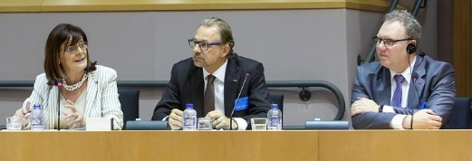
Joint Parliament Event in June 2016 – SENTINELS4REGIONS
was supported and hosted by Patrizia Toia, Member of European Parliament and Vice-Chair of the ITRE Committee.
Numerous Members of European Parliament who have their constituency in NEREUS-regions joined the debate.
Strategic Partner: European Parliament
-1-

Slide 7
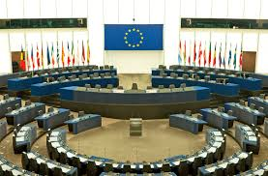
Advocating the views and concerns of the regional dimension, NEREUS represented by VP Christian Bruns exchanged with rapporteur of the ITRE-Committee Constanze Krehl, responsible for the report of the European Parliament on the European Space Strategy
Strategic Partner: European Parliament
-2-

Slide 8
Continuous exchange with ENVE-Commission and giving input to activities of members from NEREUS-regions
Prior to the publication of the EC-proposal, NEREUS-Delegation discussed with the CoR Secretary General Jiri Burianek the role and impact of the regional level in view of a future European Space Strategy and how both organisations could join forces to promote the regional dimension
Strategic Partner: Committee of the Regions
-1-

Slide 9
NEREUS is an appreciated interlocutor of the rapporteur of ENVE-Commission, Andres Jaadla (Estonia) with respect to the opinion of the Committee of the Regions on the European Space Strategy
NEREUS represented by VP Christian Bruns presented its position together with the European Parliament (MEP Krehl) and the European Commission in a session of the ENVE-Committee
NEREUS represented by SG Roya Ayazi presented its views in a stakeholder hearing with the rapporteur and the EC, organized by the Committee of the Regions
Committee of the Regions through its president asked to be represented on behalf of regions in Copernicus User Forum (key governance body for Copernicus program)
Strategic Partner: Committee of the Regions
-2-

Slide 10
Prior to the publication of European Space Strategy by EC in October 2016, NEREUS broadly promoted its position towards relevant institutional partner
To this end NEREUS-Delegation met with EC, DG Growth Director Phillippe Brunet, to discuss the regional dimension with respect to a future European Space Strategy
Strategic Partner: European Commission (EC)
-1-
Proposed European Space Strategy by EC puts the users in its centre while making concrete reference and mention of the regional level
Notes:
With the European Structural Investment Funds, the Commission will support research and innovation in Regions which have identified "space" as a priority in their Smart Specialization Strategies, and will facilitate cross-border cooperation among research and innovation actors;
Awareness-raising campaigns will be organised at regional level, including the set up of support networks such as the Copernicus Relays and the Copernicus Academy network;
The Commission will provide technical support in using innovative and cross-border procurement for space solutions, specifically targeted to the public sector;
The Commission will explore alternative business models (public-public, public-private partnerships or buying services) where this may be more efficient and would leverage available funding. This will provide manifold opportunities for SMEs and networks of entrepreneurs in NEREUS-regions;

Slide 11
NEREUS is a valued cooperation partner within multiannual framework contract to promote the up-take of Copernicus and brings the regional dimension into the project realisation and related policy debates
NEREUS is a member of the Horizon2020-Space Advisory Group
Strategic Partner: European Commission (EC)
-2-

Slide 12
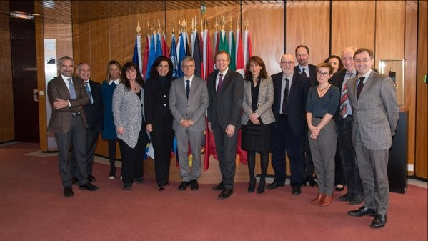
Exchange with ESA-Director General Prof. Wörner in January 2017
Strategic Partner:
ESA
(1)
Bringing space to European regions via a user-driven approach. With view to the up-coming European Space Strategy the role and impact of the regional dimension was underlined by both organisations.

Slide 13
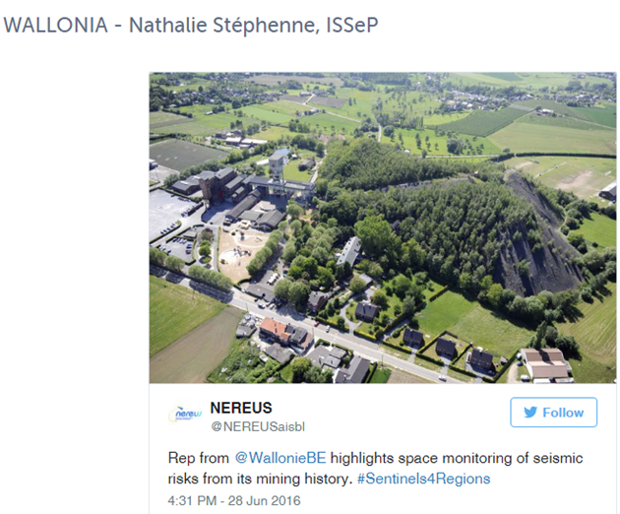
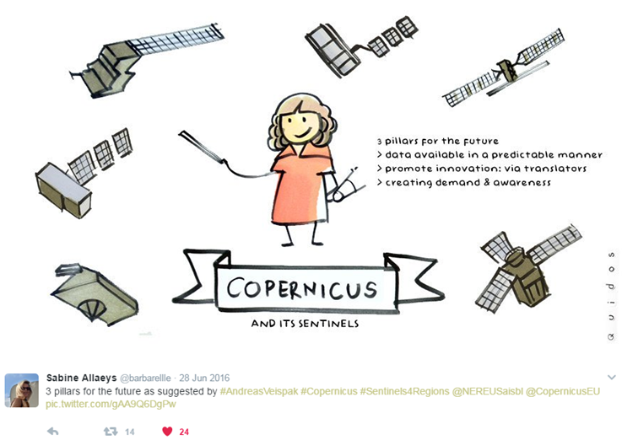
Continuation of ESA/NEREUS-partnership in order to promote Copernicus at regional level:
Joint Parliament Event in June 2016 – SENTINELS4REGIONS
Strategic Partner:
ESA
(2)
Bringing concrete regional user-experiences to the European Parliament

Slide 14
Liaising and exchanging with national space agencies is an important pillar of NEREUS-work program
CNES (French Space Agency) is an Associate Member since the foundation of the network and a continuous interloctor and cooperation partner
ASI (Italian Space Agency) is becoming an Associate Member
NEREUS has close relations to Space Agencies of Member States whose regions are present on NEREUS-platform
Strategic Partner:
National Space Agencies
-1-

Slide 15
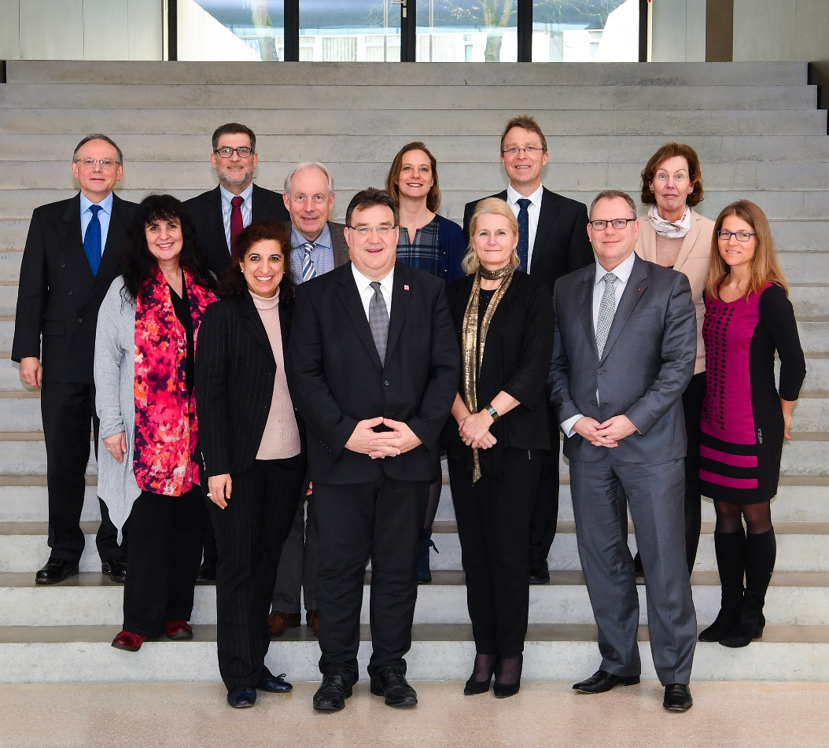
DLR (German Space Agency):
A high-level NEREUS-delegation met with DLR-chair woman Prof. Pascale Ehrenfreund to exchange and explore topics of common interest.
Both organisations agreed to meet on a regular basis.
Strategic Partner:
National Space Agencies
-2-

Slide 16
NEREUS-Position Paper:
„Recommendations on adding a regional dimension
to the European Space Strategy”
NEREUS-Position Paper

Slide 17
Outlook advocacy 2017/2018
Positioning of the network with view to the implementation of the European Space Strategy and engaging actively
Prioritisation?
Concrete measurer/actions?
New Trends?
Financial envelop?
Next Multi Annual Financial Framework (MFF)?
Gathering more information (facts & figures) on the situation of the downstream sector and the impediments at regional level for its development across Europe!!!!!
Notes:
Policies, Prioritisation and design of actions and measures have to focus on reaching regional and local eco-systems as well as public user
Pritorities and Management structures of public funded activities have to be shaped to reach also smaller entities
reliable and rapid data access at all levels of society is vital
Closing digital divide
Development and definition of European pilots and model initiatives at regional level to demonstrate tangible benefits

Slide 18
THANK YOU!

