Slide 1
Examples of regional funded projects to strengthen the Copernicus competence in Bavaria
Manfred Schroeder, bavAIRia e. V.
Copernicus- Sentinels Serving Society and the Environment,
12-13 May 2014, Athens, Greece- NEREUS- side- event: Space4Regions

Slide 2

bavAIRia e.V. is the organisation to manage the Bavarian Aerospace Cluster
bavAIRia is an association partly funded by the Bavarian State Government to manage the Cluster Aerospace
Founded in mid 2006 with 40 member organisations, bavAIRia currently has 184 member organisations
bavAIRia on behalf of the Bavarian Ministry of Economics is the coordinator for the Aerospace Cluster
bavAIRia brings together the stakeholder groups industry, science and politics on a neutral ground – the goal is to facilitate cooperation and to stimulate joint projects

Slide 3













The bavAIRia GMES-Office concentrates Bavarian
GMES-Competencies and Activities
GMES/Copernicus-WG
Comments
The bavAIRia GMES-Office has the following goals:
  Representation of interests on Federal- and EU-Level
  Networking of relevant Companies and Research Institutes in Bavaria. For this periodical meetings of a GMES/Copernicus-Working Group are held and Workshops are organized
  The GMES/Copernicus WG brings together 30 stakeholders with expertise in the scope of GMES ( approx. 16 companies,10 research instituts and 4 ministries/agencies)
  Supporting the participation in EU- und ESA-Programms (so far succesful participation in ESA‘s GMES Service Element projects, in EU‘s Fast Track and Pilot projects,in other EU FP projects and now in GIO projects)

Slide 4
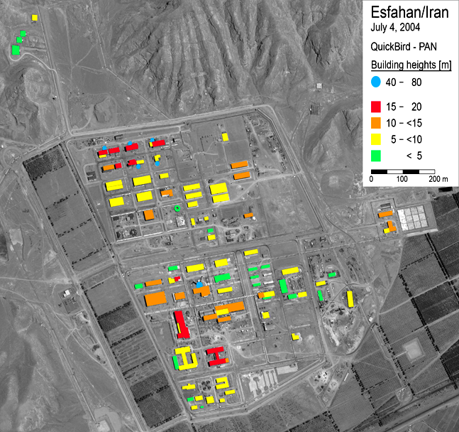
Bavarian GMES Competencies & Key Actors have been compiled in a Fact Book
Land Monitoring Emergency Response Monitoring of the Atmosphere Marine Services Civil Security Climate Change

Slide 5

Bavarian Efforts to stimulate Copernicus Activities
- Networking of Copernicus Stakeholders and initiating Cooperation
(GMES/Copernicus-Working Group)
Definition of Regional Copernicus Services in Bavaria (Study: Demand
of Copernicus Services in Bavaria)
Funding of Projects on Regional Basis to stimulate Cooperation
between SMEs and larger Companies as well as to develop
Downstream Services (2 projects: Apps4GMES, Opus-GMES)
Initiating of Copernicus relevant Projects on European Level to
establish Cooperation between Companies in Bavaria and other
European Regions (4 Projects in the Emmia Iniative)

Slide 6
Study: Demand for GMES-Services in Bavaria
Funded by the Bavarian Ministry for Economic Affairs in 2012/13
Contractors:
23 GMES relevant processes in public authorities were identified
For 6 processes a detailed analysis was made
4 applications were selected for urgent and early realisation:
Safety of animal feed- detection of potential contaminated
areas (smoke, dust, flood etc.)
Assessment of green fodder production- weather independent
observation (Radar) of grassed areas-registration of grass cuttings
State of Forest Vitality
Subsidences in former Mining Areas- Monitoring of vertical Movements
of the Earth surface

Slide 7



APPS4GMES
Development of operational processor chains and their implementation for GMES-downstream services
using Cloud Computing
- Applications: Water Quality and –Quantity, Agriculture,
Environment, Forestry(REDD), Fire Monitoring
- Close Link between Processors and GMES-Data Center
Funded by the Bavarian Ministry of Economics in the Frame Work of the Bavarian Space Programm 2012-2015
Coordinator: VISTA GmbH

Slide 8
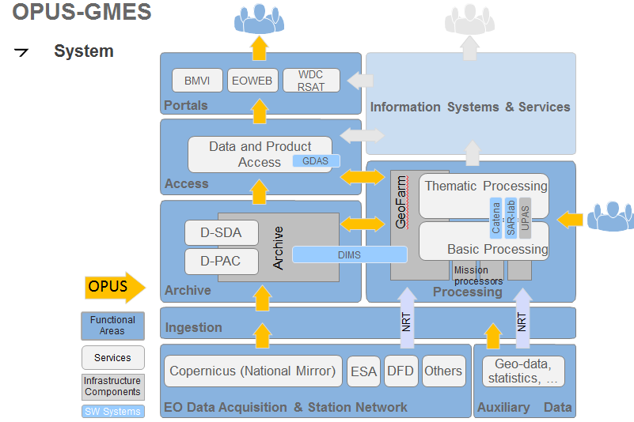
OPUS- GMES
Enhancements of a platform concept for improved supply and processing of
Sentinel- data to support national Copernicus- users and –services
(Collaborative Ground Segment).
Technical Developments:
- Easy data access and –distribution
- Processing modules and –chains
(Geocoding, Atmosheric Correction,
Image Mosaics,Time Series etc.)
- Standardisation and Quality Control
Funded by the Bavarian Ministry for Economic Affairs (Nov. 2013- 2017)
Main Contractor:
Subcontractors (tbc): CloudEO AG

Slide 9









EUROPEAN Mobile&Mobility Industries Alliance (EMMIA)
EMMIA is funded by DG Enterprise and Industry to promote
Mobile services based on
- Mobile internet - EGNOS-GNSS - Copernicus
with the goal
- to enlarge the market for mobile services
- to develop large scale demonstrators
- to support „emerging industries“ Mobile Information Systems
EMMIA- Policy Learning Platform- Political recommendations and roadmaps to
give Regions/Cities Guidelines for the Implementation of Mobile Services
Attract big
brands

Slide 10
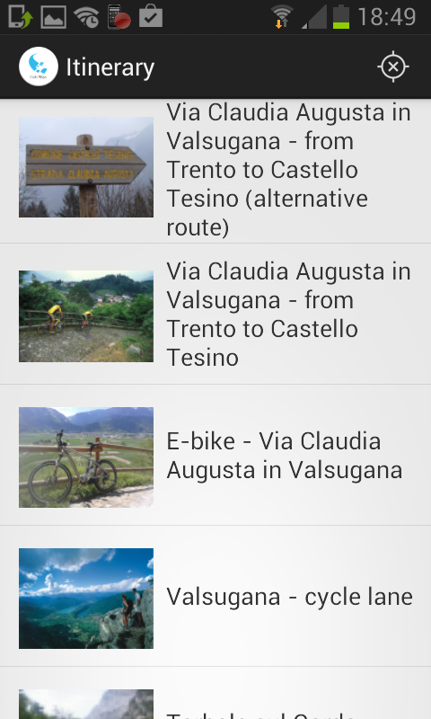






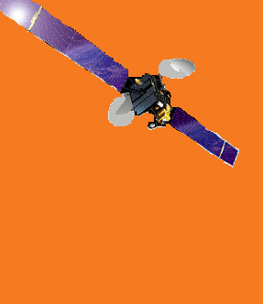
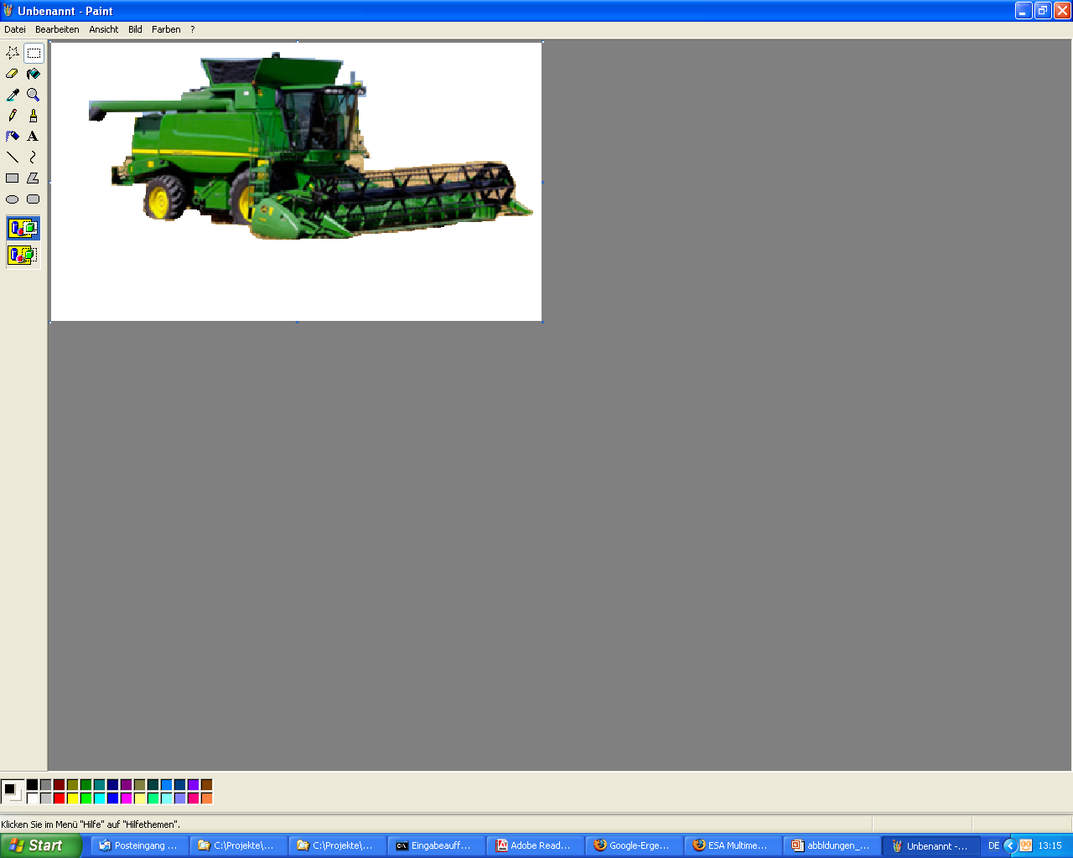



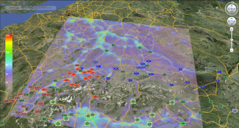




Cultways- (CULtural Tourism Ways) is a large-scale demonstrator for tourism on European Cultural routes to be tested on Via Claudia Augusta and Way of St. James
myEOrganics- providing innovative mobile services based on satellite navigation and earth observation to support organic (green) farming
obsAIRveYourBusiness- is based on the forerunner project obsAIRve and provides mobile services for monitoring the air quality status by citizens

Slide 11
CONTACT
bavAIRia e.V.
[Bavarian Aerospace Cluster]
Sonderflughafen Oberpfaffenhofen
Friedrichshafener Straße 1
82205 Gilching
Prof. Dr. Manfred Schroeder
GMES Office Bavaria
 -49-8105-272927-31
Email: schroeder@bavairia.net

