Slide 1
SHIRA Microsatellite,
May 13, 2014

Slide 2
P.O. PUGLIA 2007-2013 CONTRATTI DI PROGRAMMA REGIONALI – TITOLO VI
Ricerca Industriale e Sviluppo Sperimentale Asse I - Linea di Intervento 1.1 - Azione 1.1.1
Satellite for High resolution thermal IR Application

Slide 3
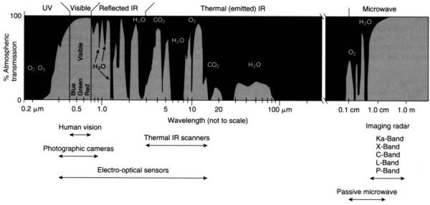
Aim of the Program
NATIONAL AEROSPACE PLAN: underlines the necessity to focus the research and development efforts in SAR and Hyperspectral Earth Observation Systems.
PRISMA
Cosmo-Terrasar
HyspIRI
COMMERCIAL
SHIRA
In the hyperspectral field, market researches have highlighted the lack of high-resolution and high number of bands sensors in the Thermal InfraRed (TIR) spectral range. SHIRA is born to fill this gap.

Slide 4
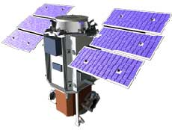
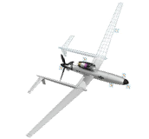
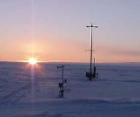
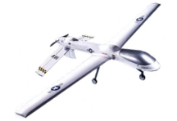
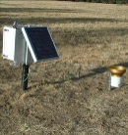
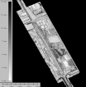
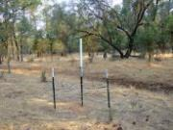
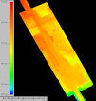
AIRBORNE DATA
SHIRA SPACE DATA
IN-SITU DATA
DATA FUSION CENTRE
LAND/SEA MONITORING
Volcanos
Fires
Earthquakes
Coal mines
Agriculture (water stress, evapotranspiration, growth trend)
Wastes
Archeology
HEALTH AND HAZARDS
Urban Heat Island
Industrial risks
Oil spill
Coastal inundations
Diseases
Asbestos-cement detection
Energy efficiency
CO2 monitoring
Albedo
SECURITY AND SURVEILLANCE
Border security
Object Detection and Recognition
Minefields and landmines detection
Industrial and power plant monitoring
Homeland Security
Long range surveillance

Slide 5
SHIRA Consortium
Hyperspectral Data Processing SW Design
Study of an innovative User Service
Real time communication module
Mission Programming Center
TIR Sensor Calibration Methods
Data Fusion Center
Innovative Applications for TIR data
Innovative Optical Sensors
HW Development for Hypersectral Sensor
Ground Segment and User Segment Electronic Interfaces
Verification and Validation
Communication Systems

Slide 6
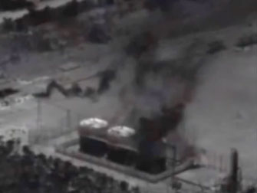
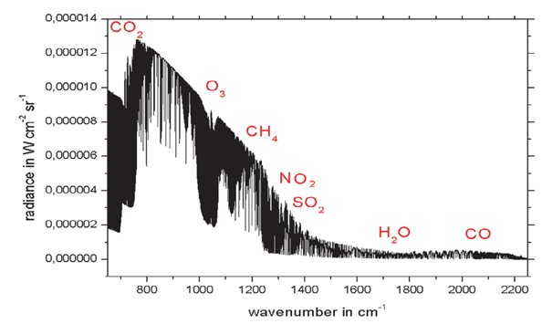
What SHIRA can do?
HEALTH AND HAZARDS: Gas Detection and Air Pollution
Power Plant
Atmosphere emission spectrum in the TIR range
By comparing the obtained spectrum with the nominal atmosphere emission spectrum, it’s possible to detect the presence of greenhouse or polluting gases produced by human activity and potentially hazardous to human health.

Slide 7
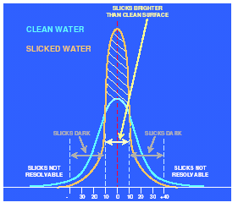
What SHIRA can do?
HEALTH AND HAZARDS: Marine Pollution (Oil Slick)
A Thermal InfraRed Hyperspectral Sensor is able to identify ocean areas polluted by oil as a result of accidental losses or criminal acts.
Different emissivity:
water 0.99;
oil 0.97.
Different temperature: because of the different thermal properties, the oil appears warmer during the day and cooler at night than water.
Surface Temperature of clean and slicked water

Slide 8
What SHIRA can do?
LAND/SEA MONITORING: Surface Energy Balance Modeling
Evapotranspiration: measures the amount of water that passes from the ground to the atmosphere (in the form of steam) due to the joint effect of vegetation transpiration and evaporation from the soil.
Balance Equation:
λET = R_{n} – G₀– H
λET , evapotranspiration latent heat flux;
R_{n} , net incident radiation;
G₀ , soil heat flux
H , soil/canopy to atmosphere heat flux.
Model of Surface Energy balance
Evapotranspiration is an index of the vegetation water stress; it lets you know the water requirements of the area and make irrigation interventions more efficient.

Slide 9
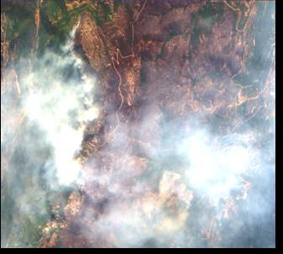
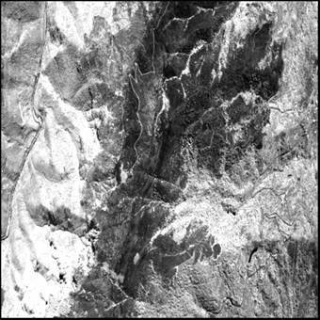
What SHIRA can do?
SECURITY AND SURVEILLANCE: High Temperature Events Monitoring
Fire detection:
Not disturbed by gas and fumes, the TIR image provides a more accurate indication of the position and the progress of the flame front.
VIS image
TIR image

Slide 10
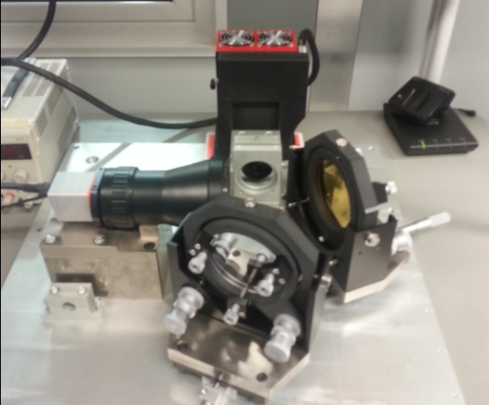
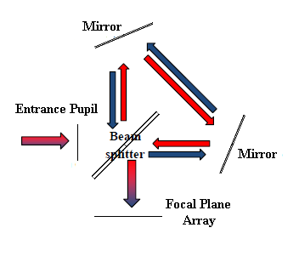
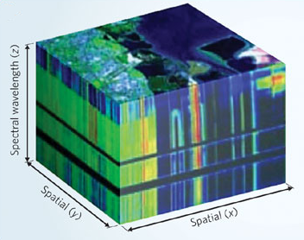
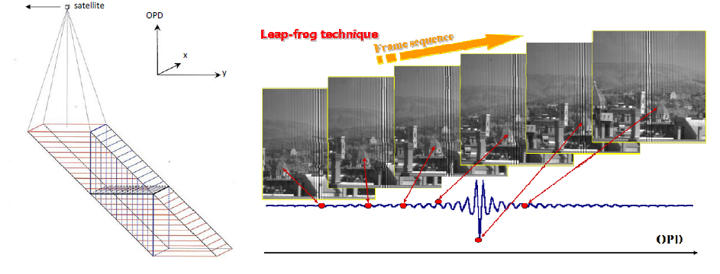
ELISIR – Payload for SHIRA
In the frame of the study for the SHIRA mission, SITAEL is responsible for the main payload development.
ELISIR
Enhanced Leap-frog Imaging Stationary interferometer in the InfraRed spectral Range
What is ELISIR ?
Hyperspectral Optical Sensor;
Interferometric Sensor (Sagnac Configuration);
Fourier Transform Spectrometer.

Slide 11
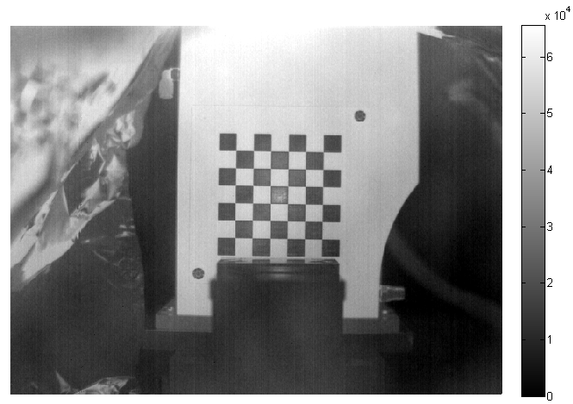
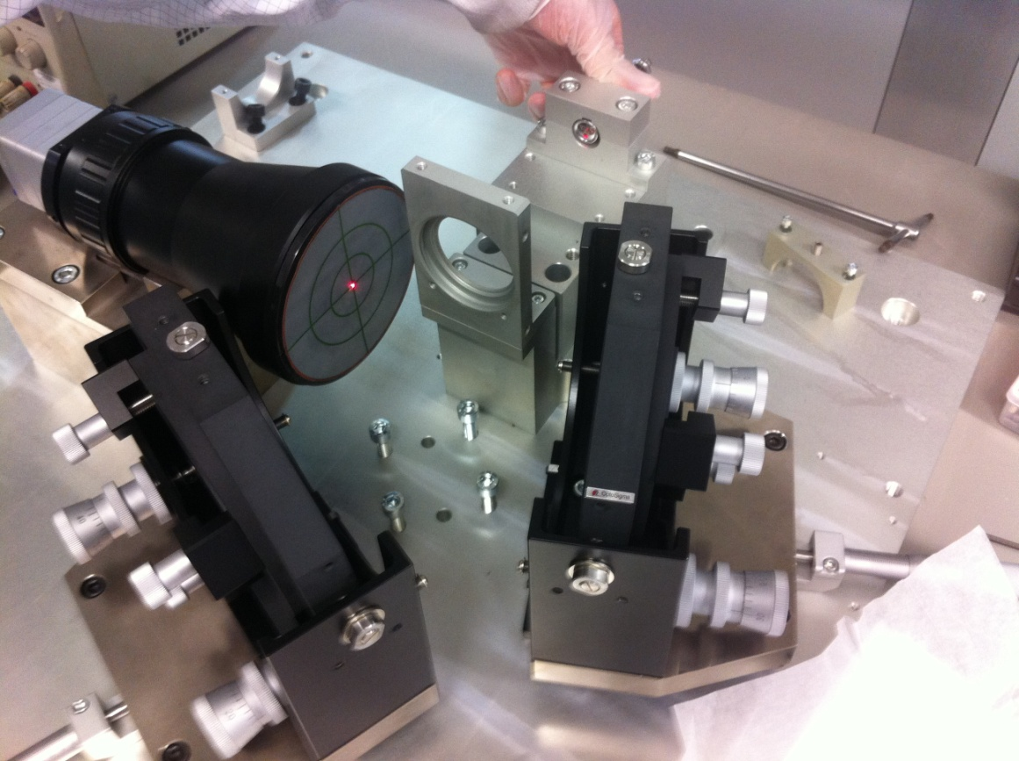
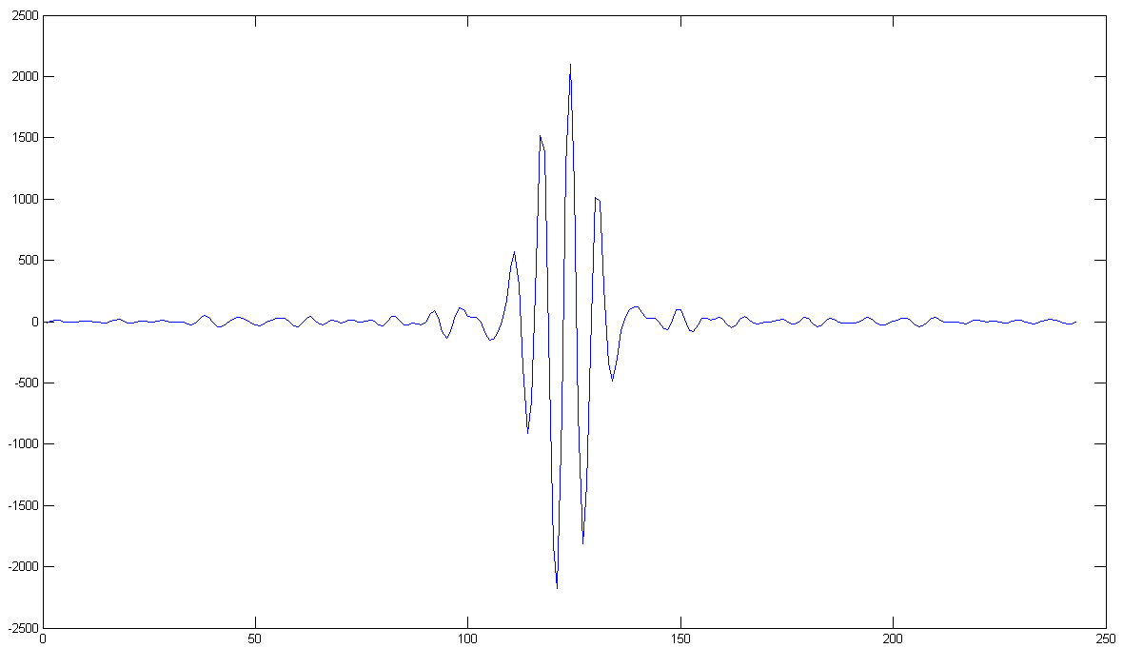
Laboratory Activities on ELISIR
Thermal Camera Characterization
Determination of the Focus Distance
Imaging Capabilities
Dark Signal
Radiometric Calibration
Sensitivity Measurement
Alignment of the Optical Elements
Mirrors
Thermal Camera
BeamSplitter
Interferometer Characterization and Calibration
Sensor Alignment
Sensor Characterization
Sensor Performances
Spectrum of Known Sources

Slide 12
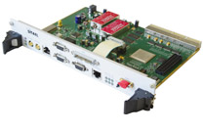
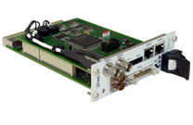
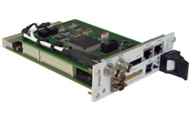
SHIRA – Payload Data Handling
POWER MODULE
CAN + LVDS + POWER + BUS
Image Sensor
Proximity
Electronics
Data Handling
Pre Processing & Compression
Processing & Controlling
Storage
TT&C
WS9107:
Form Factor CompactPCI 6U
FPGA Xilinx Virtex 6
FE 70MHz, SAW Filter 70MHz Band 2MHz
ADC 12bit, DAC 14bit
UART, CAN, CompactPCI, ETH
Data Transmitter
WS9155:
Form FactorCompactPCI 3U
FPGA Actel ProAsic
Kintex 7 K325
1GB Memoriy DDR2
SpaceWire, CAN, 1553, I2C
WS9154 :
Form Factor CompactPCI 3U
Leon2
SDRAM, RAM, FLASH, EEPROM
FPGA Actel ProAsic
SpaceWire, CAN, 1553, I2C, RS232
WS9133:
Form Factor CompactPCI 3U
FPGA Actel ProAsic
FLASH Memory, 64Gbit to 256Gbit
RS232, SpaceWire, USB
RF Interface
Antenna System

Slide 13
phone: +39 080 53 21 796
Fax: +39 080 53 55 048
e-mail: info.space@sitael.com
SITAEL S.p.A.
S. P. 231, KM. 1+300 - 70026 Modugno (BA)
Via Livornese 1019 - 56122 Pisa (PI)
ITALY
www.sitael.com

